Slide 1
Prospecting in 2030
Session 066
January 13th, 2023
Welcome – we’ll be starting soon.

Slide 2
Prospecting in 2030
Session 066
January 13th, 2023

Slide 3
Questions & Discussion

Slide 4
What’s 2030 Look Like?

Slide 5
What does the market think?
This ain’t 2030. These numbers were concluded between 2020 and 2022!
71% of B2B buyers begin their search using a search engine (Half w/ mobile device). 1
75% consult social media sites when making a purchase. 1
78% accepting of relying on VR to show how an enterprise’s end product would look. 2
Corporations believe that two-thirds of their customer engagement activities can be handled by smart machines. 3
1, Steel Croissant
2, Gartner
3, Worxwide

Slide 6
Death of a Salesperson (?? – 2030 AD)
 | SIMPLE ENVIRONMENT | COMPLEX ENVIRONMENT
SIMPLE PRODUCT / SERVICE
COMPLEX PRODUCT / SERVICE
* Cirrus Insight, What the job of a B2B Salesperson will look like in the year 2030, June 23, 2020.

Slide 7
Death of a Salesperson (?? – 2030 AD)
 | SIMPLE ENVIRONMENT | COMPLEX ENVIRONMENT
SIMPLE PRODUCT / SERVICE |  | -15%
COMPLEX PRODUCT / SERVICE
* Cirrus Insight, What the job of a B2B Salesperson will look like in the year 2030, June 23, 2020.

Slide 8
Death of a Salesperson (?? – 2030 AD)
 | SIMPLE ENVIRONMENT | COMPLEX ENVIRONMENT
SIMPLE PRODUCT / SERVICE |  | -15%
COMPLEX PRODUCT / SERVICE | -25%
* Cirrus Insight, What the job of a B2B Salesperson will look like in the year 2030, June 23, 2020.

Slide 9
Death of a Salesperson (?? – 2030 AD)
 | SIMPLE ENVIRONMENT | COMPLEX ENVIRONMENT
SIMPLE PRODUCT / SERVICE | -33% | -15%
COMPLEX PRODUCT / SERVICE | -25%
* Cirrus Insight, What the job of a B2B Salesperson will look like in the year 2030, June 23, 2020.

Slide 10
Death of a Salesperson (?? – 2030 AD)
 | SIMPLE ENVIRONMENT | COMPLEX ENVIRONMENT
SIMPLE PRODUCT / SERVICE | -33% | -15%
COMPLEX PRODUCT / SERVICE | -25% | +10%
* Cirrus Insight, What the job of a B2B Salesperson will look like in the year 2030, June 23, 2020.

Slide 11
Birth of a New Sales Professional!
 | COMPLEX ENVIRONMENT
COMPLEX PRODUCT / SERVICE | +10%

Slide 12
Birth of a New Sales Professional!

Slide 13
Prospecting in 2030
Four Opportunities to Succeed

Slide 14
1. End-Users will be overwhelmed by technology.

Slide 15
1. End-Users will be overwhelmed by technology.
Keep it simple.
Related to their scenario.
Become they’re subject matter expert and remove all burden from them.
Send content to keep them educated on a regular basis.
Start using video now.

Slide 16
2. Manufacturers will market more to end-users.

Slide 17
2. Manufacturers will market more to end-users.
Partnerships need to become more front-loaded.
RSM’s need to become an extension of their marketing.
Integration salespeople need to drive this level of activity.

Slide 18
3. They will not see you unless it’s easy, quick, and they think they need you.

Slide 19
3. They will not see you unless it’s easy, quick, and they think they need you.
DISCLAIMER ALERT
See idea #1 about helping them not feel so overwhelmed – get them to need you.
Offer remote, very brief, and indirect ways to “meet” with you.
Record short videos / presentations and send to them (90 seconds, 4 minutes, 15 minutes, etc.)

Slide 20
3. They will not see you unless it’s easy, quick, and they think they need you.
See idea #1 about helping them not feel so overwhelmed – get them to need you.
Offer remote, very brief, and indirect ways to “meet” with you.
Record short videos / presentations and send to them (90 seconds, 4 minutes, 15 minutes, etc.)

Slide 21
What’s the most important factor in prospecting?

Slide 22
What’s the most important factor in prospecting?
Persistent Branding
Smart Persistence
1995
Persistence

Slide 23
What’s the most important factor in prospecting?
Persistent Branding
Today
Smart Persistence
1995
Persistence

Slide 24
What’s the most important factor in prospecting?
2030
Persistent Branding
Today
Smart Persistence
1995
Persistence

Slide 25
What’s the most important factor in prospecting?
2030
Persistent Branding
Today
Smart Persistence
1995
Persistence

Slide 26
4. Persistence will still matter.

Slide 27
But it’s different

Slide 28
The eco-system must talk about your brand.

Slide 29
4. Persistence will still matter.
Become a strategic and consistent networker.
Consistently post educational material on social media.
Consistently use video to educate your eco-system.
Send letters in the mail.
And still … consistently knock on doors.

Slide 30
End-users will be overwhelmed.
Manufacturers will be a bigger part.
Quick and easy.
Persistent branding.

Slide 31
Poll Question

Slide 32
Which one thing below does NOT belong on the list of things excellent salespeople do?

Slide 33
Which one thing below does NOT belong on the list of things excellent salespeople do?
Debrief every sales call.
Be charismatic.
Proactively prospect for specific new accounts.
Prepare for every call.
Consistently work on professional skills.

Slide 34
Which one thing below doesn’t belong on the list of things excellent salespeople do?
Debrief every sales call.
Be charismatic.
Proactively prospect for specific new accounts.
Prepare for every call.
Consistently work on professional skills.

Slide 35
Action Plan

Slide 36
Action Plan

Slide 37
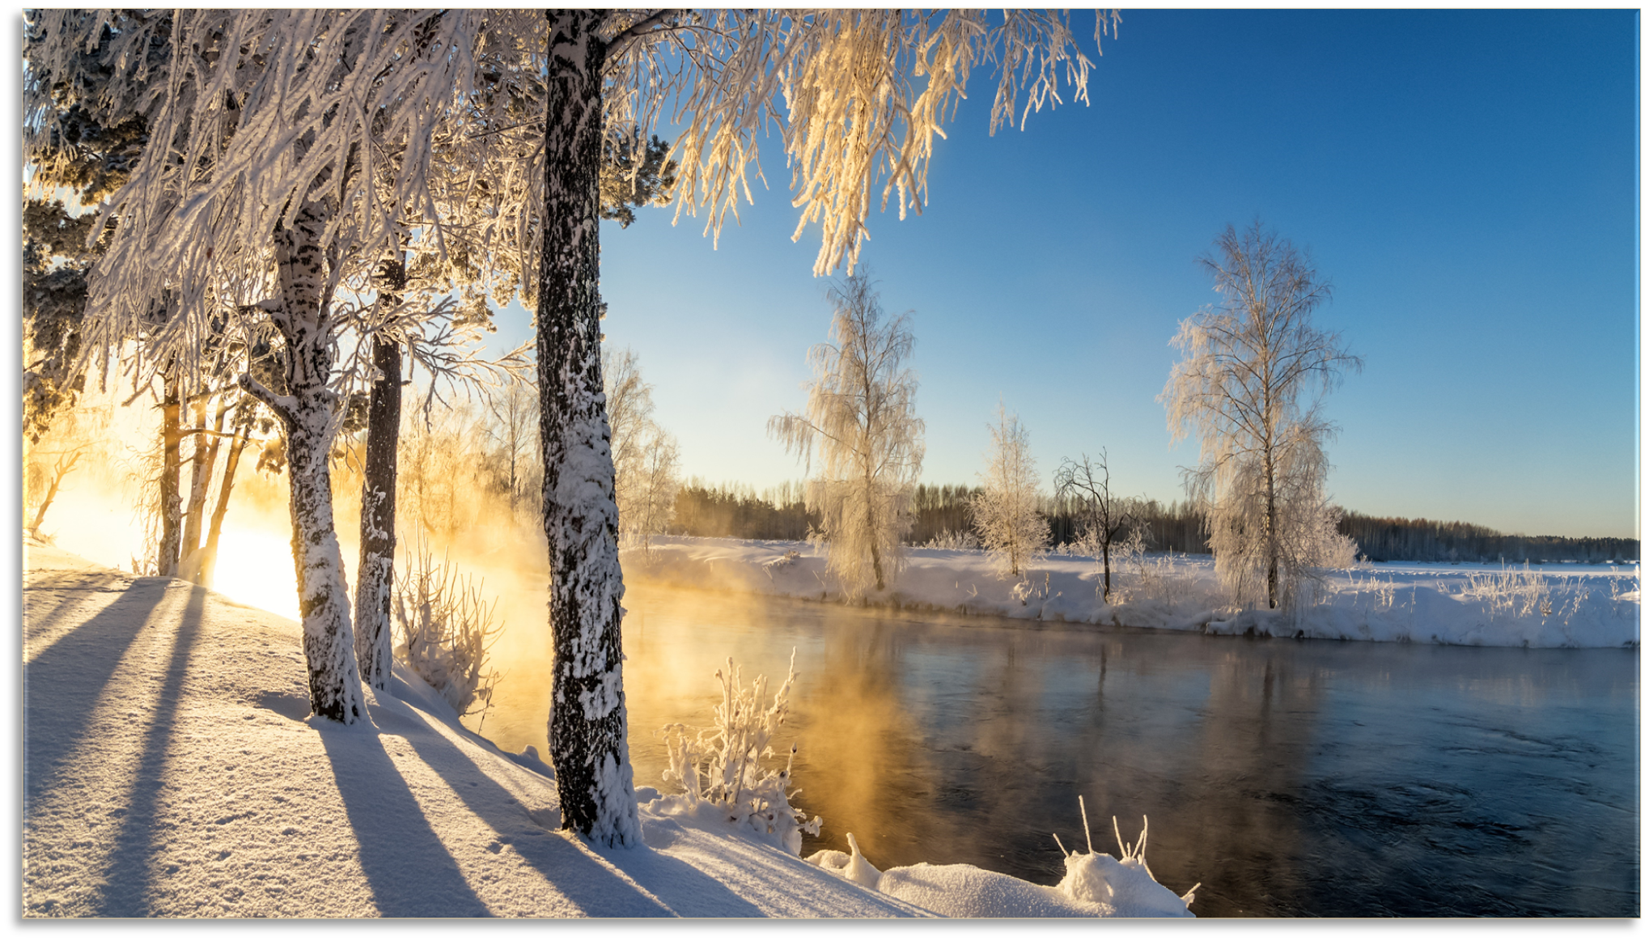
Networking in 2030
February’s Topic

Slide 40
Questions & Discussion

