Slide 1
Building Your Personal Brand
Session 063
October 14th, 2022
Welcome – we’ll be starting soon.

Slide 2

Building Your Personal Brand
Session 063
October 14th, 2022

Slide 3
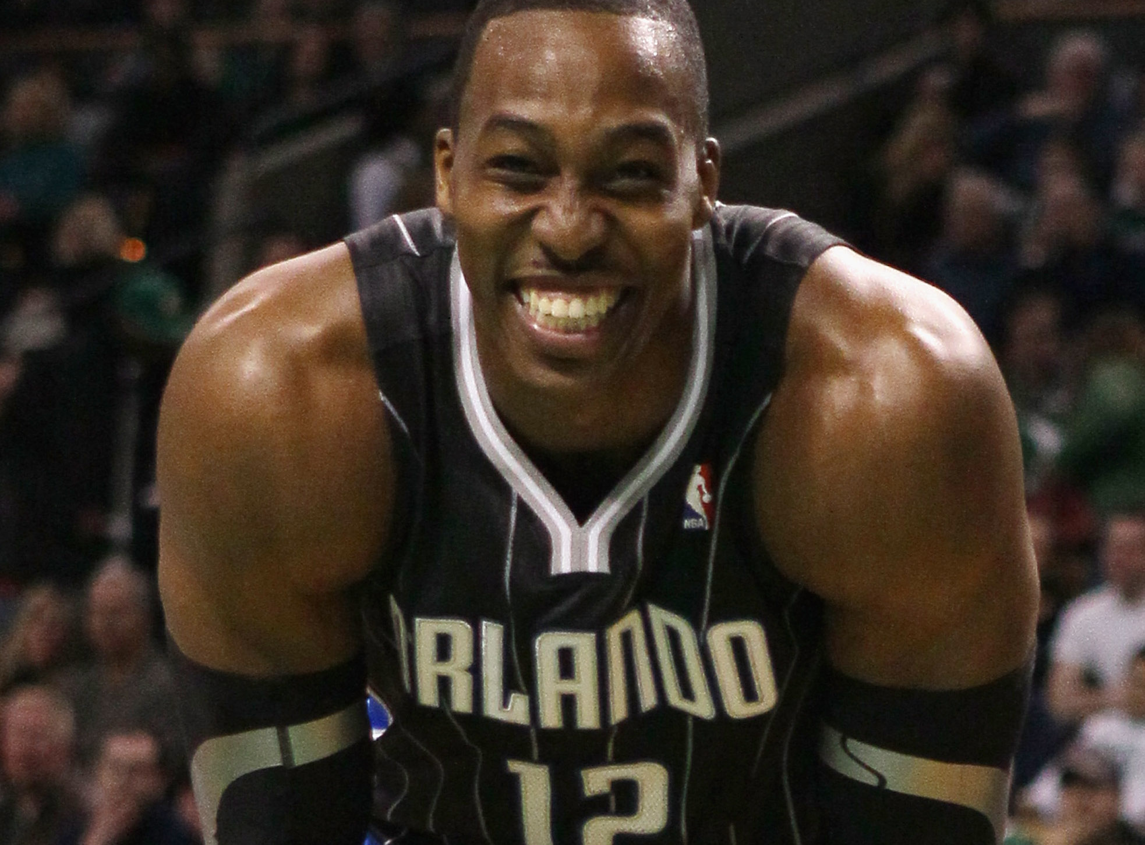

Slide 4
Definitions (credit to personalbrand.com)
Personal Brand
Personal Branding
A personal brand is a widely-recognized and largely-uniform perception or impression of an individual based on their experience, expertise, competencies, actions and/or achievements within a community, industry, or the marketplace at large.
The conscious and intentional effort to create and influence public perception of an individual by positioning them as an authority in their industry, elevating their credibility, and differentiating themselves from the competition, to ultimately advance their career, increase their circle of influence, and have a larger impact.

Slide 5
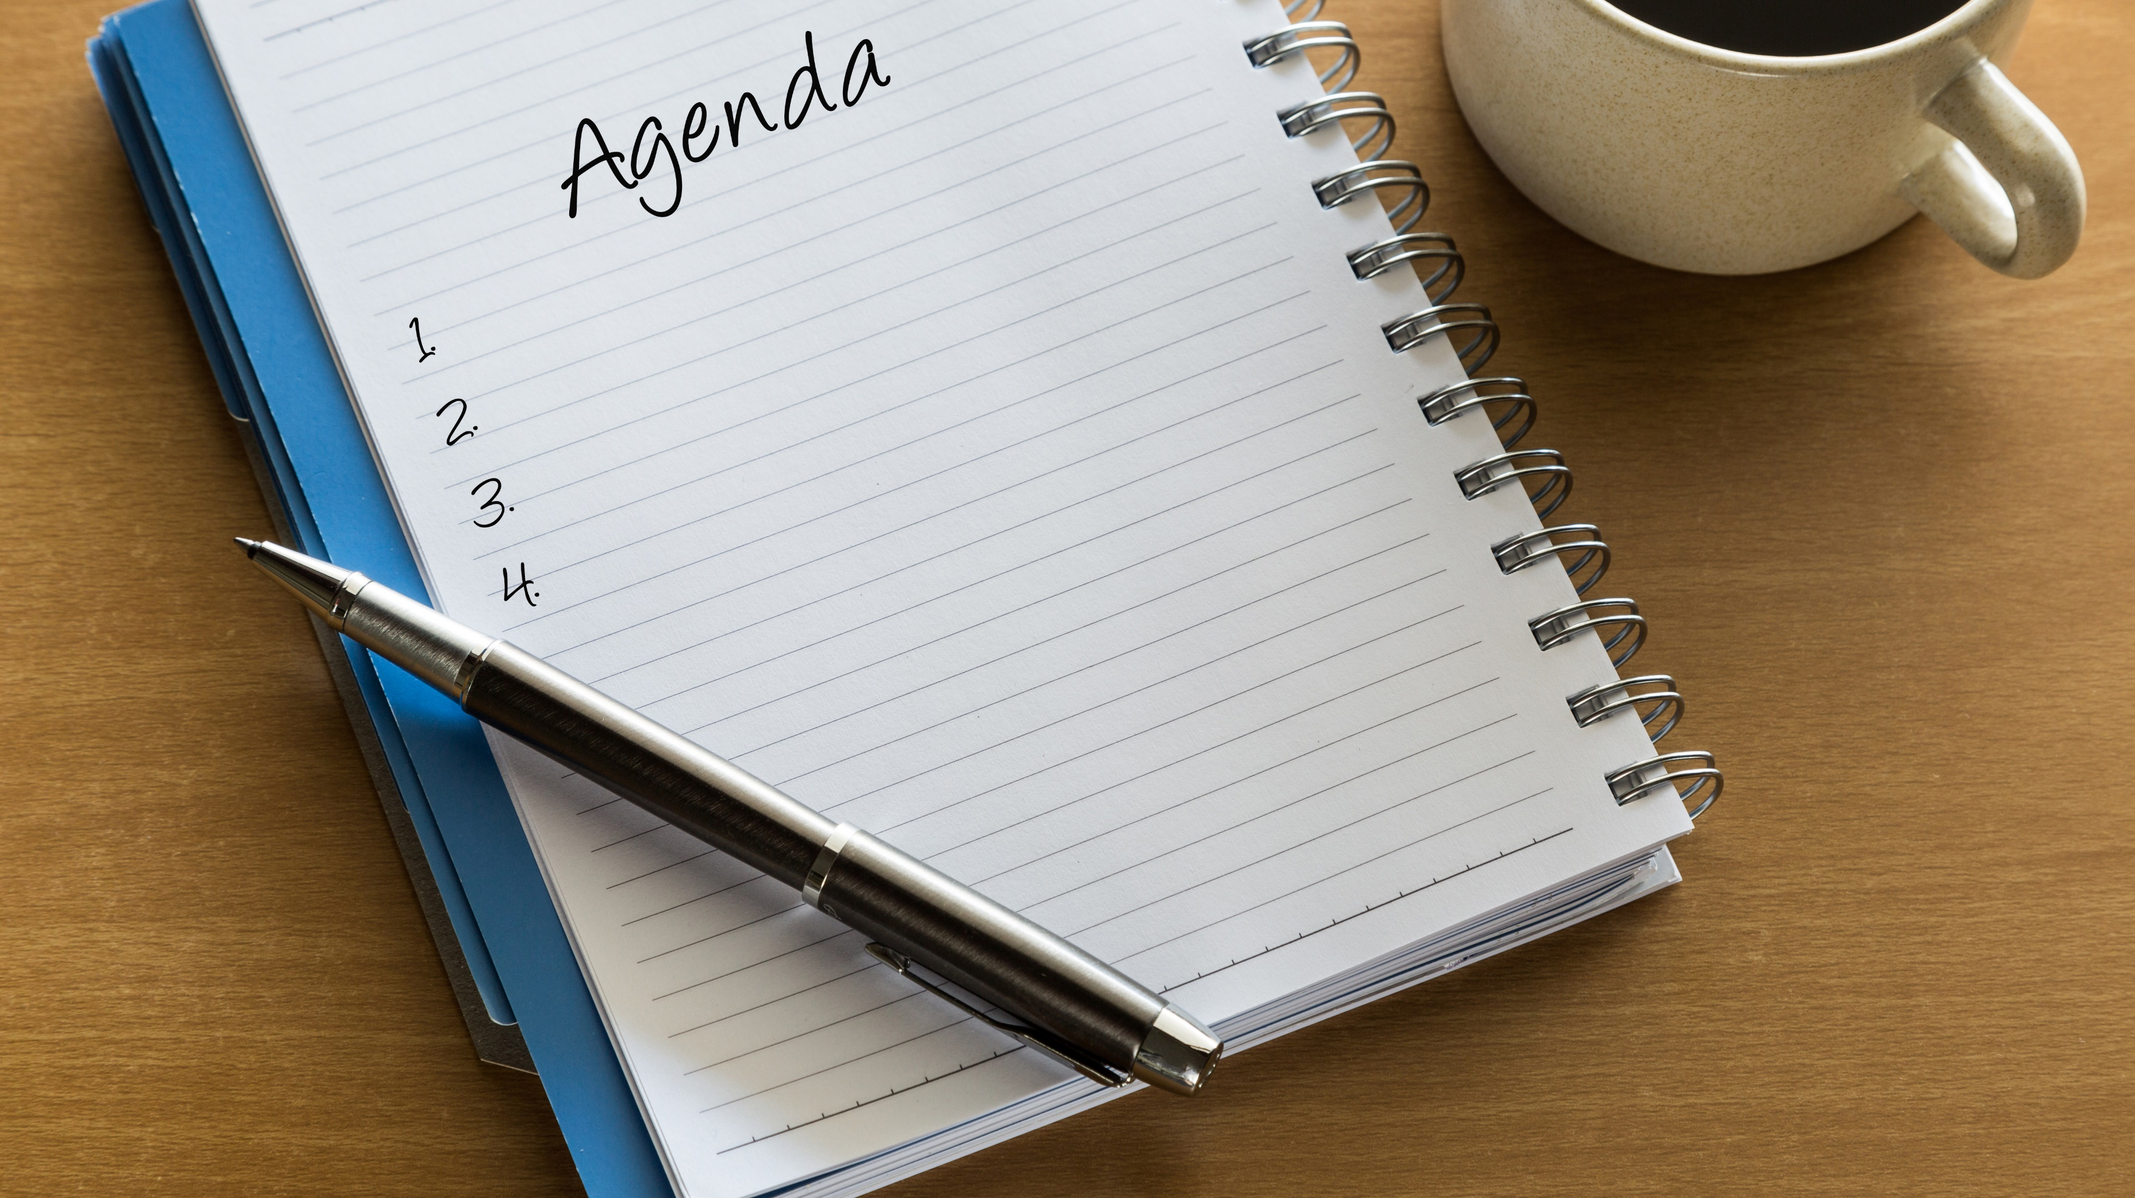
Your Personal Vision
Define Your Brand’s Audience
Define Your Brand
How to Create Your Brand

Slide 6
Your Personal Vision

Slide 7
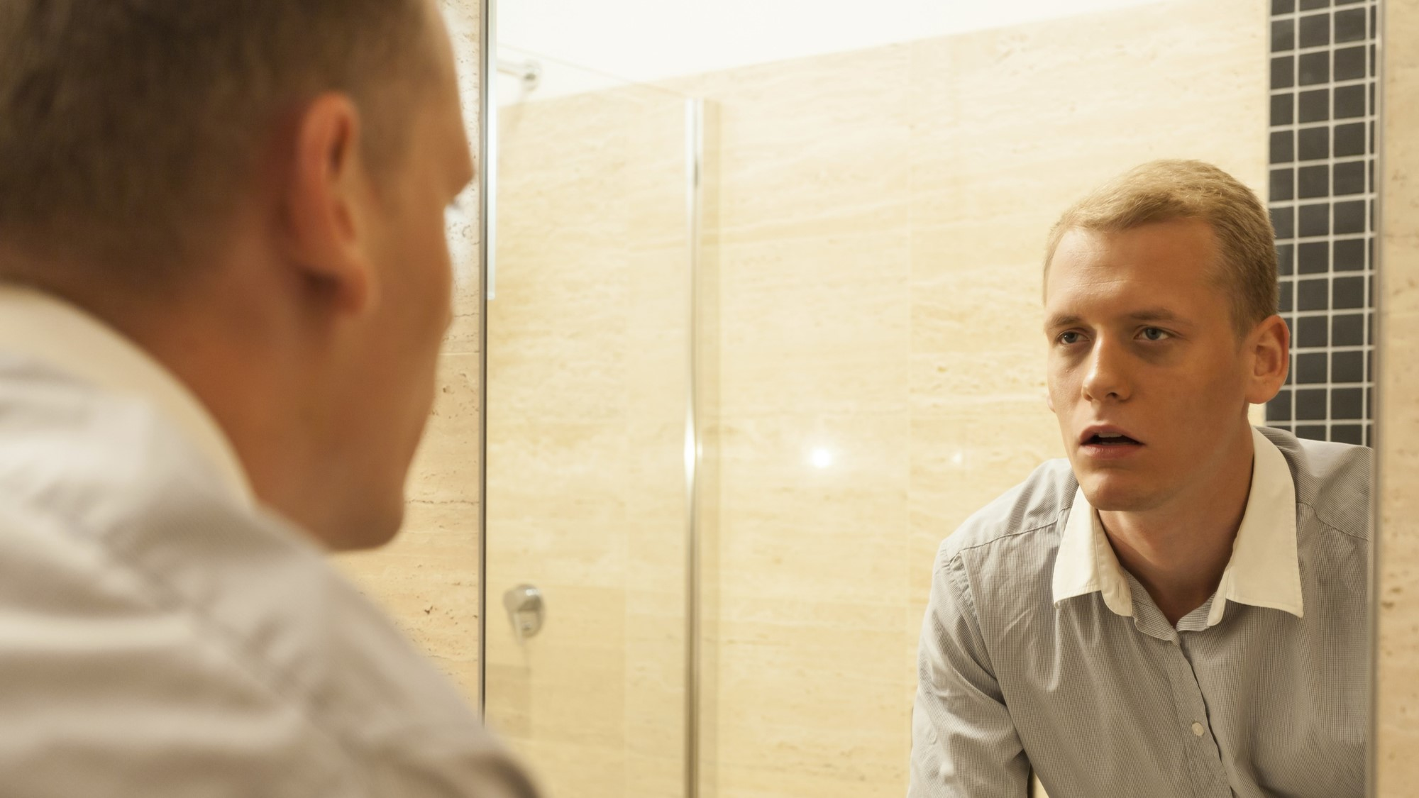
Who do you want to be?
Core Values / Vision / Mission.
The Eulogy.
Role Definitions.
Adversity Role Playing – “What Would You Do?”
Spouse / Child / Best Friend Truth Seram Test.

Slide 8
Non-Negotiable

Slide 9
Define Your Brand’s Audience

Slide 10


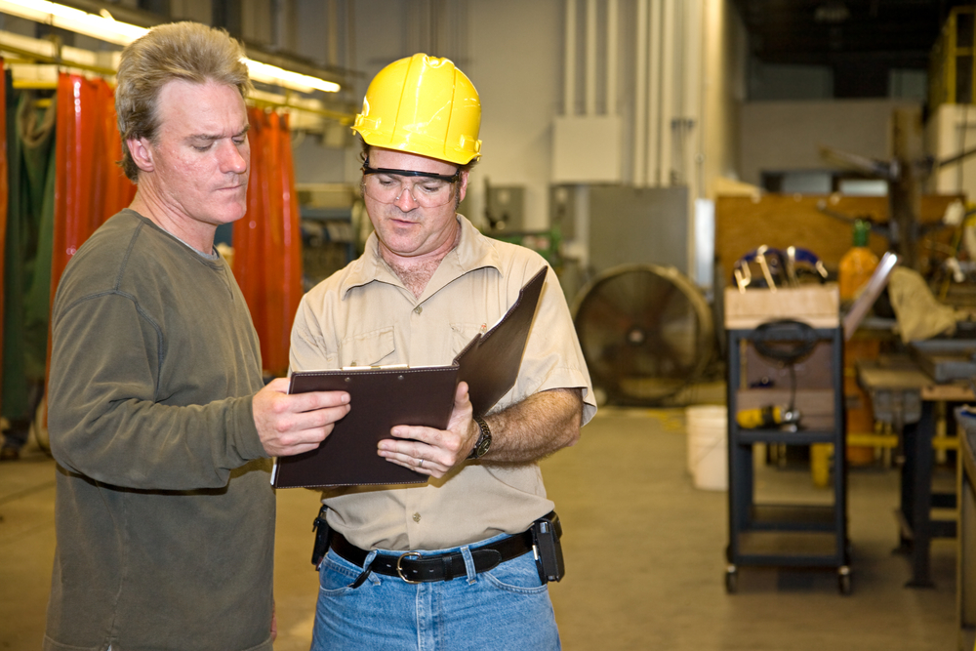

Who??
Markets
End-User Types
People and Roles
Industry Partners
Industry Leadership
Competition
Peers
Co-Workers

Slide 11
Personal Example

Slide 12

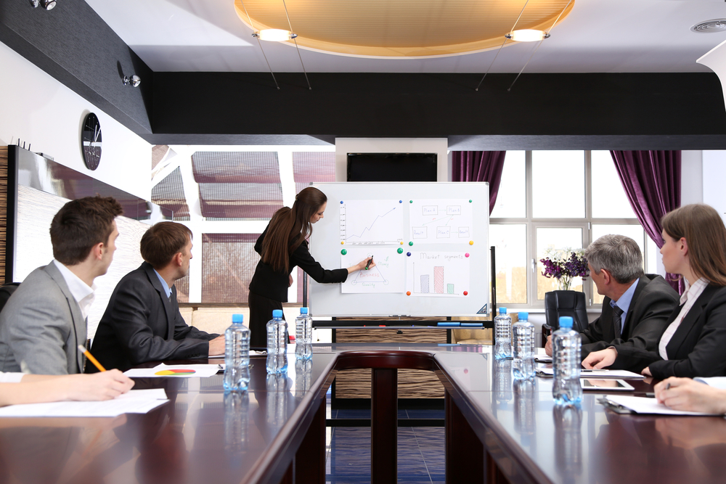
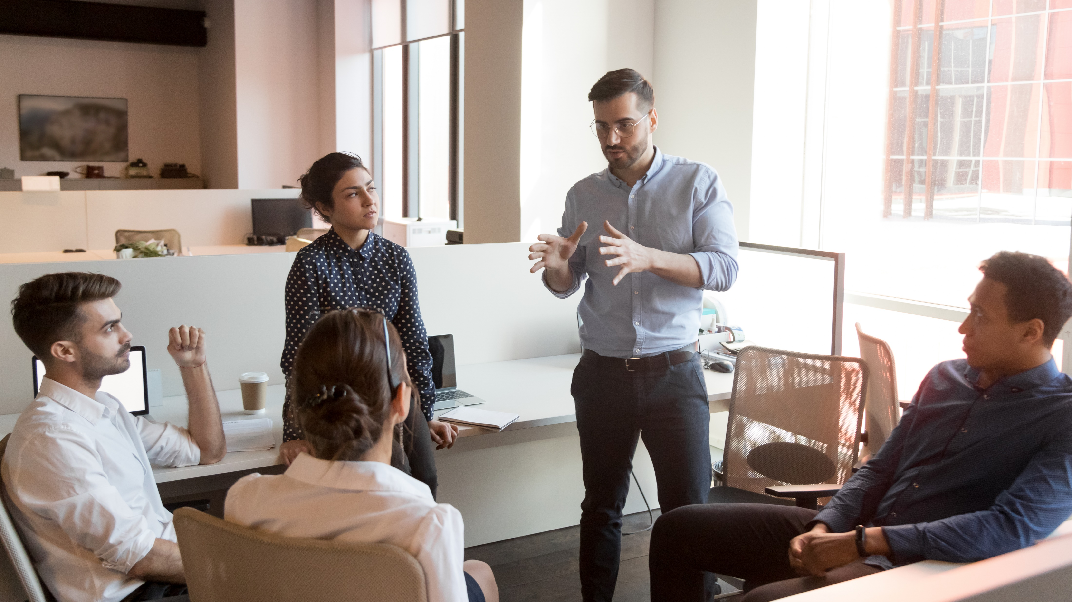

Slide 13
Define Your Brand

Slide 14

What do you want them to believe / say about you?
Apply the non-negotiable personal vision to the perspective of your audience.

Slide 15
Personal Example

Slide 16
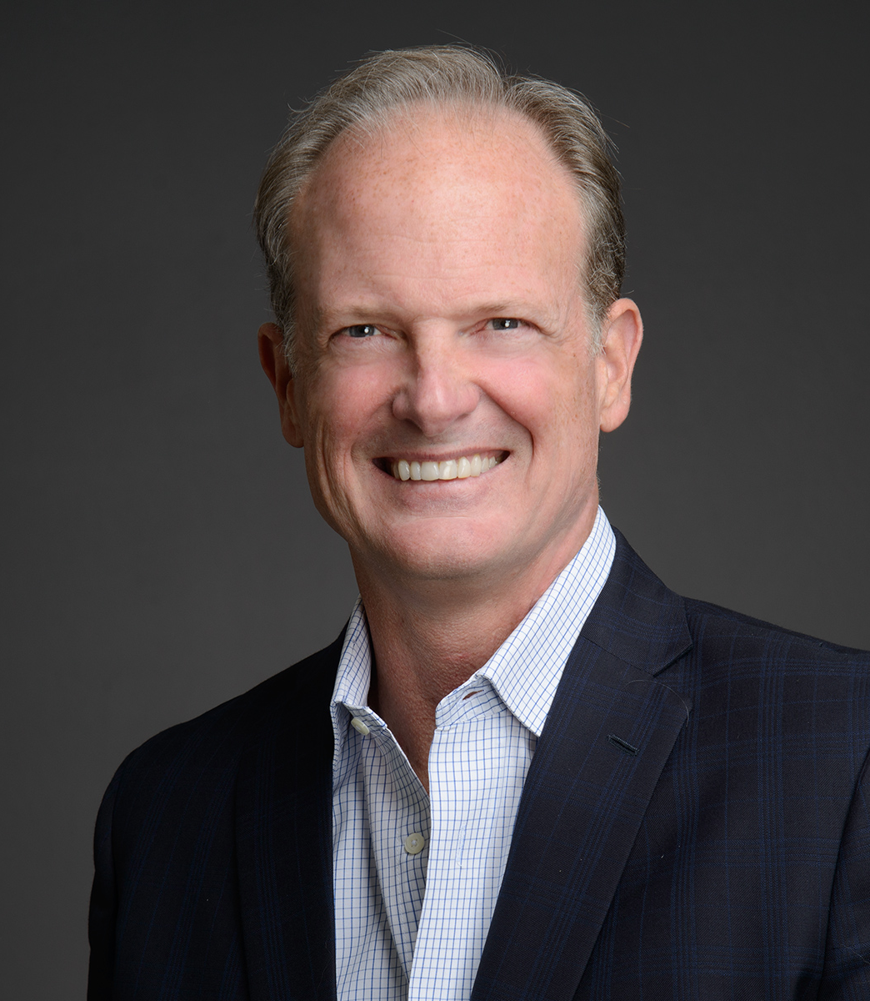
Personal Brand for Vector Firm’s Chris Peterson
Intelligent.
Innovative.
“Understands that we work in the real world.”
Not old.
Entertaining/motivating speaker.
Real.
“You’re the sales guru they were talking about.”

Slide 17
How to Create Your Brand

Slide 18

Three-Piece Toolbox
LinkedIn
Other Tools
Everyday Things That You Do

Slide 19
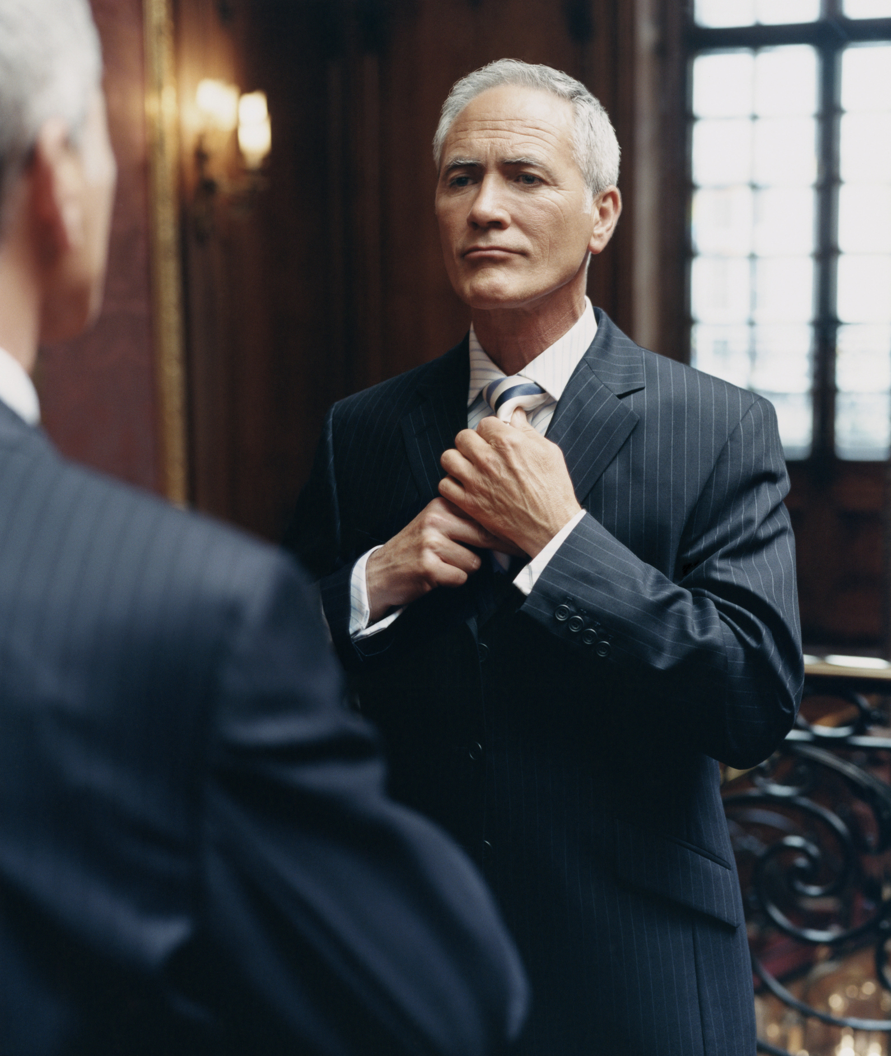
Everyday Things!
Dress to your brand.
Company that surrounds you.
Activities in which you choose to partake.
Manners / grammar / dumb things that engineers see.
Reactions.

Slide 20
Action Plan

Slide 21

Action Plan

Slide 22

Poll Question

Slide 23
Do you use email to confirm calls and appointments ahead of time?

Slide 24
Do you use email to confirm calls and appointments ahead of time?
Never.
Only for very important meetings.
About half and half.
Most of the time.
Always.

Slide 25

Getting into Large Opportunities Early
November’s Topic

Slide 26


Slide 27
Questions & Discussion

