Slide 1
Interpersonal Skills for Salespeople
Session 058
April 8th, 2022
Welcome – we’ll be starting soon.

Slide 2
Interpersonal Skills for Salespeople
Session 058
April 8th, 2022

Slide 3
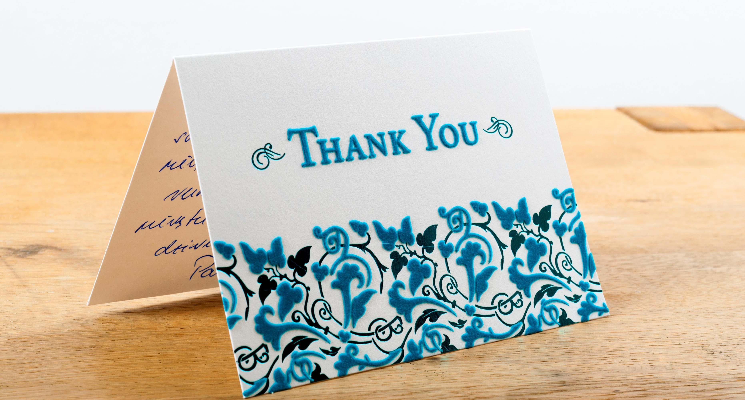

Slide 4
Here’s what happens…

Slide 5
Technology brings convenience, but quality suffers.

Slide 6
Technology brings convenience, but quality suffers.

Slide 7
We slowly accept poor quality as normal.

Slide 8
New generations assume it’s always been like this.

Slide 9
Poll Question

Slide 10
How many hours a day does the average Generation Z person (born 1997 – 2012) spend online?

Slide 11
How many hours a day does the average Generation Z person spend online?
One to two.
Two to four.
Five.
Ten.
More than ten.

Slide 12
How many hours a day does the average Generation Z person spend online?
One to two.
Two to four.
Five.
Ten.
More than ten.

Slide 13
Interpersonal Decline
LinkedIn: Gen Z’s spend an average of 10 hours per day online, with 100% smart phone adoption.
LinkedIn and Randstad: Over half of Gen Z workers used technology to resolve conflict over phone or in-person conversations.
Gen Z Goes to Work: A top priority of Gen Z’s is to learn how to communicate in person rather than with technology. (Let’s think about this one for a second.)

Slide 14
Interpersonal Decline
LinkedIn: Gen Z’s spend an average of 10 hours per day online, with 100% smart phone adoption.
LinkedIn and Randstad: Over half of Gen Z workers used technology to resolve conflict over phone or in-person conversations.
Gen Z Goes to Work: A top priority of Gen Z’s is to learn how to communicate in person rather than with technology. (Let’s think about this one for a second.)

Slide 15
The Result in the Near Future?
Sales presentations will be awful PowerPoint nightmares – worse than today.
Attention spans will be practically non-existent.
Salespeople will be reacting 100% of the time, trying to be the fastest to deliver average responses.
Creativity and proactivity will not exist.
The breakdown of salespeople with similar titles: nineteen customer support responders to one superstar sales professional. Nothing in between.
Incomes will drop relative to other careers (except that one in twenty).

Slide 16
The result for interpersonal skills in near future?

Slide 17
Forgive my corniness, but this is a huge opportunity for you.

Slide 18
Forgive my corniness, but this is a huge opportunity for you.

Slide 19
Goal for Today
Interpersonal skills have gotten so bad (and will continue to decline for years) that you can stand out as a superstar by doing a few very simple things.

Slide 20
Goal for Today
Interpersonal skills have gotten so bad (and will continue to decline for years) that you can stand out as a superstar by doing a few very simple things.

Slide 21
Seven Ideas to Better Interpersonal Skills

Slide 22
Become a pretty good public speaker.
Join Toastmasters.
Speak at every opportunity possible – internal meetings, associations, trade shows, weddings, etc.
Record and watch yourself.
Practice your opening three times as much as you practice the rest.
Be yourself.

Slide 23
Become a masterful writer
Dying
Dying
Peaked

Slide 24
Become a masterful writer
Limited
Dying
Peaked

Slide 25
Become a masterful writer
Limited
Dying
Peaked

Slide 26
Become a masterful writer
Limited
Dying
Peaked

Slide 27
Become a masterful writer
Executive Summaries
Emails
Letters
Social Media Posts
Text Messages
Summaries of Videos / Podcasts / Etc.

Slide 28
Mindfully Listen
Salespeople will become more reactive than they are today – always thinking about what they should be doing.
Watch Session 011, June 2018: Bionic Listening.
Ask follow-up questions of your customers.
That last bullet is all you need to do, btw … just ask follow-up questions.

Slide 29
Manage Confrontation Like a Pro

Slide 32
Manage Confrontation Like a Pro
Face it head-on. Not with a text or email. In person or on the phone.
“I don’t know what the solution is, but you and I will figure it out.”
Own your part … and a little more.
If they’re unreasonable, sleep well and let it go.

Slide 33
Bring the Lectern to Virtual Calls
Treat these calls like they were in-person.
If it’s a presentation, then stand up.
Use proper lighting.
Use multiple screens and webcams.
Keep these calls to 30 minutes.

Slide 34
Own the Sales Call
Send agenda to everyone ahead of time.
Connect with all attendees on LinkedIn.
Confirm action items at the end of the meeting.
Email a summary to everyone.
Send special individual notes.

Slide 35
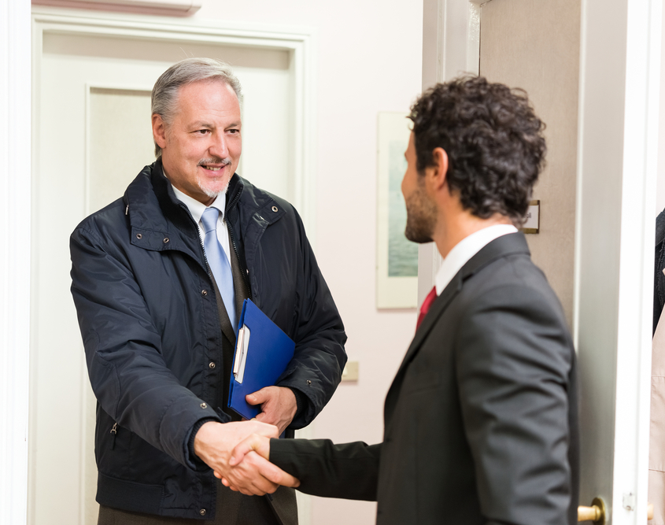
Remember Names
Find a technique that works for you and become great at it.
When in a group, write down names in the shape of the room.

Slide 36
And finally …

Slide 37
Action Plan

Slide 38
Lesson Plan
June’s Session: Selling into Vertical Markets

Slide 39
Questions & Discussion

