Slide 1


Winning New Business
Specifically Tailored for:
Session #13: Secrets to Selling Service Agreements
October 18th, 2016

Slide 2

Assumptions
You don’t have control over your plan.
You have unique value included – not just parts and labor.
90 day labor guarantee following an install.

Slide 3
Approach

Slide 4
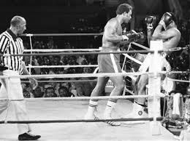
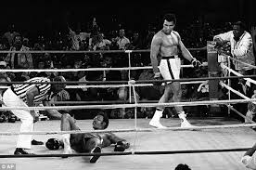
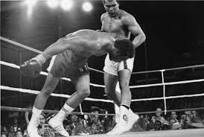
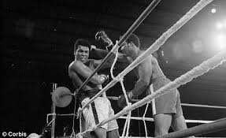
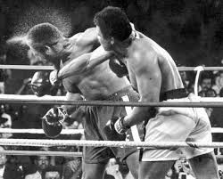
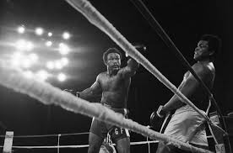

Slide 5
POLL

Slide 6
Oh yeah, here is our service agreement. For this fee, you’ll have peace of mind.
What is this guy thinking? Why would I pay this?

Slide 7

Approach to Selling Services Agreements
Understand the Benefits *
Teach
Look for Clues

Slide 8
Approach to Selling Services Agreements
Land an unexpected combination
Stay fresh while Foreman tires
Look for fatigue and mental frustration

Slide 10


Slide 11
Approach to Selling Services Agreements
Understand the Benefits *
Teach
Look for Clues

Slide 12
POLL

Slide 13
Understand all the Benefits

Slide 14

Service Agreement Benefits
Predictable and budgeted expense
Guaranteed emergency response
First priority in the queue
Hassle-free
Peak Performance of equipment
Lower Total Cost of Ownership (TCO)

Slide 15
What’s the #1 mistake made in selling service agreements?

Slide 16
…Selling it like an insurance policy.

Slide 17
Service Agreement Benefits
Predictable and budgeted expense
Guaranteed emergency response
First priority in the queue
Hassle-free
Peak Performance of equipment
Lower Total Cost of Ownership (TCO)

Slide 18
… and by the way…

Slide 19
Service Agreement Benefits
Predictable and budgeted expense
Guaranteed emergency response
First priority in the queue
Hassle-free
Peak Performance of equipment
Lower Total Cost of Ownership (TCO)
Peace of mind

Slide 20
Service Agreement Benefits
Predictable and budgeted expense
Guaranteed emergency response
First priority in the queue
Hassle-free
Peak Performance of equipment
Lower Total Cost of Ownership (TCO)
Peace of mind

Slide 21
Teach

Slide 22


Slide 23

How to Teach
Illustrate examples for each benefit to gain practical relevance.

Slide 24
Predictable Expense
Able to keep finance off the backs of my client because we eliminated surprises.
Guaranteed Emergency Response
First Priority in Queue
For non-emergencies, it’s still nice to know that you’ll be at the top of the queue.
Peace of Mind
Hassle Free
Peak Performance
Lower TCO
When a critical system fails or a major event is scheduled, this benefit has been a savior.
No more having to deal with your internal process – just call us and we fix it.
Since we provide proactive and preventive services, your investment will be optimized and will perform at the peak level throughout its life cycle.
When all the unpredictable costs are eliminated and your downtime is minimized, the reduction in costs become dramatic.
Even for those risky souls out there, the peace of mind that comes with this plan is always a welcome benefit.

Slide 25
Predictable Expense
Able to keep finance off the backs of my client because we eliminated surprises.
Guaranteed Emergency Response
First Priority in Queue
For non-emergencies, it’s still nice to know that you’ll be at the top of the queue.
Peace of Mind
Hassle Free
Peak Performance
Lower TCO
When a critical system fails or a major event is scheduled, this benefit has been a savior.
No more having to deal with your internal process – just call us and we fix it.
Since we provide proactive and preventive services, your investment will be optimized and will perform at the peak level throughout its life cycle.
When all the unpredictable costs are eliminated and your downtime is minimized, the reduction in costs become dramatic.
Even for those risky souls out there, the peace of mind that comes with this plan is always a welcome benefit.

Slide 26
Predictable Expense
Able to keep finance off the backs of my client because we eliminated surprises.
Guaranteed Emergency Response
First Priority in Queue
For non-emergencies, it’s still nice to know that you’ll be at the top of the queue.
Peace of Mind
Hassle Free
Peak Performance
Lower TCO
When a critical system fails or a major event is scheduled, this benefit has been a savior.
No more having to deal with your internal process – just call us and we fix it.
Since we provide proactive and preventive services, your investment will be optimized and will perform at the peak level throughout its life cycle.
When all the unpredictable costs are eliminated and your downtime is minimized, the reduction in costs become dramatic.
Even for those risky souls out there, the peace of mind that comes with this plan is always a welcome benefit.

Slide 27
Predictable Expense
Able to keep finance off the backs of my client because we eliminated surprises.
Guaranteed Emergency Response
First Priority in Queue
For non-emergencies, it’s still nice to know that you’ll be at the top of the queue.
Peace of Mind
Hassle Free
Peak Performance
Lower TCO
When a critical system fails or a major event is scheduled, this benefit has been a savior.
No more having to deal with your internal process – just call us and we fix it.
Since we provide proactive and preventive services, your investment will be optimized and will perform at the peak level throughout its life cycle.
When all the unpredictable costs are eliminated and your downtime is minimized, the reduction in costs become dramatic.
Even for those risky souls out there, the peace of mind that comes with this plan is always a welcome benefit.

Slide 28
Predictable Expense
Able to keep finance off the backs of my client because we eliminated surprises.
Guaranteed Emergency Response
First Priority in Queue
For non-emergencies, it’s still nice to know that you’ll be at the top of the queue.
Peace of Mind
Hassle Free
Peak Performance
Lower TCO
When a critical system fails or a major event is scheduled, this benefit has been a savior.
No more having to deal with your internal process – just call us and we fix it.
Since we provide proactive and preventive services, your investment will be optimized and will perform at the peak level throughout its life cycle.
When all the unpredictable costs are eliminated and your downtime is minimized, the reduction in costs become dramatic.
Even for those risky souls out there, the peace of mind that comes with this plan is always a welcome benefit.

Slide 29
Predictable Expense
Able to keep finance off the backs of my client because we eliminated surprises.
Guaranteed Emergency Response
First Priority in Queue
For non-emergencies, it’s still nice to know that you’ll be at the top of the queue.
Peace of Mind
Hassle Free
Peak Performance
Lower TCO
When a critical system fails or a major event is scheduled, this benefit has been a savior.
No more having to deal with your internal process – just call us and we fix it.
Since we provide proactive and preventive services, your investment will be optimized and will perform at the peak level throughout its life cycle.
When all the unpredictable costs are eliminated and your downtime is minimized, the reduction in costs become dramatic.
Even for those risky souls out there, the peace of mind that comes with this plan is always a welcome benefit.

Slide 30
Predictable Expense
Able to keep finance off the backs of my client because we eliminated surprises.
Guaranteed Emergency Response
First Priority in Queue
For non-emergencies, it’s still nice to know that you’ll be at the top of the queue.
Peace of Mind
Hassle Free
Peak Performance
Lower TCO
When a critical system fails or a major event is scheduled, this benefit has been a savior.
No more having to deal with your internal process – just call us and we fix it.
Since we provide proactive and preventive services, your investment will be optimized and will perform at the peak level throughout its life cycle.
When all the unpredictable costs are eliminated and your downtime is minimized, the reduction in costs become dramatic.
Even for those risky souls out there, the peace of mind that comes with this plan is always a welcome benefit.

Slide 31
Predictable Expense
Able to keep finance off the backs of my client because we eliminated surprises.
Guaranteed Emergency Response
First Priority in Queue
For non-emergencies, it’s still nice to know that you’ll be at the top of the queue.
Peace of Mind
Hassle Free
Peak Performance
Lower TCO
When a critical system fails or a major event is scheduled, this benefit has been a savior.
No more having to deal with your internal process – just call us and we fix it.
Since we provide proactive and preventive services, your investment will be optimized and will perform at the peak level throughout its life cycle.
When all the unpredictable costs are eliminated and your downtime is minimized, the reduction in costs become dramatic.
Even for those risky souls out there, the peace of mind that comes with this plan is always a welcome benefit.

Slide 32
Predictable Expense
Able to keep finance off the backs of my client because we eliminated surprises.
Guaranteed Emergency Response
First Priority in Queue
For non-emergencies, it’s still nice to know that you’ll be at the top of the queue.
Peace of Mind
Hassle Free
Peak Performance
Lower TCO
When a critical system fails or a major event is scheduled, this benefit has been a savior.
No more having to deal with your internal process – just call us and we fix it.
Since we provide proactive and preventive services, your investment will be optimized and will perform at the peak level throughout its life cycle.
When all the unpredictable costs are eliminated and your downtime is minimized, the reduction in costs become dramatic.
Even for those risky souls out there, the peace of mind that comes with this plan is always a welcome benefit.

Slide 33
How to Teach
Illustrate examples for each benefit to gain practical relevance.
Highlight service agreement in every sales call – the earlier the better.
Visit Top 20 current clients to teach them about your “new” service plan.

Slide 34
Aniticipate Clues

Slide 35
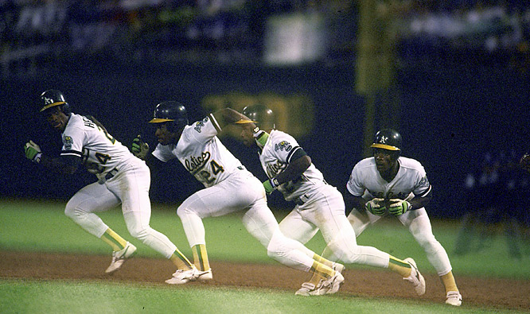

Slide 36
Predictable Expense
High service invoice, complaints about finance, mention “OpEx”
Guaranteed Emergency Response
First Priority in Queue
Impatient, client is member of “clubs”, asks about response time
Peace of Mind
Hassle Free
Peak Performance
Lower TCO
ROI comments of system, compliance requirements, disruption of ops
Complaints about internal process, system been down a while
Complaints about not having updated system, personal purchases on newest things.
Mentions ROI or TCO, finance involved, outsourcing common
Uses this term, has service contracts on personal items, anxious mindset

Slide 37
Predictable Expense
High service invoice, complaints about finance, mention “OpEx”
Guaranteed Emergency Response
First Priority in Queue
Impatient, client is member of “clubs”, asks about response time
Peace of Mind
Hassle Free
Peak Performance
Lower TCO
ROI comments of system, compliance requirements, disruption of ops
Complaints about internal process, system been down a while
Complaints about not having updated system, personal purchases on newest things.
Mentions ROI or TCO, finance involved, outsourcing common
Uses this term, has service contracts on personal items, anxious mindset

Slide 40
What’s the easiest way to find these clues?

Slide 41

Perform weekly service audits

Slide 42
A Few More Ideas

Slide 43

A Few More Ideas
Add to every proposal possible.

Slide 44
Do you want to increase your service agreement sales by 20% - 33% by just doing practically nothing?

Slide 45
Add your service agreement to every proposal

Slide 46
A Few More Ideas
Add to every proposal possible.
Don’t think they’ll say “yes” in a year from now.
Be able to answer this question in your sleep:

Slide 47
A Few More Ideas
Add to every proposal possible.
Don’t think they’ll say “yes” in a year from now.
Be able to answer this question in your sleep:
“Why should I do this now? All the equipment is under warranty for a while.”

Slide 48

Action Plan
Know and master your benefits.
Live in the world of clues.
Never send another proposal without a service agreement.
Never, ever sell your service agreement like an insurance policy again.
One more survey – Specific Topics for Year #2
Schedule a Vision Meeting
Begin a Service Audit Process
Present the “New” Maintenance Benefits
Exercise in LinkedIn Group
Build your Contact Strategy for 5 accounts
Build your Top 3 Contacts

Slide 49
Action Plan
Know and master your benefits.
Live in the world of clues.
Never send another proposal without a service agreement.
Never, ever sell your service agreement like an insurance policy again.
One more survey – Specific Topics for Year #2
Schedule a Vision Meeting
Begin a Service Audit Process
Present the “New” Maintenance Benefits
Exercise in LinkedIn Group
Build your Contact Strategy for 5 accounts
Build your Top 3 Contacts

Slide 50
Action Plan
Know and master your benefits.
Live in the world of clues.
Never send another proposal without a service agreement.
Never, ever sell your service agreement like an insurance policy again.
One more survey – Specific Topics for Year #2
Schedule a Vision Meeting
Begin a Service Audit Process
Present the “New” Maintenance Benefits
Exercise in LinkedIn Group
Build your Contact Strategy for 5 accounts
Build your Top 3 Contacts

Slide 51
Action Plan
Know and master your benefits.
Live in the world of clues.
Never send another proposal without a service agreement.
Never, ever sell your service agreement like an insurance policy again.
One more survey – Specific Topics for Year #2
Schedule a Vision Meeting
Begin a Service Audit Process
Present the “New” Maintenance Benefits
Exercise in LinkedIn Group
Build your Contact Strategy for 5 accounts
Build your Top 3 Contacts

Slide 52

Passing the Baton to Sales Leaders
Create an accountability process to ensure these are being quoted.
Discuss and listen – why are more of these not being sold?
Role Playing Exercise:
Until everyone can answer this in their sleep: “Why should I buy this now?”
Schedule a Vision Meeting
Begin a Service Audit Process
Present the “New” Maintenance Benefits
Exercise in LinkedIn Group
Build your Contact Strategy for 5 accounts
Build your Top 3 Contacts

Slide 53

Questions / Discussion
Chris Peterson cpeterson@vectorfirm.com
321-439-3025

