Slide 1
Session #16: How to Sell Hosted & Managed Services to IT

Slide 2
Who?

Slide 3
IT Department, IT Manager, IT Guy, IT Provider, CIO, CTO, Etc.

Slide 4
IT Department, IT Manager, IT Guy, IT Provider, CIO, CTO, Etc.

Slide 5
IT Department, IT Manager, IT Guy, IT Provider, CIO, CTO, Etc.

Slide 6
IT Department, IT Manager, IT Guy, IT Provider, CIO, CTO, Etc.

Slide 7
IT Department, IT Manager, IT Guy, IT Provider, CIO, CTO, Etc.

Slide 8
IT Department, IT Manager, IT Guy, IT Provider, CIO, CTO, Etc.

Slide 9
IT Department, IT Manager, IT Guy, IT Provider, CIO, CTO, Etc.

Slide 10
Poll

Slide 11
Which type of IT role do you work with the most frequently?

Slide 12
Who? Really … Who?

Slide 13


Slide 14


Slide 15
Characteristics | Descriptors
Background Job? Career Path? Family? | College or tech school graduates. Worked up through the MIS department. Very single or very married.
Demographics Gender? Age? Income? Location? | 35 – 45 years old. Mostly males, but females are becoming common in leadership roles. Upper middle class income.
Identifiers Demeanor? Communication Preference / Style? | Binary in opinion – very black or white. Blunt - always seem overwhelmed. Use technology to communicate – texters (whatsapp), no voicemails.

Slide 16
Characteristics | Descriptors
Background Job? Career Path? Family? | College or tech school graduates. Worked up through the MIS department. Very single or very married.
Demographics Gender? Age? Income? Location? | 35 – 45 years old. Mostly males, but females are becoming common in leadership roles. Upper middle class income.
Identifiers Demeanor? Communication Preference / Style? | Binary in opinion – very black or white. Blunt - always seem overwhelmed. Use technology to communicate – texters (whatsapp), no voicemails.

Slide 17
Characteristics | Descriptors
Background Job? Career Path? Family? | College or tech school graduates. Worked up through the MIS department. Very single or very married.
Demographics Gender? Age? Income? Location? | 35 – 45 years old. Mostly males, but females are becoming common in leadership roles. Upper middle class income.
Identifiers Demeanor? Communication Preference / Style? | Binary in opinion – very black or white. Blunt - always seem overwhelmed. Use technology to communicate – texters (whatsapp), no voicemails.

Slide 18
Characteristics | Descriptors
Background Job? Career Path? Family? | College or tech school graduates. Worked up through the MIS department. Very single or very married.
Demographics Gender? Age? Income? Location? | 35 – 45 years old. Mostly males, but females are becoming common in leadership roles. Upper middle class income.
Identifiers Demeanor? Communication Preference / Style? | Binary in opinion – no gray area. Blunt - always seem overwhelmed. Use technology to communicate – texters (whatsapp), no voicemails.

Slide 19
Characteristics | Descriptors
Background Job? Career Path? Family? | College or tech school graduates. Worked up through the MIS department. Very single or very married.
Demographics Gender? Age? Income? Location? | 35 – 45 years old. Mostly males, but females are becoming common in leadership roles. Upper middle class income.
Identifiers Demeanor? Communication Preference / Style? | Binary in opinion – no gray area. Blunt - always seem overwhelmed. Use technology to communicate – texters (whatsapp), no voicemails.

Slide 20
Characteristics | Descriptors
Goals Primary Goal? Secondary Goals? | Minimize downtime Secure the network and data Standardize Meet their budget Free up data storage space
Challenges Primary Challenge? Secondary Challenges? | Time Personnel resources Working on objectives other than IT’s Staying up to date on technology Video taking up storage space
Common Objections to HMS Why wouldn’t they buy from you? | Concern about the security of the data being hosted somewhere else Already have the servers and infrastructure Already have people on board to manage the services Power and authority taken away

Slide 21
Characteristics | Descriptors
Goals Primary Goal? Secondary Goals? | Minimize downtime Secure the network and data Standardize Meet their budget Free up data storage space
Challenges Primary Challenge? Secondary Challenges? | Time Personnel resources Working on objectives other than IT’s Staying up to date on technology Video taking up storage space
Common Objections to HMS Why wouldn’t they buy from you? | Concern about the security of the data being hosted somewhere else Already have the servers and infrastructure Already have people on board to manage the services Power and authority taken away

Slide 22
Characteristics | Descriptors
Goals Primary Goal? Secondary Goals? | Minimize downtime Secure the network and data Standardize Meet their budget Free up data storage space
Challenges Primary Challenge? Secondary Challenges? | Time Personnel resources Working on objectives other than IT’s Staying up to date on technology Video taking up storage space
Common Objections to HMS Why wouldn’t they buy from you? | Concern about the security of the data being hosted somewhere else Already have the servers and infrastructure Already have people on board to manage the services Power and authority taken away

Slide 23
Characteristics | Descriptors
Goals Primary Goal? Secondary Goals? | Minimize downtime Secure the network and data Standardize Meet their budget Free up data storage space
Challenges Primary Challenge? Secondary Challenges? | Time Personnel resources Working on objectives other than IT’s Staying up to date on technology Video taking up storage space
Common Objections to HMS Why wouldn’t they buy from you? | Concern about the security of the data being hosted somewhere else Already have the servers and infrastructure Already have people on board to manage the services Power and authority taken away

Slide 24
Characteristics | Descriptors
Goals Primary Goal? Secondary Goals? | Minimize downtime Secure the network and data Standardize Meet their budget Free up data storage space
Challenges Primary Challenge? Secondary Challenges? | Time Personnel resources Working on objectives other than IT’s Staying up to date on technology Video taking up storage space
Common Objections to HMS Why wouldn’t they buy from you? | Concern about the security of the data being hosted somewhere else Already have the servers and infrastructure Already have people on board to manage the services Power and authority taken away

Slide 25
Poll

Slide 27
Benefits that Matter to IT

Slide 28
Hosted & Managed Services Benefits
24/7 services as needed
Always have access to fully trained administrator
Always have most updated system
Business process improvements
Lower TCO
CapEx -> OpEx
Minimize IT requirements
Optimize IT staff
Optimize security staff
Reduction of guards
Remote access from anywhere with internet
Resiliency

Slide 29
Benefits that Matter to IT
24/7 services as needed
Always have access to fully trained administrator
Always have most updated system
Business process improvements
Lower TCO
CapEx -> OpEx
Minimize IT requirements
Optimize IT staff
Optimize security staff
Reduction of guards
Remote access from anywhere with internet
Resiliency

Slide 30
Benefits that Matter
24/7 services as needed
Always have access to fully trained administrator
Minimize IT requirements
Optimize IT staff
Resiliency

Slide 31
Benefits that Matter
But…

Slide 32
When Selling Hosted and Managed Services…

Slide 33
When Selling Hosted and Managed Services…
It’s not about selling benefits.

Slide 34
When Selling Hosted and Managed Services…
It’s not even about selling solutions.

Slide 35
When Selling Hosted and Managed Services…
It’s all about finding problems and connecting their problems to the benefits that matter to IT.

Slide 36
When Selling Hosted and Managed Services…
It’s all about finding problems and connecting their problems to the benefits that matter.

Slide 37
When Selling Hosted and Managed Services…
It’s all about finding problems and connecting their problems to the benefits that matter.

Slide 38
When Selling Hosted and Managed Services…
… especially with IT!

Slide 39

We’ve got a new access control system that’s hosted in the cloud. It’s gonna optimize your staff. Just sign here.
What’s he mean “optimize my staff”. I hate this guy.

Slide 40
Finding Problems
What problems does the IT department have that could be solved by hosted and managed services?

Slide 41

Obvious, urgent problems that they share with everyone.

Slide 42
“Haven’t really thought about it” Problems
New contract with Raytheon forces them to upgrade system
Limited IT Resources
Updates / back-ups not current
Overtime pay
Different versions at various sites
Travel expense and time between sites
IT hardware costs
Turnover and retraining admin
Unpredictable expenses
Outdated features / technology

Slide 43
Poll

Slide 44
On a personal level, which one of the scenarios below is NOT a "wasn't really thinking about it" problem?

Slide 45
Move the “haven’t really thought about it” Problems to…
New contract with Raytheon forces them to upgrade system
Limited IT Resources
Updates / back-ups not current
Overtime pay
Different versions at various sites
Travel expense and time between sites
IT hardware costs
Turnover and retraining admin
Unpredictable expenses
Outdated features / technology

Slide 46
“Top of mind I have a real problem” problem.
Limited IT Resources
Updates / back-ups not current
Overtime pay
Different versions at various sites
Travel expense and time between sites
IT hardware costs
Turnover and retraining admin
Unpredictable expenses
Outdated features / technology

Slide 47


Slide 48
Clues
If they “haven’t really thought about it”, how will you know about it?

Slide 49

Obsess about clues…

Slide 50
Limited IT resources
IT complaining about security
Security complaining about IT
Updates / back-ups not current
Overtime pay
Different versions at various sites
Travel expense & time b/t sites
IT hardware ongoing costs
Turnover and retraining of admin
Unpredictable expenses
Outdated features / technology

Slide 51
Limited IT resources
IT complaining about security
Security complaining about IT
Updates / back-ups not current
End-users complaining about system
Overtime pay
Different versions at various sites
Travel expense & time b/t sites
IT hardware ongoing costs
Turnover and retraining of admin
Unpredictable expenses
Outdated features / technology
Current customer that you know has let their SSA lapse

Slide 52
Limited IT resources
IT complaining about security
Security complaining about IT
Updates / back-ups not current
End-users complaining about system
Overtime pay
Any negative remark about finance department
Recent inquiries about outsourcing part of all IT duties
Different versions at various sites
Travel expense & time b/t sites
IT hardware ongoing costs
Turnover and retraining of admin
Unpredictable expenses
Outdated features / technology
Current customer that you know has let their SSA lapse

Slide 53
Limited IT resources
IT complaining about security
Security complaining about IT
Updates / back-ups not current
End-users complaining about system
Overtime pay
Any negative remark about finance department
Recent inquiries about outsourcing part of all IT duties
Multiple sites
Different versions at various sites
Travel expense & time b/t sites
IT hardware ongoing costs
Turnover and retraining of admin
Unpredictable expenses
Outdated features / technology
Current customer that you know has let their SSA lapse
Any mention of chaos because of various sites

Slide 54
Limited IT resources
IT complaining about security
Security complaining about IT
Updates / back-ups not current
End-users complaining about system
Overtime pay
Any negative remark about finance department
Recent inquiries about outsourcing part of all IT duties
Multiple sites
Multiple sites
Different versions at various sites
Travel expense & time b/t sites
IT hardware ongoing costs
Turnover and retraining of admin
Unpredictable expenses
Outdated features / technology
Current customer that you know has let their SSA lapse
Any mention of chaos because of various sites
Someone traveling any amount between sites

Slide 55
Limited IT resources
IT complaining about security
Security complaining about IT
Updates / back-ups not current
End-users complaining about system
Overtime pay
Any negative remark about finance department
Recent inquiries about outsourcing part of all IT duties
Multiple sites
Multiple sites
Mention of server space being limited
Different versions at various sites
Travel expense & time b/t sites
IT hardware ongoing costs
Turnover and retraining of admin
Unpredictable expenses
Outdated features / technology
Current customer that you know has let their SSA lapse
Any mention of chaos because of various sites
Someone traveling any amount between sites
Term “OpEx” or “CapEx” being used

Slide 56
Limited IT resources
IT complaining about security
Security complaining about IT
Updates / back-ups not current
End-users complaining about system
Overtime pay
Any negative remark about finance department
Recent inquiries about outsourcing part of all IT duties
Multiple sites
Multiple sites
Mention of server space being limited
IT having to run reports, print badges, etc.
Different versions at various sites
Travel expense & time b/t sites
IT hardware ongoing costs
Turnover and retraining of admin
Unpredictable expenses
Outdated features / technology
Current customer that you know has let their SSA lapse
Any mention of chaos because of various sites
Someone traveling any amount between sites
Term “OpEx” or “CapEx” being used

Slide 57
Limited IT resources
IT complaining about security
Security complaining about IT
Updates / back-ups not current
End-users complaining about system
Overtime pay
Any negative remark about finance department
Recent inquiries about outsourcing part of all IT duties
Multiple sites
Multiple sites
Mention of server space being limited
IT having to run reports, print badges, etc.
Any negative remark about finance department
Different versions at various sites
Travel expense & time b/t sites
IT hardware ongoing costs
Turnover and retraining of admin
Unpredictable expenses
Outdated features / technology
Current customer that you know has let their SSA lapse
Any mention of chaos because of various sites
Someone traveling any amount between sites
Term “OpEx” or “CapEx” being used
Term “OpEx” or “CapEx” being used

Slide 58
Limited IT resources
IT complaining about security
Security complaining about IT
Updates / back-ups not current
End-users complaining about system
Overtime pay
Any negative remark about finance department
Recent inquiries about outsourcing part of all IT duties
End-users complaining about system
Multiple sites
Multiple sites
Mention of server space being limited
IT having to run reports, print badges, etc.
Any negative remark about finance department
Different versions at various sites
Travel expense & time b/t sites
IT hardware ongoing costs
Turnover and retraining of admin
Unpredictable expenses
Outdated features / technology
Current customer that you know has let their SSA lapse
Any mention of chaos because of various sites
Someone traveling any amount between sites
Term “OpEx” or “CapEx” being used
Term “OpEx” or “CapEx” being used
Your knowledge of the system being old

Slide 59
Security complaining about IT
Any negative remark about finance department
Recent inquiries about outsourcing part of all IT duties
Multiple sites
Mention of server space being limited
IT having to run reports, print badges, etc.
Current customer that you know has let their SSA lapse
Any mention of chaos because of various sites
Someone traveling any amount between sites
Term “OpEx” or “CapEx” being used
Your knowledge of the system being old
IT Complaining about Security
End-Users complaining about system
… and make really good guesses.

Slide 60
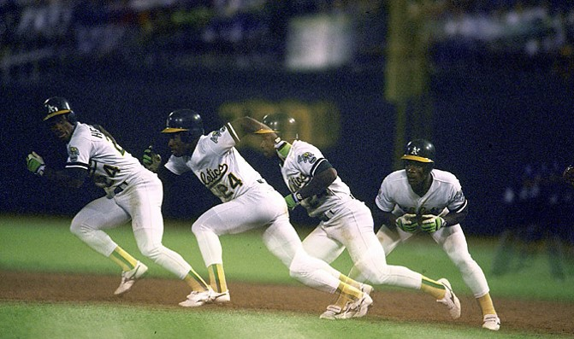

Slide 61
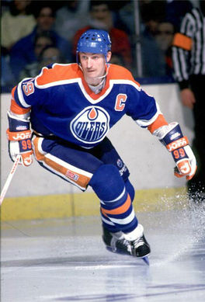
Power of Anticipating
“A good hockey player skates to where to puck is. A great hockey player skates to where the puck is going to be.”
Wayne Gretzky

Slide 62
Security complaining about IT
Any negative remark about finance department
Recent inquiries about outsourcing part of all IT duties
Multiple sites
Mention of server space being limited
IT having to run reports, print badges, etc.
Current customer that you know has let their SSA lapse
Any mention of chaos because of various sites
Someone traveling any amount between sites
Term “OpEx” or “CapEx” being used
Your knowledge of the system being old
IT Complaining about Security
End-Users complaining about system
… and make really good guesses.

Slide 64
… and once we identify a problem…

Slide 65
Benefits that Matter
24/7 services as needed
Always have access to fully trained administrator
Minimize IT requirements
Optimize IT staff
Resiliency

Slide 66
We’ve got a new access control system that’s hosted in the cloud. It’s gonna optimize your staff. Just sign here.
What’s he mean “optimize my staff”. I hate this guy.

Slide 67
Man, I hope this solves our problem. I love this guy and am going to buy millions from him.
We’ve got a new system that’s helped other hospitals reduce I.T. overtime. It might solve your problem. Would you like to learn more?
Another email from finance about our costs. Do they think I want to assign overtime to my staff?

Slide 68
Logical Justification

Slide 69
Objective of Logically Justify Stage
Validate the emotional need with logical, sensible justification.

Slide 70
Total Cost of Ownership Factors
Access Control HMS Example…
Server Cost and Replacements
IT Labor
Administrative Labor
Support and Maintenance
SSA
Cost of Cards and Printer
Utility Cost

Slide 71

Providing Logical Justification
Best Practices
Show them sample TCO calculations (they’ll conclude in your favor)
Have other IT professionals provide endorsement
Give them numbers to justify up the chain
Be careful about suggesting that they or others won’t be necessary

Slide 72
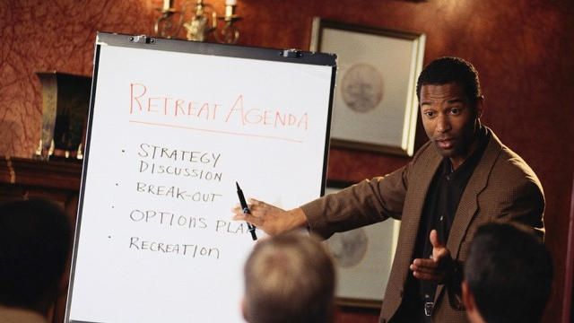
Summary
Understand the unique persona of IT.
Live in the world of clues.
Find the IT-specific problem.
Connect the problem to a benefit that matters.
Provide logical justification.

Slide 73

Action Items
Master the IT persona.
Memorize and add to the Clues slide.

Slide 74

Accountability and Coaching
Role play exercises to identify clues to problems that IT suffers and could be solved by a hosted or managed service.

Slide 75
Questions & Discussion

