Slide 1
Sales Training Session #20: Selling Cloud Services
June 20th, 2017

Slide 2
Survey Results

Slide 3
Once upon a time…

Slide 4

Kick-Off Meeting
We’re all gettin’ rich!

Slide 5

Leadership is Ecstatic

Slide 6

First Deal in the Bag!
10-Year customers that will do anything you say.
Innovators and Early Adopters.
A few that have asked for it.

Slide 7
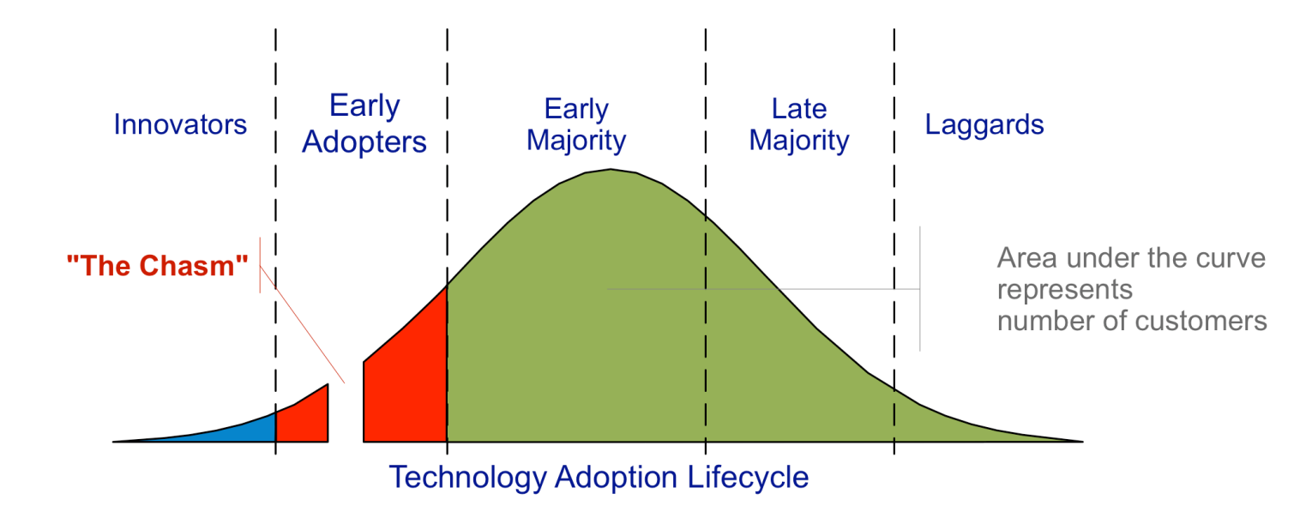
Bam … The Chasm!

Slide 8


Slide 9
Poll

Slide 10

Agenda
Customers’ Perspectives
Who?
Problems Solved by the Cloud
Clues to Problems
Getting in the Door

Slide 11
Customers’ Perspectives

Slide 13
I have no idea what he’s saying. I hate this guy.
It’s a no-brainer. We host it in the cloud. Just sign here.

Slide 14

What Went Wrong?
It’s not about selling features and benefits … it’s all about managing change.

Slide 15
What Went Wrong?
It’s not about selling features and benefits … it’s all about managing change.

Slide 16
What Went Wrong?
It’s not about selling features and benefits … it’s all about managing change.

Slide 17
Keys to Managing This Change
Understanding the Consensus Decision
Winning Their Confidence
Knowing their Problems

Slide 18
Keys to Managing This Change
Understanding the Consensus Decision
Winning Their Confidence
Knowing their Problems

Slide 19
Keys to Managing This Change
Understanding the Consensus Decision
Winning Their Confidence
Knowing their Problems

Slide 20
Keys to Managing This Change
Understanding the Consensus Decision
Winning Their Confidence
Knowing their Problems

Slide 21
Keys to Managing This Change
Understanding the Consensus Decision
Winning Their Confidence
Knowing their Problems

Slide 22
Who?

Slide 23
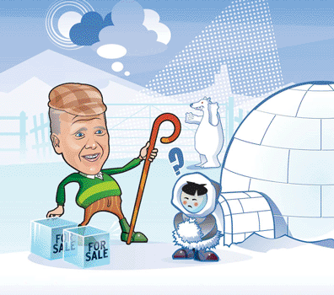
Who?

Slide 24
Who?
Vertical Markets | Descriptors
Property Managers Public Schools / School Districts Private Schools Regional Banks / Credit Unions Technology Business Manufacturing Plants Law Offices Small Business | Any Mercury-based system customer that has let their SSA expire or looking for more enhanced functionality. Current customers that need upgrading Innovative / Early Adopters 8 – 15 bank facilities Multiple sites Corporate campuses Law offices being regulated IT staff overloaded or already outsourced

Slide 25
Who?
Vertical Markets | Descriptors
Property Managers College Campuses Technology Business Manufacturing Plants Non-Profit Cannabis Small Business | Current customers that need upgrading Innovative / Early Adopter accounts Customers that trust you Multiple sites Heavy regulations IT staff overloaded or already being outsourced

Slide 26
Who?
Vertical Markets | Descriptors
Property Managers College Campuses Technology Business Manufacturing Plants Non-Profit Cannabis Small Business | Current customers that need upgrading Innovative / Early Adopter accounts Customers that trust you Multiple sites Heavy regulations IT staff overloaded or already being outsourced

Slide 27
Problems
What problems are your customers and prospects having that can be solved by Cloud Services?

Slide 28
Keys to Managing This Change
Understanding the Consensus Decision
Winning Their Confidence
Knowing their Problems

Slide 29
Keys to Managing This Change
Understanding the Consensus Decision
Winning Their Confidence
Knowing their Problems

Slide 30
We’ve got a new access control system that’s hosted in the cloud. Look at all the great benefits of this system – blah blah blah.
Management will never go for this. I hate this guy.

Slide 31

Obvious, urgent problems that they share with everyone.

Slide 32
“Haven’t really thought about it” Problems
New contract with Raytheon forces them to upgrade system

Slide 33
What problems are solved by cloud services?

Slide 34
Problems Solved by Cloud Services
New contract with Raytheon forces them to upgrade system
Limited IT Resources
Updates / back-ups not current
Overtime pay
Different versions at various sites
Travel expense and time between sites
IT hardware costs
Unpredictable expenses
Outdated features / technology
Small budget

Slide 35
“Top of mind I have a real problem” problem.
Limited IT Resources
Updates / back-ups not current
Overtime pay
Different versions at various sites
Travel expense and time between sites
IT hardware costs
Unpredictable expenses
Outdated features / technology
Small budget

Slide 36


Slide 37
Poll

Slide 38
Clues
If they “haven’t really thought about it”, how will you know about it?

Slide 39

Obsess about clues…

Slide 40
Limited IT resources
IT complaining about security
Security complaining about IT
Updates / back-ups not current
Overtime pay
Different versions at various sites
Travel expense & time b/t sites
IT hardware ongoing costs
Small budget
Unpredictable expenses
Outdated features / technology

Slide 41
Limited IT resources
IT complaining about security
Security complaining about IT
Updates / back-ups not current
End-users complaining about system
Overtime pay
Different versions at various sites
Travel expense & time b/t sites
IT hardware ongoing costs
Small budget
Unpredictable expenses
Outdated features / technology
Current customer that you know has let their SSA lapse

Slide 42
Limited IT resources
IT complaining about security
Security complaining about IT
Updates / back-ups not current
End-users complaining about system
Overtime pay
Any negative remark about finance department
Recent inquiries about outsourcing part of all IT duties
Different versions at various sites
Travel expense & time b/t sites
IT hardware ongoing costs
Small budget
Unpredictable expenses
Outdated features / technology
Current customer that you know has let their SSA lapse

Slide 43
Limited IT resources
IT complaining about security
Security complaining about IT
Updates / back-ups not current
End-users complaining about system
Overtime pay
Any negative remark about finance department
Recent inquiries about outsourcing part of all IT duties
Multiple sites
Different versions at various sites
Travel expense & time b/t sites
IT hardware ongoing costs
Small budget
Unpredictable expenses
Outdated features / technology
Current customer that you know has let their SSA lapse
Any mention of chaos because of various sites

Slide 44
Limited IT resources
IT complaining about security
Security complaining about IT
Updates / back-ups not current
End-users complaining about system
Overtime pay
Any negative remark about finance department
Recent inquiries about outsourcing part of all IT duties
Multiple sites
Multiple sites
Different versions at various sites
Travel expense & time b/t sites
IT hardware ongoing costs
Small budget
Unpredictable expenses
Outdated features / technology
Current customer that you know has let their SSA lapse
Any mention of chaos because of various sites
Someone traveling any amount between sites

Slide 45
Limited IT resources
IT complaining about security
Security complaining about IT
Updates / back-ups not current
End-users complaining about system
Overtime pay
Any negative remark about finance department
Recent inquiries about outsourcing part of all IT duties
Multiple sites
Multiple sites
Mention of server space being limited
Different versions at various sites
Travel expense & time b/t sites
IT hardware ongoing costs
Small budget
Unpredictable expenses
Outdated features / technology
Current customer that you know has let their SSA lapse
Any mention of chaos because of various sites
Someone traveling any amount between sites
Term “OpEx” or “CapEx” being used

Slide 46
Limited IT resources
IT complaining about security
Security complaining about IT
Updates / back-ups not current
End-users complaining about system
Overtime pay
Any negative remark about finance department
Recent inquiries about outsourcing part of all IT duties
Multiple sites
Multiple sites
Mention of server space being limited
Questions about terms or extending payments on current work
Different versions at various sites
Travel expense & time b/t sites
IT hardware ongoing costs
Small budget
Unpredictable expenses
Outdated features / technology
Current customer that you know has let their SSA lapse
Any mention of chaos because of various sites
Someone traveling any amount between sites
Term “OpEx” or “CapEx” being used
Less than eight doors

Slide 47
Limited IT resources
IT complaining about security
Security complaining about IT
Updates / back-ups not current
End-users complaining about system
Overtime pay
Any negative remark about finance department
Recent inquiries about outsourcing part of all IT duties
Multiple sites
Multiple sites
Mention of server space being limited
Questions about terms or extending payments on current work
Any negative remark about finance department
Different versions at various sites
Travel expense & time b/t sites
IT hardware ongoing costs
Small budget
Unpredictable expenses
Outdated features / technology
Current customer that you know has let their SSA lapse
Any mention of chaos because of various sites
Someone traveling any amount between sites
Term “OpEx” or “CapEx” being used
Less than eight doors
Term “OpEx” or “CapEx” being used

Slide 48
Limited IT resources
IT complaining about security
Security complaining about IT
Updates / back-ups not current
End-users complaining about system
Overtime pay
Any negative remark about finance department
Recent inquiries about outsourcing part of all IT duties
End-users complaining about system
Multiple sites
Multiple sites
Mention of server space being limited
Questions about terms or extending payments on current work
Any negative remark about finance department
Different versions at various sites
Travel expense & time b/t sites
IT hardware ongoing costs
Small budget
Unpredictable expenses
Outdated features / technology
Current customer that you know has let their SSA lapse
Any mention of chaos because of various sites
Someone traveling any amount between sites
Term “OpEx” or “CapEx” being used
Less than eight doors
Term “OpEx” or “CapEx” being used
Your knowledge of the system being old

Slide 49
We’ve got a new system that’s helped other facilities reduce I.T. overtime. It might solve your problem. Would you like to learn more?
Man, I hope this solves our problem.
Another email from finance about our costs. Do they think I enjoy assigning overtime to my staff?

Slide 50
Messaging
Getting in the Door Worksheet

Slide 51
Formula
Lately we’ve noticed “type of company” experiencing “customer / prospect relevant problem(s)”. We’ve been able to solve this problem at “success story customer” by “what we did”.
I’ll be in your area on “date”, and would like to “reason to meet”. We’ll be able to determine pretty quickly if your group could possibly benefit in the same way.
Can you meet on “date” at “time”?

Slide 52
Getting in the Door Message
Lately we’ve noticed companies with many sites investing a ton of time and resources traveling between sites to keep their security system updated. We’ve been able to solve this problem for many organizations, including Downtown Property Management Co. We did so by installing our hosted system. Now they manage 12 different sites without traveling. This has reduced their overtime spend by 60% and kept their system updated at all sites.
I’ll be in your area on April 28th, and would like to demonstrate our system for you. We’ll be able to determine pretty quickly if your group could possibly benefit ias much as Downtown Property Management Co. has.
Can you meet on the 28th at 8:30?

Slide 53

Exercises
Identify a problem at each of the scenarios in the exercises I send.
Build a Getting in the Door Message for cloud services.

Slide 54
Questions and Discussion
Chris Peterson
cpeterson@vectorfirm.com

