Slide 1
Sales Leadership Specifically Tailored for: Session #5: Professional Development of Sales People (and yourself)

Slide 3
Becoming the Perceived Expert
As their leader, how can you help your sales people be the perceived experts in your market?

Slide 4
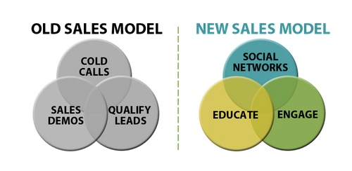

Slide 5
Becoming the Perceived Expert
Have your team run campaigns.
Assign a topic to each sales person.
Assign periodicals to each salesperson
Use the Networking Alignment Document to ensure they’re getting out there.
Speak, Speak, Speak

Slide 6
Monthly Action Plan
Pick a topic on which you’ll educate your market place for the remainder of 2016.
Begin to collect content from specific sources.
Forum Contest
Share the content you find on the online forum. Whoever shares the most pieces by March 8th wins an Amazon Gift Card.

Slide 7
Monthly Action Plan
Pick a topic on which you’ll educate your market place for the remainder of 2016.
Begin to collect content from specific sources.
Forum Contest
Share the content you find on the online forum. Whoever shares the most pieces by March 8th wins an Amazon Gift Card.

Slide 8
Professional Development of Sales People (and yourself)
POLL

Slide 9
Best Practices in Building Sales Pros
First, let’s talk about a tool for you to use…

Slide 10
Process of Building Sales Pros
Assessment / Scorecard
Each of you complete scorecard section.
Bring hard copies to a meeting to review and discuss.

Slide 11
Process of Building Sales Pros
Assessment / Scorecard
Develop four to eight objectives.
What objectives do I need to meet in order to improve my performance?
Not necessarily “improve weaknesses”

Slide 12
Process of Building Sales Pros
Assessment / Scorecard
Develop four to eight Objectives.
Establish two to four Initiatives
What do I need to do to achieve Objectives?
Cross Train as much as possible.

Slide 13
Process of Building Sales Pros
Assessment / Scorecard
Develop four to eight Objectives.
Establish two to four Initiatives.
Define the steps for each Initiative.
Keep it simple
Regular check-in meetings

Slide 14
Process of Building Sales Pros
Assessment / Scorecard
Develop four to eight Objectives.
Establish two to four Initiatives.
Define the steps for each Initiative.
Manage the process
Weekly or Bi-Weekly

Slide 15
Bonus Idea
Ask your sales people for a personal goal, and get them there.

Slide 16
A few more items…
Las Vegas Session – How a System Integrator Can Grow RMR … Specifically Built for the Sales Leader
KST SNAPP Success Story
Contact me …
321-439-3025
cpeterson@vectorfirm.com

Slide 17
Questions / Discussion Chris Peterson cpeterson@vectorfirm.com 321-439-3025

