Slide 1
Sales Leadership Specifically Tailored for: On-Boarding New Sales People Phase 2 After the 30-60-90 Day Plan

Slide 2
Sales Leadership Specifically Tailored for: On-Boarding New Sales People Phase 2 After the 30-60-90 Day Plan

Slide 4
Needs Analysis Questioning

Slide 5
Monthly Action Plan
Make sure your sales people are not asking questions too soon.

Slide 6
1980s
“Tell me about your company.”

Slide 7
1990s
“Don’t tell me about you. Ask about me.”

Slide 8
Today
“You should already know about me. Teach me something.”

Slide 9
Different Positioning = Different Answers
Asking Questions Immediately
After Establishing Authority

Slide 10
Before Asking Questions…
“We’ve seen many scenarios in which property managers wanted to provide access control to their various properties, but didn’t have the resources for multiple sites.”
“We’ve been able to solve this problem most of the time by implementing an access control system that can be managed remotely.”
“It doesn’t work for everyone. I’d like to ask a few questions to find out if we might be a good fit for each other.”

Slide 11
Before Asking Questions…
“We’ve seen many scenarios in which property managers wanted to provide access control to their various properties, but didn’t have the resources for multiple sites.”
“We’ve been able to solve this problem most of the time by implementing an access control system that can be managed remotely.”
“It doesn’t work for everyone. I’d like to ask a few questions to find out if we might be a good fit for each other.”

Slide 12
Before Asking Questions…
“We’ve seen many scenarios in which property managers wanted to provide access control to their various properties, but didn’t have the resources for multiple sites.”
“We’ve been able to solve this problem by implementing an access control system that can be managed remotely.”
“It doesn’t work for everyone. I’d like to ask a few questions to find out if we might be a good fit for each other.”

Slide 13
Before Asking Questions…
“We’ve seen many scenarios in which property managers wanted to provide access control to their various properties, but didn’t have the resources for multiple sites.”
“We’ve been able to solve this problem by implementing an access control system that can be managed remotely.”
“It doesn’t work for everyone. I’d like to ask a few questions to find out if we might be a good fit for each other.”

Slide 14
Before Asking Questions…
“We’ve seen many scenarios in which property managers wanted to provide access control to their various properties, but didn’t have the resources for multiple sites.”
“We’ve been able to solve this problem most of the time by implementing an access control system that can be managed remotely.”
“It doesn’t work for everyone. I’d like to ask a few questions to find out if it might be a good fit for you.”

Slide 15
Before Asking Questions…
“We’ve seen many scenarios in which property managers wanted to provide access control to their various properties, but didn’t have the resources for multiple sites.”
“We’ve been able to solve this problem most of the time by implementing an access control system that can be managed remotely.”
“It doesn’t work for everyone. I’d like to ask a few questions to find out if it might be a good fit for you.”

Slide 16
Monthly Action Plan
Make sure your sales people are not asking questions too soon. Have they positioned themselves as the authority before asking?

Slide 17
Monthly Action Plan
Make sure your sales people are not asking questions too soon. Have they positioned themselves as the authority before asking questions?

Slide 18
Monthly Action Plan
Make sure your sales people are not asking questions too soon. Have they positioned themselves as the authority before asking questions?

Slide 19
On-Boarding Sales People

Slide 20
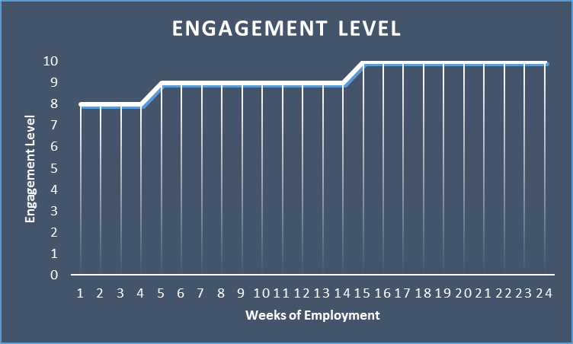

Slide 21
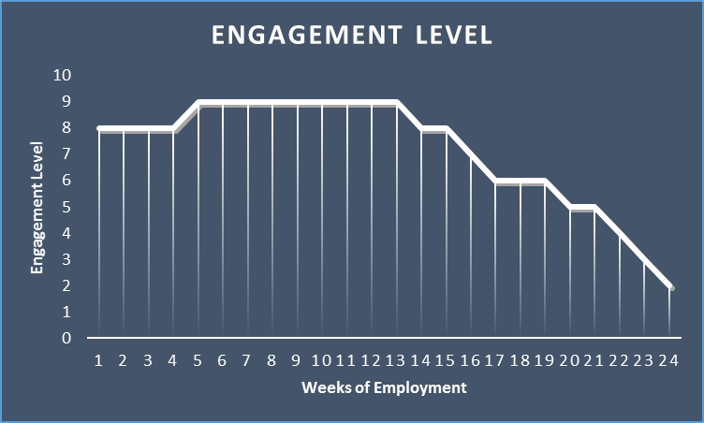

Slide 22
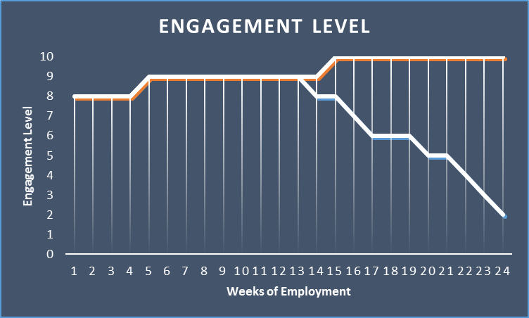
?

Slide 23
Coaching
Personal Commitment
Personal Desire
Experience

Slide 24
Coaching
Personal Commitment
Personal Desire
Experience

Slide 25
Commitment to You
Coaching
Personal Desire
Experience

Slide 26
Commitment to You
Coaching
Personal Desire
Experience

Slide 27
Commitment to You
Coaching
Personal Desire
Experience

Slide 28
Commitment to You
Coaching

Slide 29
HOW?

Slide 30
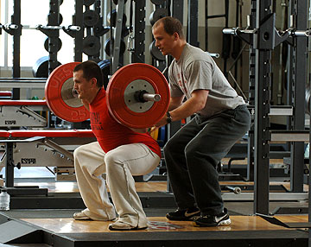

Slide 31
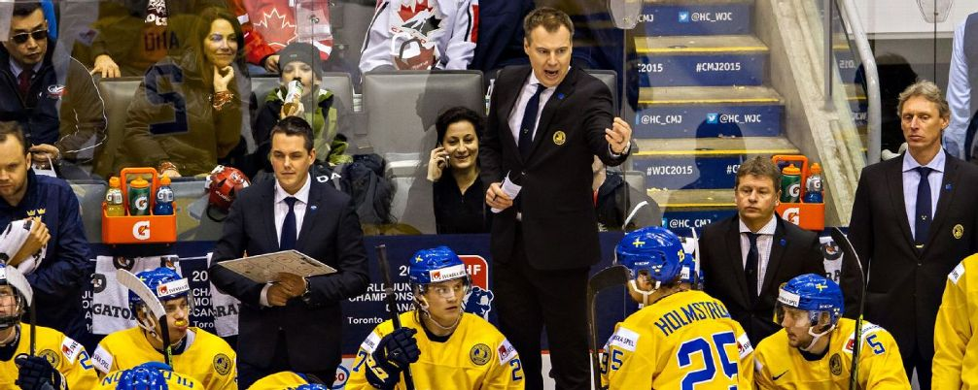

Slide 32
Phase 2 – The Second 12 (or so) Weeks

Slide 33
Structure, Best Practices, and Tools to Tailor

Slide 34
Phase 2 – The Next 12 Weeks
Field Work
Weekly Coaching Sessions
Sales Calls (1 per week)
Networking Events (3 during phase 2)
Prospecting Work (1/2 hour per week)
Four-Week Cycle:
Progress Meeting
Role Playing Work
Progress Meeting
Presentation Evaluations

Slide 35
Phase 2 – The Next 12 Weeks
Field Work
Weekly Coaching Sessions
Sales Calls (1 per week)
Networking Events (3 during phase 2)
Prospecting Work (1/2 hour per week)
Four-Week Cycle:
Progress Meeting
Role Playing Work
Progress Meeting
Presentation Evaluations

Slide 36
Phase 2 – The Next 12 Weeks
Field Work
Weekly Coaching Sessions
Sales Calls (1 per week)
Networking Events (3 during phase 2)
Prospecting Work (1/2 hour per week)
Four-Week Cycle:
Progress Meeting
Role Playing Work
Progress Meeting
Presentation Evaluations

Slide 37
Sales Calls
At least one per week
Observe - coach later
Always Debrief

Slide 38
Networking Events
Attend three with the new sales person during Phase 2
Introduce during the first event
Observe and coach during the next two events
Always Debrief

Slide 39
Prospecting Work
Work the phones with them - ½ hour per week
Role playing exercises
Observe and coach
Unique methods (Twitter, LinkedIn, Personal Visits)
Email coaching

Slide 40
Email Refresher
Before We Move Forward
25 seconds to read
Simple to respond
One Call to Action
Unique and relevant material
Confident and conversational
Make it easy

Slide 41
12 Weekly Coaching Sessions
Progress Meeting
Presentation
Progress Meeting
Role Playing Exercises
Progress Meeting
Presentation
Progress Meeting
Role Playing Exercises
Progress Meeting
Presentation
Progress Meeting
Role Playing Exercises

Slide 42
12 Weekly Coaching Sessions
Progress Meeting
Presentation
Progress Meeting
Role Playing Exercises
Progress Meeting
Presentation
Progress Meeting
Role Playing Exercises
Progress Meeting
Presentation
Progress Meeting
Role Playing Exercises

Slide 43
Progress Meetings
Outstanding Quotes Tracker

Slide 44
Progress Meetings
Outstanding Quotes Tracker
Sales Person Scorecard

Slide 45
Presentation Evaluation
Company story
15 – 20 minutes
Include others to evaluate and coach

Slide 46
Role Playing
The #1 exercise and best thing you can do with your sales team!
One sales person, one customer, and one evaluator
Scenarios
Evaluation Form

Slide 47
Sales people stay or leave because of one person…

Slide 48
Sales people stay or leave because of one person…
…usually their boss

Slide 49
Personal Out-of-Office Engagement
Formalize this part of the on-boarding as part of Phase 2
If appropriate, include spouses
Consider hosting dinner at your house
This is not lunch in between appointments

Slide 50
How do we track all of this?

Slide 51
Owner’s On-Boarding Phase 2 Checklist

Slide 52
When?
Hours Activity
24 Sales Calls
6 Phone Work
6 Networking Events
3 Out-of-Office Engagement
12 Weekly Coaching Sessions
63 Total Hours
5.25 Hours / Week

Slide 53
When?
Hours Activity
24 Sales Calls
6 Phone Work
6 Networking Events
3 Out-of-Office Engagement
12 Weekly Coaching Sessions
51 Total Hours
4.25 Hours / Week

Slide 54
When?
Hours Activity
24 Sales Calls
6 Networking Events

Slide 55
When?
Hours Activity
6 Phone Work
3 Out-of-Office Engagement
12 Weekly Coaching Sessions
21 Total Hours
1.75 Hours / Week

Slide 56
Next Month
New Sales Person Personal Evaluation Scorecard
Presentation Testing and Evaluating
Role Playing Scenarios
Role Playing Evaluation Sheets
Leader Accountability Checklist

Slide 57
Monthly Action Plan
Make sure your sales people are not asking questions too soon. Have they positioned themselves as the authority before asking?
Look for my email with these tools.

Slide 58
Questions / Discussion Chris Peterson cpeterson@vectorfirm.com 321-439-3025

