Slide 1
Sales Leadership Specifically Tailored for: Session #3: Creative Metrics

Slide 2
Agenda
Passing the Baton
Engagement in the First Meeting
Creative and Useful Metrics
Questions and Discussion

Slide 3
Goals
You think of and use at least one new creative metric that helps you increase your sales.
You save time with these tools and methods.

Slide 4
Passing the Baton
Engagement in the First Meeting

Slide 6
Engagement in the First Meeting

Slide 9
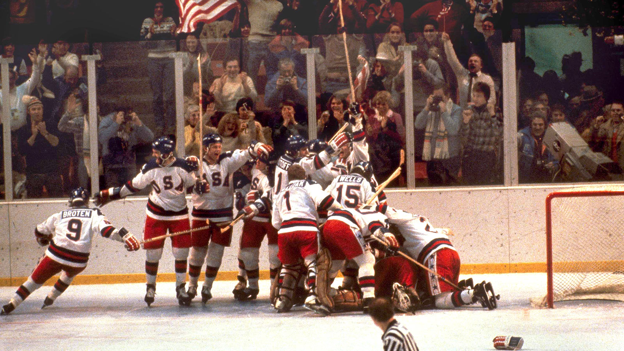

Slide 10
Action Items & Exercises
Action Items
Download the Preparation Worksheet from SNAPP and use it.
Poll

Slide 11
Best Practices for Leadership
Buy in to the Prep Sheet
Have sales people turn in their next 25 prep sheets before their meetings
Ride in the field with sales people, with completed prep sheets
Discuss the difference of meetings with and without preparation
Surprise them with a meeting without using the prep sheet

Slide 12
Action Items & Exercises
Action Items
Download the Preparation Worksheet from SNAPP and use it.
Use the “Are you ready for…” and report back on your experience on the online forum.
Report back on your experience with both.

Slide 13
Creative and Useful Metrics

Slide 14
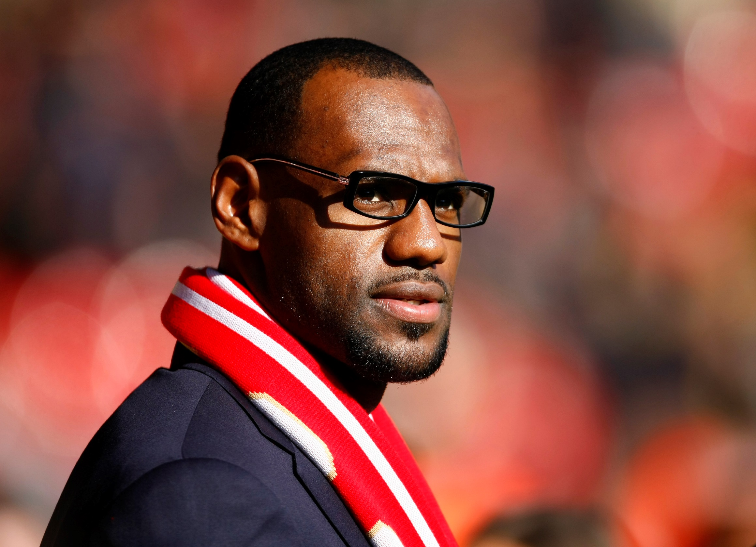

Slide 15
Creative and Useful Metrics
Quoted $$ YTD
Outstanding Quoted $$
Poll #2 and #3
LeBron James Answer

Slide 16
Creative and Useful Metrics
Quoted $$ YTD
Outstanding Quoted $$
Performance Factor

Slide 17
Performance Factor = (Last 90 Days of Sales) + (Weighted Pipeline)
Rule of thumb for Weighted Pipeline: (Outstanding Quoted $$) / 3

Slide 18
Creative and Useful Metrics
Quoted $$ YTD
Outstanding Quoted $$
Performance Factor

Slide 19
Creative and Useful Metrics
Quoted $$ YTD
Outstanding Quoted $$
Performance Factor
Relationship Rating
LinkedIn Connections
Twitter Followers
Networking Events
Referrals
Tracking?

Slide 20
A few more items…
Good interaction for the Holidays
Now that it’s January, let’s kick it up a gear
Encourage use of SNAPP
Online forum challenges
POLL

Slide 21
Questions / Discussion Chris Peterson cpeterson@vectorfirm.com 321-439-3025

