Slide 1
We will be starting shortly!
Most Common Mistakes to Avoid when Selling Against Low-Cost
September 18th, 2018

Slide 2
Most Common Mistakes to Avoid when Selling Against Low-Cost
September 18th, 2018

Slide 3
Agenda
Don’t …
Underestimate their performance
Jump into a TCO / ROI debate
Act cheap
Let up when you have them against the ropes
Wait
Get into a price battle
Bash the competition
Action Items

Slide 4
1. Don’t underestimate their performance

Slide 5
Poll Question

Slide 6
Who is this team?

Slide 7
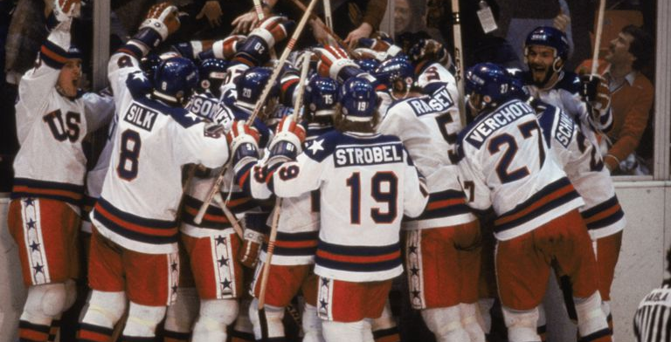

Slide 8
Who is this team? - 1994 New York Rangers - 1980 USA Olympic Hockey Team - 2017 San Jose Sharks - 2002 USA Olympic Hockey Team

Slide 9
Who is this team? - 1994 New York Rangers - 1980 USA Olympic Hockey Team - 2017 San Jose Sharks - 2014 USA Olympic Team

Slide 11
Know your weapons … and theirs

Slide 12
2. Don’t jump into a TCO / ROI debate

Slide 13
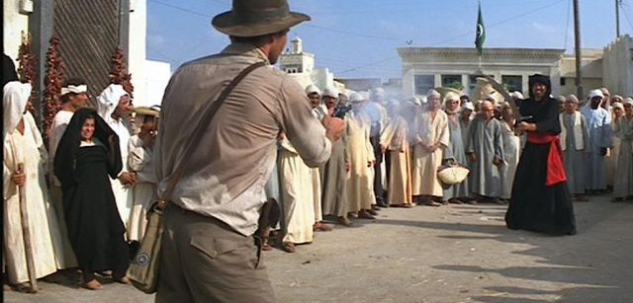

Slide 14
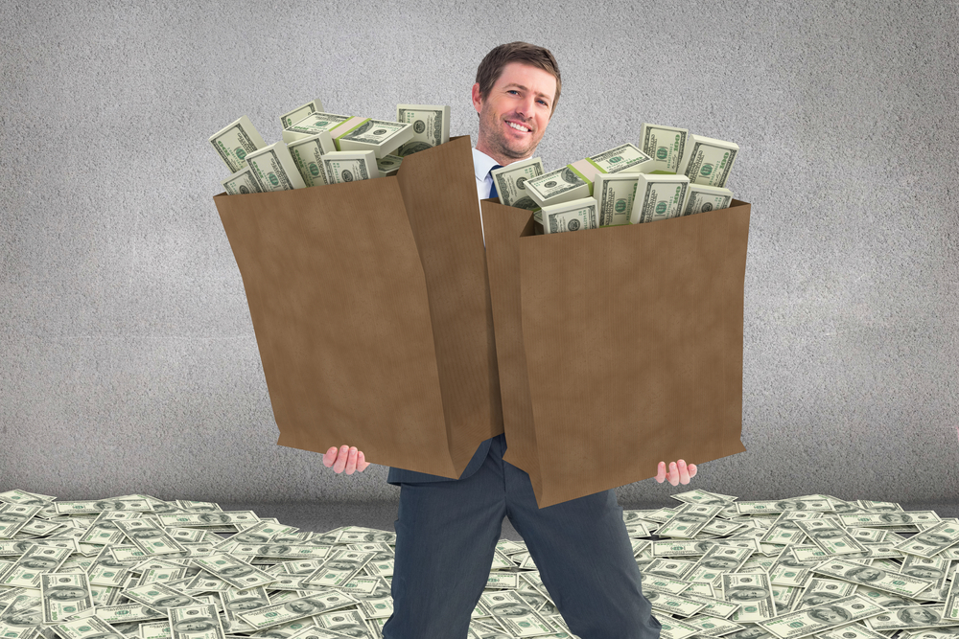
Don’t jump into a TCO / ROI debate

Slide 15
Best Practices to Providing Logical Justification
Wait until they want you.
Provide general numbers as a teaser.
Don’t stretch the logic, but let them.
Include the subjective, intangible benefits as bonus.
Let customer drive calculations.
Provide graphical image.

Slide 16
3. Don’t act cheap (desperate)

Slide 17
Don’t act cheap (desperate)
“I won’t mention any names, but …”
“I don’t talk badly about my competition, so I’ll keep quiet.”
“You get what you pay for.”
Taking up more time than allotted during demo or presentation phase.

Slide 18
Sell Yourself
Explain exactly how you work with your clients.
Don’t use adjectives describing you – tell them what you do.
Use personal references from clients.
Ask personal questions that matter to them – not the organization.

Slide 19
4. When you’ve got them on the ropes, don’t let up.

Slide 20
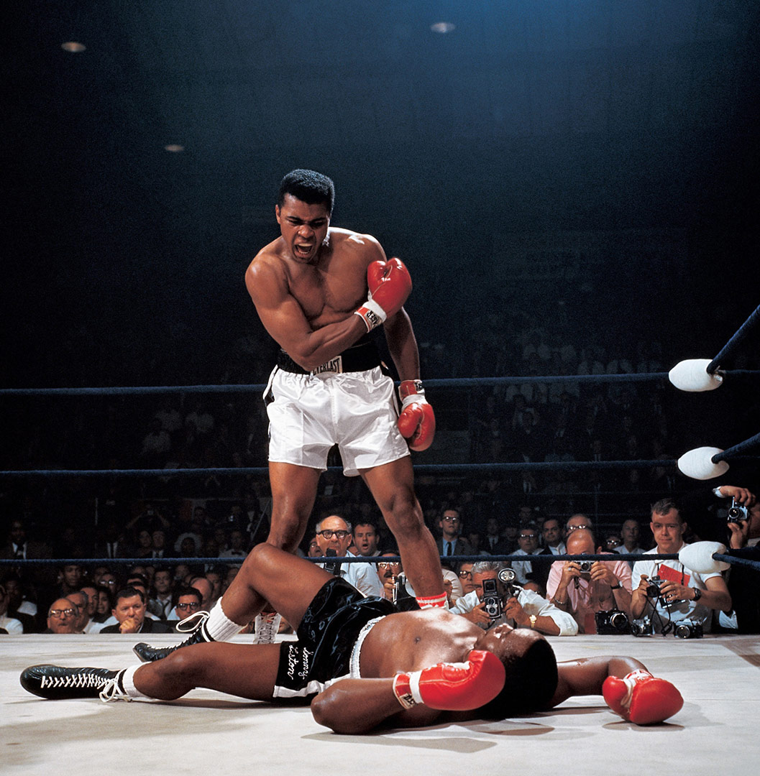

Slide 23
Make sure they feel it
Q: I thought you mentioned coaching your daughter’s basketball team. How do you manage that while working most Saturdays on your network?
A: Sometimes I have to miss games, and it’s terrible.

Slide 24
5. Don’t Wait

Slide 27
Let ‘em know that you’ll be more expensive … early.

Slide 28
6. Don’t get into a price battle

Slide 29
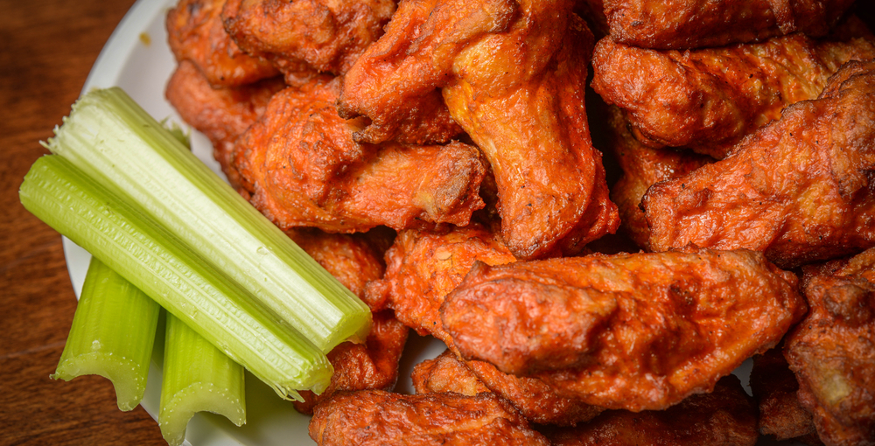

Slide 30
7. Don’t bash the competition

Slide 31
Back in the 1980’s…

Slide 32
Poll Question

Slide 33
If you can’t bash the competition, who can?

Slide 34
If you can’t bash the competition, who can? - Your boss. - If you’re careful about it, you can. - Your internal champion / coach. - Your sales engineer.

Slide 35
If you can’t bash the competition, who can? - Your boss. - If you’re careful about it, you can. - Your internal champion. - You sales engineer.

Slide 36
“Why are they looking at these cheap bozos?”

Slide 37
Why are we even talking to these people? This is our security system and we’re counting pennies?

Slide 38
Summary
Don’t …
Underestimate their performance
Jump into a TCO / ROI debate
Act cheap
Let up when you have them against the ropes
Wait
Get into a price battle
Bash the competition

Slide 39
Action

Slide 40
Action Item List the top three reasons your customers should pay an extra 20% for you vs. the competition.

Slide 41
Questions and Discussion
Chris Peterson
cpeterson@vectorfirm.com

