Slide 1
“How Sales and Operations Can Work
Together More Effectively”
Session 071
June 9, 2023
Welcome – we’ll be starting soon.

Slide 2
Overcoming the Most Common Problems
Identify the Problems
Offer 5 Strategies
The Biggest Challenge

Slide 3
What Sales says…
This hasn’t been an issue before, why is it now?
I have to keep stepping in because ops doesn’t communicate.
There is no way it should take that many hours.
You already know the site.
We need better trained techs.
Our prices are too high.
They are going to leave us (because of you)
I’ve tried; nothing changes.

Slide 4
What Operations says…
This hasn’t been an issue before, why is it now?
We keep hitting roadblocks because sales wasn’t clear.
There is no way we can do it in so few hours.
Where do they want it exactly?
We’d love to give more training to our techs.
Our prices are too low.
Would it be such a bad thing if they leave us?
I’ve tried; nothing changes.

Slide 5
What Leadership thinks…
Our guys are Rockstars.
They talk everyday.
We have meetings every week.
They’re working on it.
It takes time.
It’s big ship to turn.
Our new software will fix most of this.
and so on and so on
I’ve tried; nothing changes.

Slide 6
It always comes back to these 3 things.
Lack of Communication
Lack of Clarity
Lack of Accountability

Slide 7
5 Strategies
Establish a Shared Vision
Promote Regular Communication
Foster Cross-Departmental Collaboration
Implement (and use) Technology
Establish Shared Goals and Metrics
Notes:
#5 – #7 great ideas to offer to operations I the roles sand responsibilities
Kyle is very technical – prepare them to do things that they may not otherwise know/think about when they are

Slide 8
Who owns it?
Establish a Shared Vision
Promote Regular Communication
Foster Cross-Departmental Collaboration
Implement (and use) Technology
Establish Shared Goals and Metrics
Notes:
#5 – #7 great ideas to offer to operations I the roles sand responsibilities
Kyle is very technical – prepare them to do things that they may not otherwise know/think about when they are

Slide 9
Establish a Shared Vision
Notes:
Mending a fence

Slide 10
Who owns it?
Sales Owns the Rest!

Slide 11
Who owns it?
Establish a Shared Vision
Promote Regular Communication
Foster Cross-Departmental Collaboration
Implement (and use) Technology
Establish Shared KPIs

Slide 12
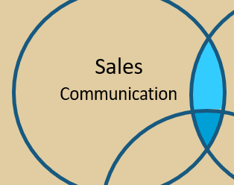
Why Me?
“Sales Leads the Way”
Someone has to do it.
You are built for it.
It all comes back to you in the end.
Notes:
Who is responsible for leading the way, when it comes to stopping the finger pointing between sales and operations teams?

Slide 13
2. Promote Regular Communication
1:1 Meetings
Weekly Hand-offs
Quarterly After-Action Reviews
Notes:
They are too busy with their current sales activities.
It’s not their responsibility to schedule them.
They feel it doesn’t make any difference in the end.
All of the above

Slide 14
2. Promote Regular Communication
1:1 Meetings
Weekly Hand-offs
Quarterly After-Action Reviews
Notes:
Advantech Story
Handoffs – pepper with questions every Friday morning – everyone is there PMs etc. present your projects.
National Accounts team – it goes through Pm and Ops Managers before it goes to the customer.
You are going to spend the time on it somewhere… better to do it upfront.

Slide 15
2. Promote Regular Communication
1:1 Meetings
Weekly Hand-offs
Quarterly After-Action Reviews
Notes:
Advantech Story
Handoffs – pepper with questions every Friday morning – everyone is there PMs etc. present your projects.
National Accounts team – it goes through Pm and Ops Managers before it goes to the customer.
You are going to spend the time on it somewhere… better to do it upfront.

Slide 16
3. Foster Cross-Departmental Collaboration
Invite them to the right trainings.
Attend job kick-offs and close-outs.
Mentor the techs (with permission)
Do your thing. Socialize

Slide 17
3. Foster Cross-Departmental Collaboration
Invite them to the right trainings.
Attend job kick-offs and close-outs.
Mentor the techs (with permission)
Do your thing. Socialize
Notes:
This approach enables employees from both departments to understand each other’s roles, challenges, and processes. By fostering empathy and building relationships, potential conflicts can be mitigated, and a spirit of cooperation can flourish.

Slide 18
3. Foster Cross-Departmental Collaboration
Invite them to the right trainings.
Attend job kick-offs and close-outs.
Mentor the techs (with permission)
Do your thing. Socialize.
Notes:
Kyle is very technical – prepare them to do things that they may not otherwise know/think about when they are

Slide 19
3. Foster Cross-Departmental Collaboration
Invite them to the right trainings.
Attend job kick-offs and close-outs.
Mentor the techs (with permission)
Do your thing. Socialize.

Slide 20
4. Implement (and use) Technology
Survey Tools
Voice to Text
CRM, Teams, HubSpot, etc.
Notes:
Mending a fence

Slide 21
4. Implement (and use) Technology
Survey Tools
Voice to Text
CRM, Teams, HubSpot, etc.
Notes:
Mending a fence

Slide 22
4. Implement (and use) Technology
Survey Tools
Voice to Text
CRM, Teams, HubSpot, etc.
Notes:
Mending a fence

Slide 23
Who owns it?
Establish a Shared Vision
Promote Regular Communication
Foster Cross-Departmental Collaboration
Implement (and use) Technology
Establish Shared Goals and Metrics

Slide 24
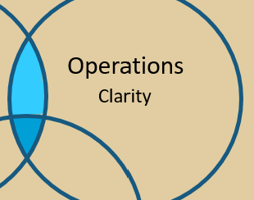
You do, BUT Ops does it.
They are built for it.
They fix things.
They are responsible for delivering, for you.
Data, Data, Data.

Slide 25
The most important factor in minimizing the rift between sales and ops?
Defining shared goals and metrics.
Notes:
Its in their wheel-house.
80/20

Slide 26
The Biggest Challenge?

Slide 27
When am I supposed to find time for all this? You can’t… find time that is.

Slide 28
The best statement I’ve ever heard about being finding time …

Slide 29
You can’t find time. You’ve gotta just do it, knowing that the more pressing matters will be handled.

Slide 30
What Stops Us?
They are too busy with their current sales activities.
It’s not their responsibility to schedule them.
They feel it doesn’t make any difference in the end.

Slide 31
Despite what everyone says, you can’t make time, you can only take it from something else and use it more wisely.

Slide 32
Job Handoff
Kickoffs
Postmortems
Sales
Operations
Relationships
Knowledge
Leadership
Non-Negotiables

Slide 33
Sales
Operations
Relationships
Knowledge
Leadership
Non-Negotiables

Slide 34
Sales
Operations
Relationships
Knowledge
Leadership
Non-Negotiables

Slide 35
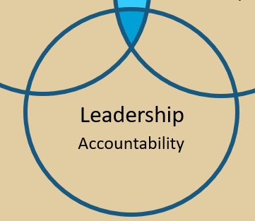
Leaders
It is your job.
Whether you are built for it or not.
It is non-negotiable.
Notes:
Who is responsible for leading the way, when it comes to stopping the finger pointing between sales and operations teams?

Slide 36
Establish a Shared Vision
Notes:
Mending a fence

Slide 37
Action Plan

Slide 38
How To Be Great at Following Up
July’s Topic

Slide 39
Questions / Comments

