Slide 1
How Salespeople Can Get and Stay Organized
Session 069
April 14, 2023
Welcome – we’ll be starting soon.

Slide 2
How Salespeople Can Get and Stay Organized
Session 069
April 14, 2023

Slide 3
Sometime in early 2015 …

Slide 4
So, I decided to search for an answer…
Workout for exactly seven hours per week.
Sleep at a 20-degree incline.
90-day challenges for everything.
Drink two glasses of red wine per night.
Fast for 16 hours every day, and 24 hours once per week.
Get 20 minutes of sunlight before 10am.
Kale – a lot of kale.
Write one affirmation / hour.
Read one non-fiction book per month.
Work hard at one creative hobby, but don’t judge yourself or try to improve.
Journal, journal, journal.
Massages followed by chiro followed by cryotherapy.

Slide 5
By mid-2016, I gave up on “best life” for the first time in my life...

Slide 6
After returning from ISCW, April 2017 …
750 Active Calories
<80 Pick-Ups
<One Drink
20 Minutes

Slide 7
After returning from ISCW, April 2017 …
>7.5 Hours
750 Active Calories
<80 Pick-Ups
<One Drink
20 Minutes

Slide 8
After returning from ISCW, April 2017 …
>7.5 Hours
750 Active Calories
<80 Pick-Ups
<One Drink
20 Minutes

Slide 9
After returning from ISCW, April 2017 …
>7.5 Hours
750 Active Calories
<80 Pick-Ups
<One Drink
20 Minutes

Slide 10
After returning from ISCW, April 2017 …
>7.5 Hours
750 Active Calories
<80 Pick-Ups
<One Drink
20 Minutes

Slide 11
After returning from ISCW, April 2017 …
>7.5 Hours
750 Active Calories
<80 Pick-Ups
<One Drink
20 Minutes

Slide 12
What’s this got to do with salespeople getting and staying organized?

Slide 14
Expectations non-salespeople have of salespeople…
Make 25 cold calls per week and note every detail.
Update CRM every day.
Schedule tasks with dates and priority.
Keep your desk area perfectly organized.
Make sure your expense receipts are legible and organized chronologically.
Create the ideal day on your calendar and live it.
Prepare for everything.
Digitize all business cards right away.
Provide all accurate information needed by the design team.
Save all documents in the exact right spot.
Forecast perfectly every quarter.
Know everything about every contact and opportunity at every account.

Slide 16
We’re going to focus on only three areas … and everything else will follow.

Slide 17
How Salespeople Can Get and Stay Organized
Accounts
Tasks
Opportunities
Overall Philosophy and Approach

Slide 18
Poll Question

Slide 19
To what magnitude does your company / boss hold you accountable to these items?

Slide 20
To what magnitude does your company / boss hold you accountable to these items?
Weekly meetings that require organization in these areas.
Periodic meetings that require organization in these areas.
A little, but not predictable.
None to minimal beyond closing sales.

Slide 21
Accounts

Slide 22
First … Prioritize
 | Tier 1 | Tier 2 | Tier 3
Strategic Plan
Proactive Routines
Responsive to All

Slide 23
First … Prioritize
 | Tier 1 | Tier 2
Strategic Plan
Proactive Routines
Responsive to All

Slide 24
Just the Basics
Budgeting cycle.
Decision-making processes.
Current systems and providers.
Influencers.

Slide 25
Tasks

Slide 26
Prospecting Tasks
No scheduled tasks – huge duplication of effort!
Document a finite list of prospects and call on part of the list every week.
Track basics of every contact.
Use the Outbound Call Plan worksheet (Jan. 2020).
If they tell you to call back or do something at a particular time, then create a task!
CRM, spreadsheet, shoe box of index cards …

Slide 27
Yes, a Shoe Box…
Create index cards for each prospect with basic info.
Add 12 dividers in the shoe box for each month.
Run through your list of prospects and only use the months for situations when they tell you to call then.

Slide 28
Time-Sensitive Tasks
Debrief after every encounter in which action items are present.
Assign action items to one tool – CRM, Outlook, Other App, Shoe Box – but not a calendar.
Add date to every task and note if the date is flexible.
Include hints to remind you of details.
Take photos of handwritten notes and add as file.

Slide 29
Routines and Appointments
Add to calendar.
“Tasks” should be added to your calendar.
Rule of thumb: if a task takes more than 15 minutes, add it to your calendar.
Routines should be recurring events on calendar, not tasks – another duplication of effort.

Slide 30
Opportunities

Slide 31
Poll Question

Slide 32
How do you keep your sales opportunities organized today?

Slide 33
How do you keep your sales opportunities organized today?
CRM or estimating system.
Spreadsheet.
Another formalized system.
No defined system – I just know.

Slide 34
Knowing Your Pipeline
CRM or spreadsheet for pipeline management.
Update weekly, at least.
Same time and day of the week and make it fun.
Keep it simple, even if your company doesn’t.
30-Day Closing Notepad.

Slide 35
Fields to Update to Stay Organized

Slide 36
Fields to Update to Stay Organized

Slide 37
Stuff

Slide 38
Email

Slide 39
Organizing Email

Slide 40
What about Email
Create folders but don’t use rules that auto-file emails into certain folders (unless you’ve mastered this).
Clean inbox at the end (or beginning) of the day - zero emails that arrived before 5:00 pm.
Delete – File – Act.
Watch Sprint 018.

Slide 41
Inbox
File
Act
Greater than 2 minutes
Delete
Less than
2 minutes
Do
File for later

Slide 42
Inbox
File
Act
Greater than 2 minutes
Delete
Less than
2 minutes
Do
File for later

Slide 43
Inbox
File
Act
Greater than 2 minutes
Delete
Less than
2 minutes
Do
File for later

Slide 44
Inbox
File
Act
Greater than 2 minutes
Delete
Less than
2 minutes
Do
File for later

Slide 45
Inbox
File
Act
Greater than 2 minutes
Delete
Less than
2 minutes
Do
Functional Folder

Slide 46
Inbox
File
Act
Greater than 2 minutes
Delete
Less than
2 minutes
Do
Functional Folder

Slide 47
What about Organizing Email
June 2019 – Time Management for Salespeople Part 2.
September 2022 – Salespeople and Email
Sprint 018.

Slide 48
Philosophy and Approach

Slide 50
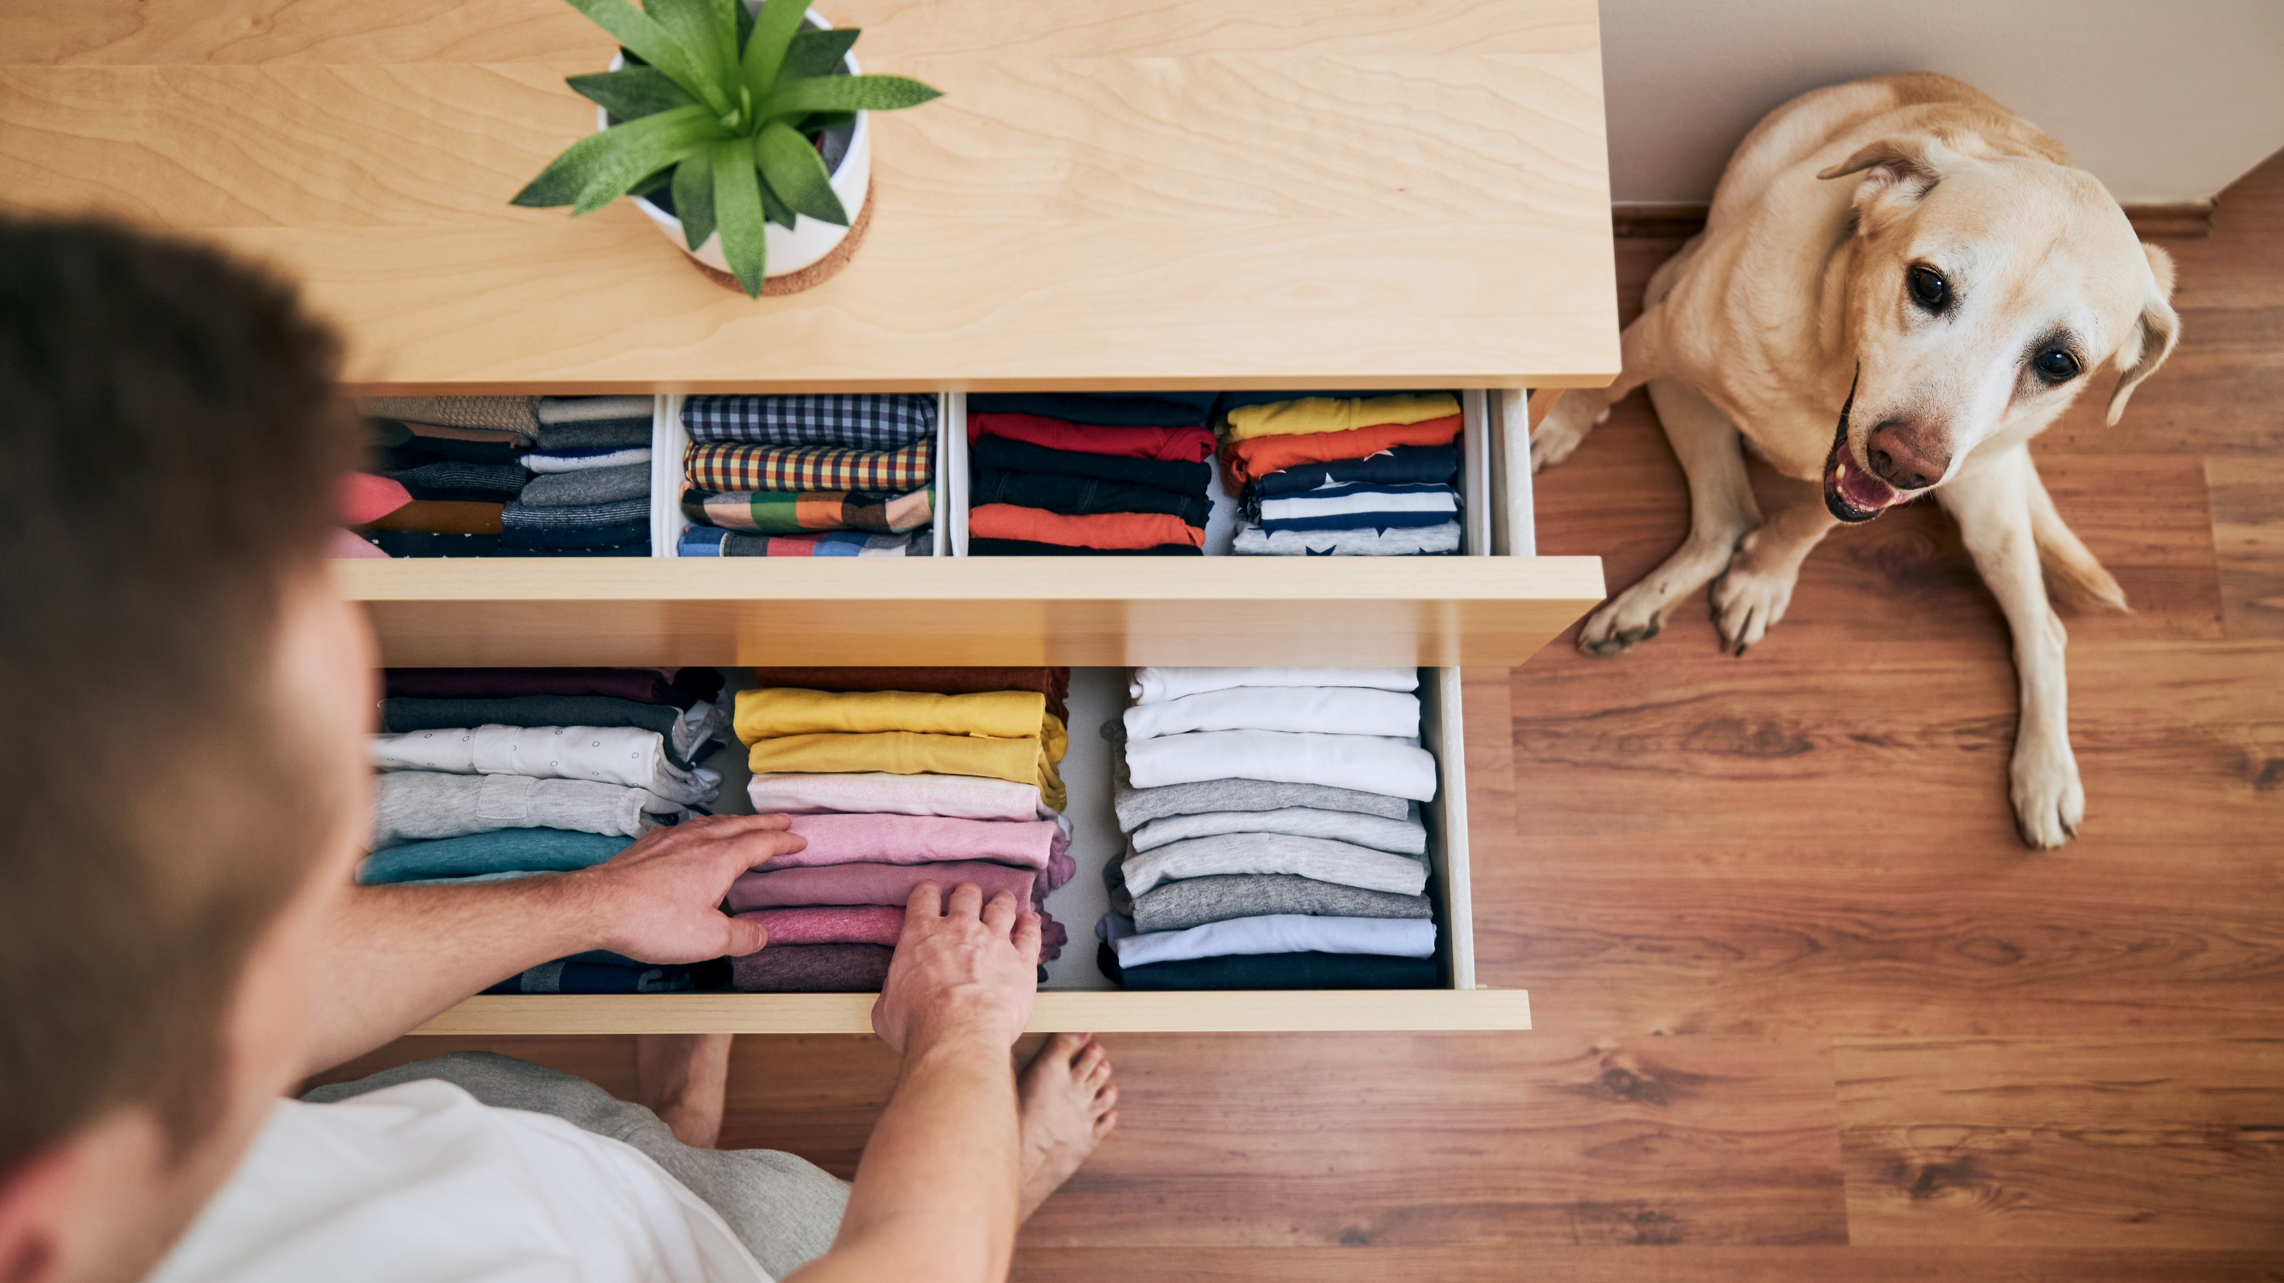

Slide 51
Order for Salespeople: Our Philosophy and Approach
Maintain 70% - 80% order in only a few defined areas (Tasks, Accounts, Opportunities.)
Do NOT expect or accept perfection.
Start over every morning.
Whether you have a personality for order or not, your role of sales makes it difficult.

Slide 52
Focus only on Accounts, Tasks, Opportunities, and Emails.

Slide 53
Action Plan

Slide 54
Action Plan

Slide 55
How to Present the Value of “as-a-Service”
May’s Topic

Slide 56
Poll Question

Slide 57
What do you think about us holding only one live webinar each month at 11:00 or 12:00 Eastern?

Slide 62
30-Minute Live Practice
Fourth Friday at 12:00 ET
Review the Action Item
Live Q&A
Recorded and posted
50 points for watching recording (in place of podcast)
50 points for attending live
If we use your action item as an example, 100 bonus points
No invitation, but a reminder with link

Slide 63
Questions & Discussion

