Slide 1
Winning New Business Specifically Tailored for: Session #7: Needs Analysis – Part 1 Scenario Questions April 19th, 2016

Slide 2
Objectives
Understanding of Needs Analysis Questions in 2016
Full grasp of the difference between Scenario and Outcome questions
Set the foundation to gaining emotional engagement

Slide 3
Our Objective is not to…
List a bunch of questions

Slide 4
POLL

Slide 5
Positioning Yourself

Slide 6
1980s
“Tell me about your company.”

Slide 7
1990s
“Don’t tell me about you. Ask about me.”

Slide 8
Today
“You should already know about me. Teach me something.”

Slide 9
1980s
“Tell me about your company.”
1990s
“Don’t tell me about you. Ask about me.”
Today
“You should already know about me. Teach me something.”

Slide 10
“blah,blah,blah… our service is awesome!”
Bad Sales Person

Slide 11
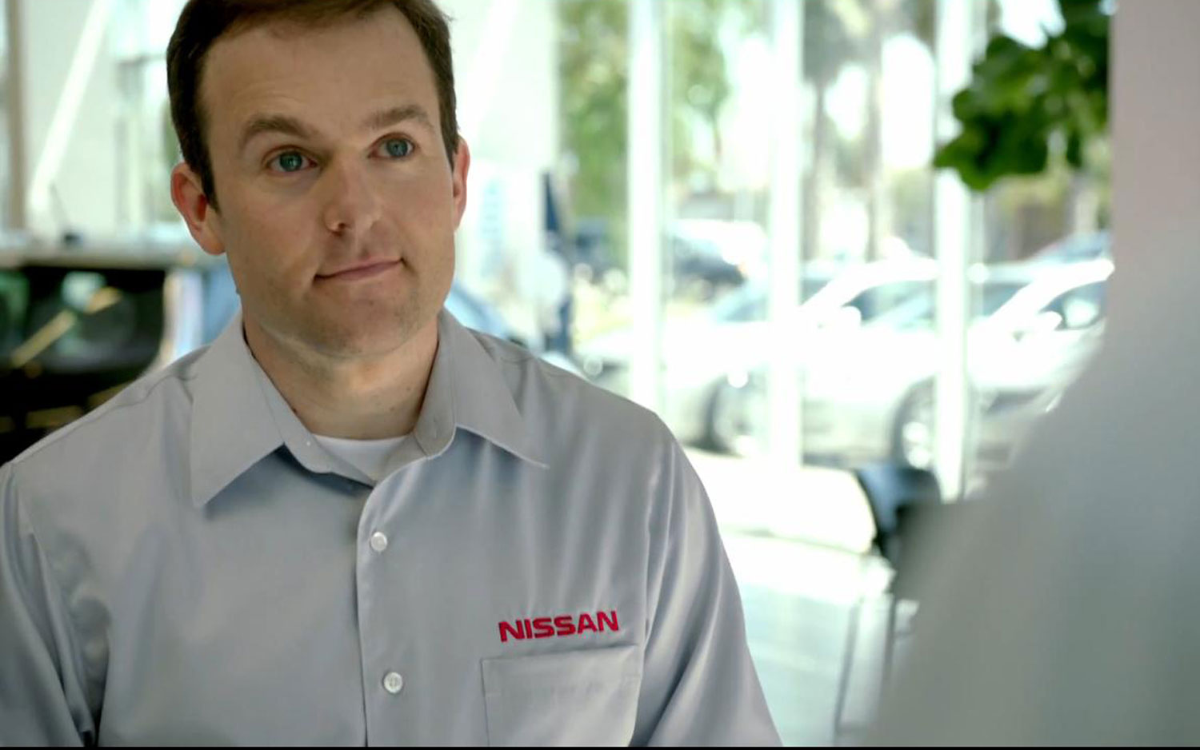
“What keeps you awake at night?”
Average Sales Person

Slide 12
“Wow, she knows what I need before asking.”
Great Sales Professional

Slide 13
Before Asking Questions…
“We’ve seen many scenarios of companies like yours in which …
“We’ve been able to solve their problem by ….”
“I’d like to ask a few questions to find out if we might be a good fit for each other.”

Slide 14
Before Asking Questions…
“We’ve seen many scenarios of companies like yours in which …
“We’ve been able to solve their problem by ….”
“I’d like to ask a few questions to find out if we might be a good fit for each other.”

Slide 15
Before Asking Questions…
“We’ve seen many scenarios of companies like yours in which …
“We’ve been able to solve their problem by ….”
“I’d like to ask a few questions to find out if we might be a good fit for each other.”

Slide 16
Before Asking Questions…
“We’ve seen many scenarios of companies like yours in which …
“We’ve been able to solve their problem by ….”
“I’d like to ask a few questions to find out if we might be a good fit for each other.”

Slide 17
Before Asking Questions…
“We’ve seen many scenarios in which property managers wanted to provide access control to their various properties, but didn’t have the resources for multiple sites.”
“We’ve been able to solve this problem most of the time by implementing an access control system that can be managed remotely.”
“It doesn’t work for everyone. I’d like to ask a few questions to find out if we might be a good fit for each other.”

Slide 18
Before Asking Questions…
“We’ve seen many scenarios in which property managers wanted to provide access control to their various properties, but didn’t have the resources for multiple sites.”
“We’ve been able to solve this problem most of the time by implementing an access control system that can be managed remotely.”
“It doesn’t work for everyone. I’d like to ask a few questions to find out if we might be a good fit for each other.”

Slide 19
Before Asking Questions…
“We’ve seen many scenarios in which property managers wanted to provide access control to their various properties, but didn’t have the resources for multiple sites.”
“We’ve been able to solve this problem by implementing an access control system that can be managed remotely.”
“It doesn’t work for everyone. I’d like to ask a few questions to find out if we might be a good fit for each other.”

Slide 20
Before Asking Questions…
“We’ve seen many scenarios in which property managers wanted to provide access control to their various properties, but didn’t have the resources for multiple sites.”
“We’ve been able to solve this problem by implementing an access control system that can be managed remotely.”
“It doesn’t work for everyone. I’d like to ask a few questions to find out if we might be a good fit for each other.”

Slide 21
Before Asking Questions…
“We’ve seen many scenarios in which property managers wanted to provide access control to their various properties, but didn’t have the resources for multiple sites.”
“We’ve been able to solve this problem most of the time by implementing an access control system that can be managed remotely.”
“It doesn’t work for everyone. I’d like to ask a few questions to find out if it might be a good fit for you.”

Slide 22
Before Asking Questions…
“We’ve seen many scenarios in which property managers wanted to provide access control to their various properties, but didn’t have the resources for multiple sites.”
“We’ve been able to solve this problem most of the time by implementing an access control system that can be managed remotely.”
“It doesn’t work for everyone. I’d like to ask a few questions to find out if it might be a good fit for you.”

Slide 23
Different Positioning = Different Answers
Asking Questions Immediately
After Establishing Authority

Slide 24
Positioning Yourself to Ask Questions
Real World Example

Slide 25
Two Types of Questions
Scenario
Outcome

Slide 26
Scenario Questions

Slide 27
Purpose of Scenario Questions
Help you understand your customer’s complete scenario, and sets the stage for asking Outcome Questions.

Slide 28
Scenario Questions
Project

Slide 29
Scenario Questions
Account

Slide 30
Scenario Questions
Contact

Slide 31
Scenario Questions
Project
Account
Contact

Slide 32
Scenario Questions
Sales Call Prep Sheet

Slide 33
Scenario Questions
Example

Slide 34
Scenario and Outcome Questions

Slide 35
Difference in Types of Questions
Scenario Questions
Outcome Questions
Typical questions that you’re used to asking.
Set up Outcome Questions.
Help you understand the customer’s scenario.
Example: Do you currently offer access control throughout your multiple sites?
Unique and personal questions that ask about an outcome.
Follow Scenario Questions.
Help your customer feel the impact of not working with you.
Example: If you lose tenants because they might feel safer in a building with access control, how does that affect you?

Slide 36
Scenario Questions will not …
… create emotional engagement.

Slide 37
Scenario Questions will not …
… create emotional engagement.

Slide 38
Scenario Questions
POLL

Slide 39
Purpose of Outcome Questions
Connect the impersonal scenario to a personal outcome that creates emotional engagement.

Slide 40
Purpose of Outcome Questions
Connect the impersonal scenario to a personal outcome that creates emotional engagement.

Slide 41
Purpose of Outcome Questions
Connect the impersonal scenario to a personal outcome that creates emotional engagement.

Slide 42
Purpose of Outcome Questions
Real World Example

Slide 45
Action Plan
For every sales call you have in the next four weeks, prepare a Disarming Authority Statement and write down the Scenario Questions that are appropriate for that meeting.

Slide 46
Action Plan
For every sales call you have in the next four weeks, prepare a Disarming Authority Statement and write down the Scenario Questions that are appropriate for that meeting.

Slide 47
Action Plan
For every sales call you have in the next four weeks, prepare a Disarming Authority Statement and write down the Scenario Questions that are appropriate for that meeting.
Accept my invitation to join the Security-Net Sales Training Forum LinkedIn group.

Slide 48
Questions / Discussion Chris Peterson cpeterson@vectorfirm.com 321-439-3025

