Slide 1
Winning New Business Specifically Tailored for: Session #4: Managing Your Targets (and your time)

Slide 2
Recap of Engagement in the 1st Meeting
Make the First Pitch a Strike

Slide 3
Recap of Engagement in the 1st Meeting
Make the First Pitch a Strike
Understand Their Current Personality

Slide 4
Recap of Engagement in the 1st Meeting
Make the First Pitch a Strike
Understand Their Current Personality

Slide 5
Recap of Engagement in the 1st Meeting
Make the First Pitch a Strike
Understand Their Current Personality
Use Disarming Authority

Slide 6
Recap of Engagement in the 1st Meeting
Make the First Pitch a Strike
Understand Their Current Personality
Use Disarming Authority
Depart with Confidence

Slide 7
Recap of Engagement in the 1st Meeting
Meeting Prep Worksheet
“Are you ready for… ?”

Slide 8
How’d it go?

Slide 9
“Great. I have a project right now. Can you give me a quote?”
“Thanks for sharing this info with me. I’ll pass it along to …”
“Get outta here before I call security.”
“I don’t have anything going on right now, but you seem to be different than all these other security companies. Let’s stay in touch.”
“Give me a call back this summer. I’m super busy now and I’m getting married in April.”
We use my nephew’s company, but thanks for your time. I’ll be in touch and give you a shot to bid on our next job.
“We’re in good shape right now, and happy with our provider, but keep in touch.”

Slide 10
Now What?

Slide 11
Managing Your Targets (and your time)
Intelligence
Staying Organized
Ongoing Nurturing Routine
Time and Territory Management
Questions and Discussion

Slide 12
Managing Your Targets (and your time)
Poll #1

Slide 13
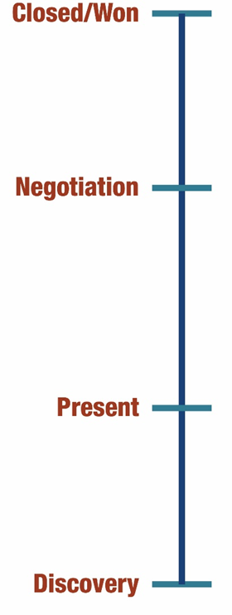

Slide 14
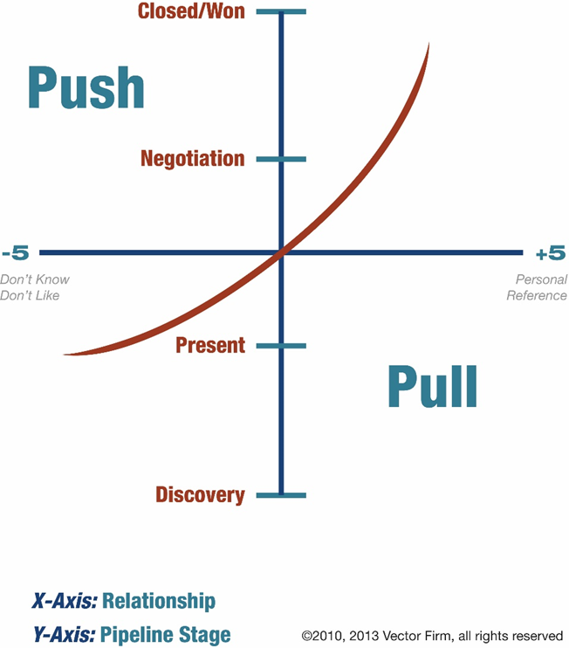

Slide 15
Intelligence

Slide 17
Prep Sheet Update

Slide 18
Staying Organized
Poll #2

Slide 19
Staying Organized
GOAL: Easy access to your intelligence

Slide 20
Staying Organized
Core Accounts
All Other Qualified Accounts

Slide 21
Staying Organized
Core Accounts
Qualified Accounts

Slide 22
Core Accounts
Core Account SIMPLE Strategy One-Pager

Slide 23
Staying Organized
Core Accounts
All Other Qualified Accounts

Slide 24
Qualified Account Management
CRM, Outlook, Excel, Shoebox, Manual Filing System?

Slide 25
Qualified Account Management
CRM, Outlook, Excel, Shoebox, Manual Filing System?

Slide 26
Qualified Account Management
CRM

Slide 27
Qualified Account Management
Manual Filing System

Slide 28
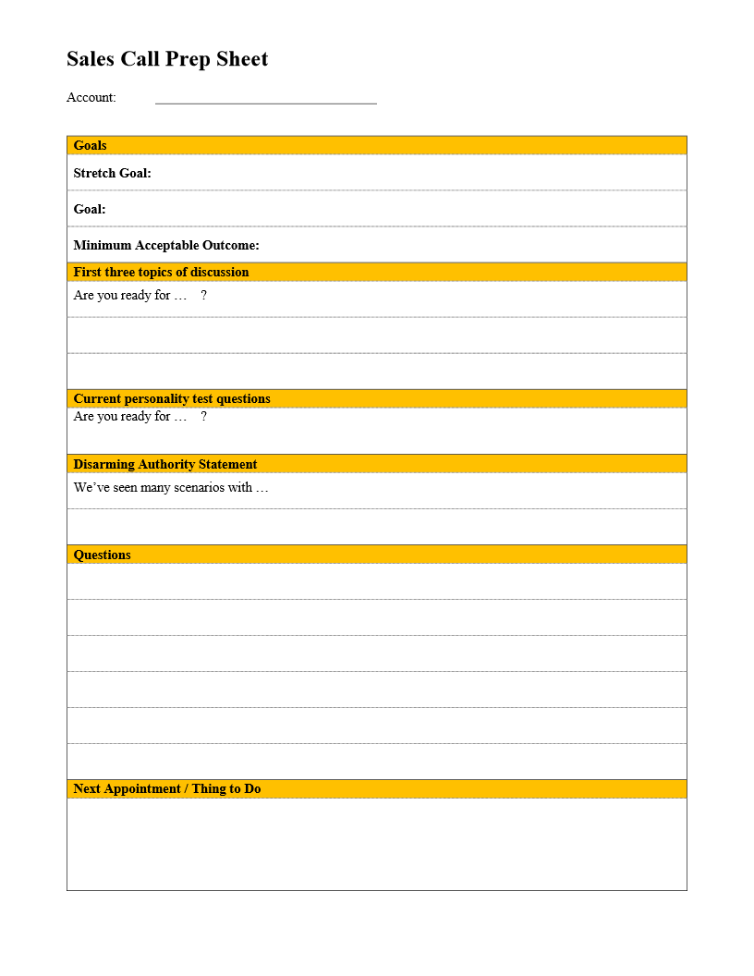
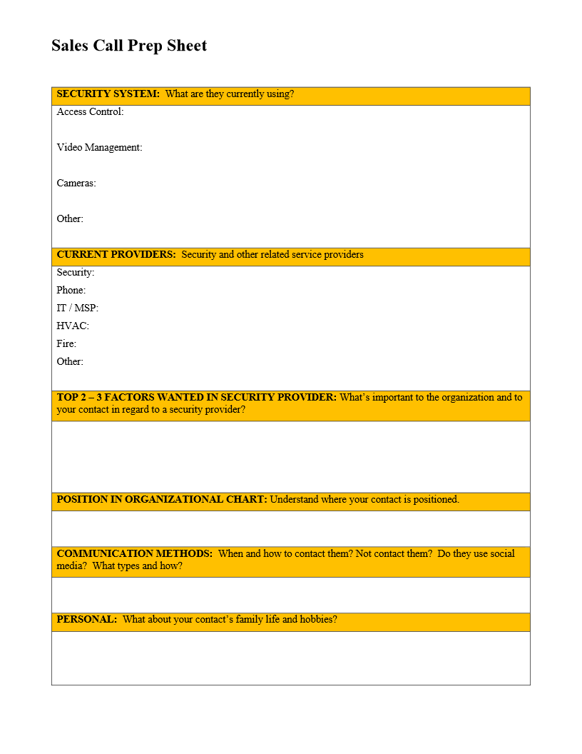
Old Fashioned File System

Slide 29
Old Fashioned File System

Slide 30
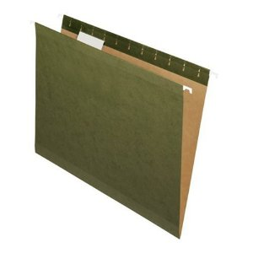
Old Fashioned File System
A
Adams Man.

Slide 31
Ongoing Nurturing Routine

Slide 32
Ongoing Nurturing
One of the major mistakes security sales people make …
We focus on opportunities and projects. We should be focusing on accounts and people.

Slide 33
Ongoing Nurturing Routine
Use your task tool – never miss a deadline
Schedule Personal Touches
Follow and support socially
Random texts / tweets / emails
Touch every six weeks

Slide 34
Elevate the Relationship to Partnership
Poll #3

Slide 35
Elevate the Relationship to Partnership
Ask for referral – specific referrals
Make your prospects your advisers
Quoting Process Revisions
Subcontractor Evaluations
Product / Technology Decisions
Sales Personnel

Slide 36
Time and Territory Management

Slide 37
Time and Territory Management
Design your Paper Route … and accept never getting it perfect
Anchor appointments drive planning
Daily Close-Out Routine
Schedule prospecting / nurturing time
Schedule debriefs after every meeting

Slide 38
Summary
Gather intelligence
Get and stay organized
Conduct your ongoing nurturing routine
Elevate your relationships
Manage your activities and own your time

Slide 39
Action Plan
Action Plan
Use the Prep Sheet in at least one meeting before next Friday.
Complete the One-Page Strategy Sheet for one Core Account.
If you don’t have one, decide on a system to stay organized (shoebox with index cards method is better than nothing).
Try one of the Elevate techniques.
Forum Work

Slide 40
Questions / Discussion Chris Peterson cpeterson@vectorfirm.com 321-439-3025

