Slide 1
Formula
Lately we’ve noticed “type of company” experiencing “customer / prospect relevant problem(s)”. We’ve been able to solve this problem at “success story customer” by “what we did”.
I’ll be in your area on “date”, and would like to “reason to meet”. We’ll be able to determine pretty quickly if your group could possibly benefit in the same way.
Can you meet on “date” at “time”?

Slide 2
Example
Lately we’ve noticed facilities with large perimeters spending a significant amount of their budget on guard services, and still have vulnerable areas on their fence lines. We’ve been able to solve this problem at Countryside Auto Yard by implanting our video analytics system, reducing their costs by 40%, while covering their entire perimeter surrounding 75 acres.
I’ll be in your area on April 28th, and would like to demo our video analytics system for you. We’ll be able to determine pretty quickly if your group could possibly benefit in the same way as Countryside has.
Can you meet on the 28th at 8:30?
BTW, I noticed on LinkedIn that you’re a UF grad. Congrats on the great basketball season!

Slide 3

Summary of Getting in the Door in 2017 & Beyond
Focus only on Targeted Accounts.
Invest more time on less touches – get deeper on each touch.
Give them a real reason to meet with you.
Research and tailor each message – no more throwing mud against the wall.

Slide 4

Exercises
Define three Reasons to Meet on the worksheet.
Build out the corresponding cells for one of the Reasons, and create messaging to get in the door for that one.

Slide 5
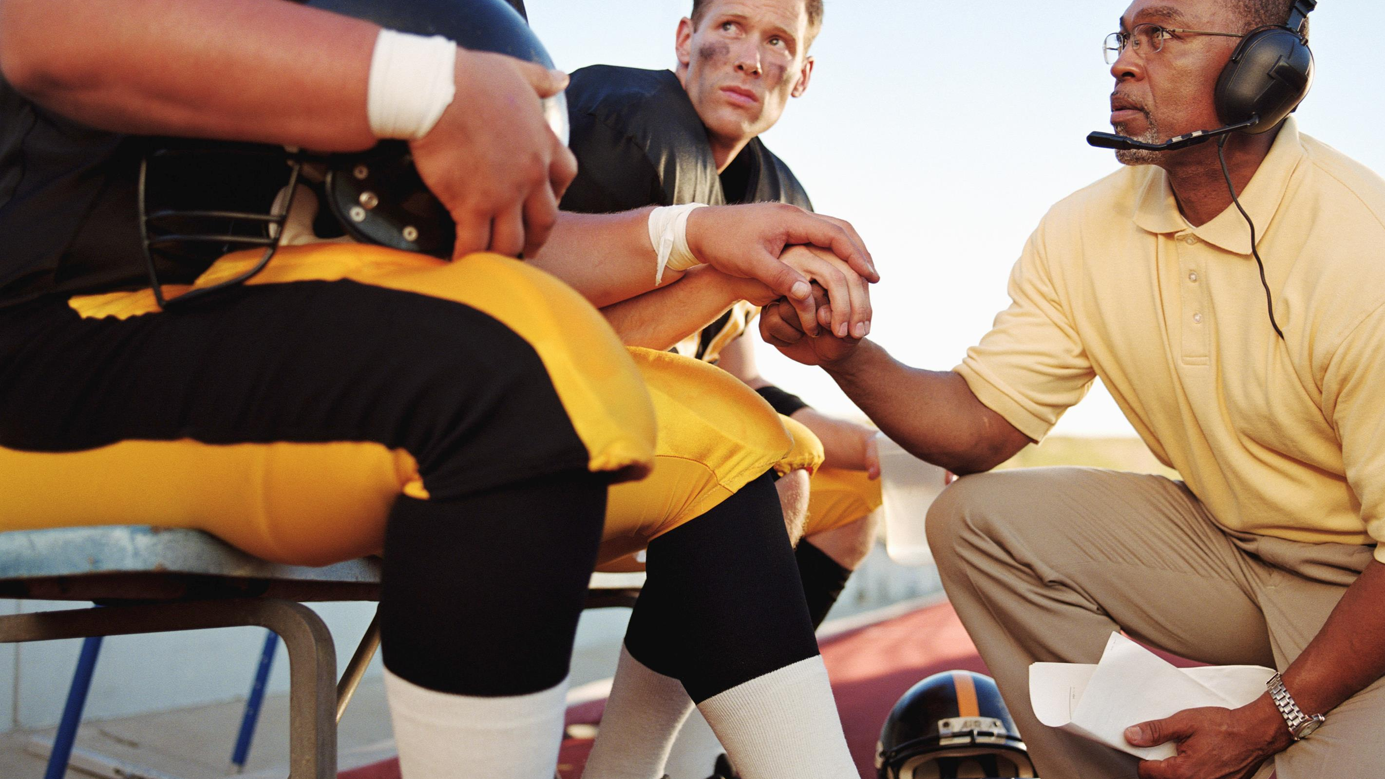
Sales Leaders
Do the exercises as a team.
Make sure you can support the Reasons to Meet.
Build your ideal client descriptors.

