Slide 1


Winning New Business
Specifically Tailored for:
Session #11: Finding Unknown Problems
August 16th, 2016

Slide 2
Why?

Slide 3
Before 1990: Sell benefits, not features

Slide 4
1990s: Sell solutions, not benefits

Slide 5
Today: Selling solutions is a commodity

Slide 6
Our Customers’ Environment Today
Internal Turf Wars
Access to Endless Information
Committee Decisions

Slide 7
Our Customers’ Environment Today
Internal Turf Wars
Access to Endless Information
Committee Decisions

Slide 8
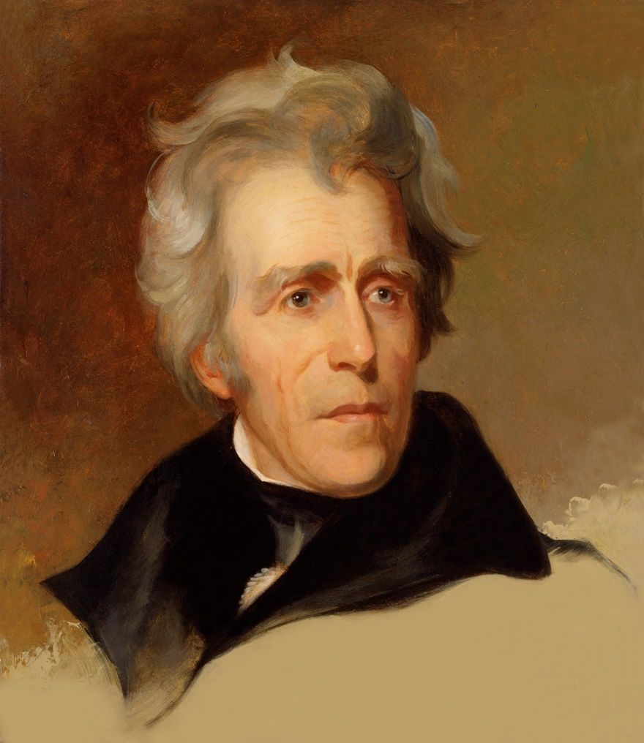
Who was Andrew Jackson’s first Vice President?

Slide 9

What Do You Do?
You have to become Google

Slide 10
Google this: “Find my specific problem.”

Slide 11
Google this: “Find my specific problem.”

Slide 12
Google this: “Find my specific problem.”

Slide 13
Google this: “Find my specific problem.”

Slide 14
Back to our question … Why?

Slide 15
Finding unknown problems will make you more useful to your customers than Google.

Slide 16
Our Customers’ Environment Today
Internal Turf Wars
Access to Endless Information
Committee Decisions

Slide 17
When We Become Problem Finders
Internal Turf Wars
Rely on you as their personal trusted advisor
Committee Decisions

Slide 18
When We Become Problem Finders
Internal Turf Wars
Rely on you as their personal trusted advisor
Committee rubber stamps

Slide 19
When We Become Problem Finders
Admiration from other departments
Rely on you as their personal trusted advisor
Committee rubber stamps

Slide 20

Agenda
Understand Problems You Solve
Identify Customers’ Problems
Connecting the Dots
Action Items

Slide 21
Understanding Problems You Solve

Slide 22

What’s the Problem?
Customer Negative Outcome | Problem You Solve
Internal Theft / Shrinkage | $300k per year potential Network potential Notoriety and exposure is high
Paying too much overtime to the IT department | $100k per year potential Property Managers that can refer Help with referrals
Long lines in the lobby of a multi-tenant commercial high rise

Slide 23
What’s the Problem?
Customer Negative Outcome | Problem You Solve
Internal Theft / Shrinkage | Terrible culture Poor key management system Bad hiring practices
Paying too much overtime to the IT department | Unorganized IT Manager Unpredictable labor requirements for the IT staff Compensation rates too high
Long lines in the lobby of a multi-tenant commercial high rise | Inefficient visitor management process Lobby guards slow Only one kiosk

Slide 24
Where do we start?

Slide 25
Start with the problems that you solve.

Slide 26
What’s the Problem?
Customer Negative Outcome | Problem You Solve
Internal Theft / Shrinkage | Terrible culture Poor key management system Bad hiring practices
Paying too much overtime to the IT department | Unorganized IT Manager Unpredictable labor requirements for the IT staff Compensation rates too high
Long lines in the lobby of a multi-tenant commercial high rise | Inefficient visitor management process Lobby guards slow Only one kiosk

Slide 27


Slide 28

Unique Problems that KST Solves
Problem 1 | Don’t’ have the funding to afford proper security system – capital budget too low.
Problem 2 | Messy environment / poor, sloppy work and performance by incumbent.
Problem 3 | Overworked and understaffed IT departments, or no IT resources.
Problem 4
Problem 5

Slide 29
Identify Customers’ Problems

Slide 30
Negative Outcome

Slide 31
Problem
Negative Outcome

Slide 32
Clues
Problem
Negative Outcome

Slide 33
Clues
Problem
Negative Outcome

Slide 34

How Do We Identify the Problems?
Present / demonstrate your solutions.
Look for clues.
Offer free assessments of negative outcomes.

Slide 35
How Do We Identify the Problems?
Present / demonstrate your solutions.
Look for clues.
Offer free assessments of negative outcomes.

Slide 36
Goal of Presenting / Demonstrating Solution
I didn’t realize how deep you got into loss prevention. We have a real shrinkage issue and our problem could be key management.

Slide 37
POLL

Slide 38

Present / Demonstrate Solutions
Share relevant case studies
List your ideal customers
Look for clues.
Offer free assessments of negative outcomes.

Slide 39
Present / Demonstrate Solutions
Share relevant case studies
List your ideal customers
Look for clues.
Offer free assessments of negative outcomes.

Slide 40
Our ideal customers…
Have sensitive equipment, firearms, or vehicles that can be checked out by certain personnel.
Key management system doesn’t have a comprehensive or electronic auditing system.
Experiencing large shrinkage and can’t identify the issue.
Several departments and managers per site.

Slide 41
Present / Demonstrate Solutions
Share relevant case studies
List your ideal customers
Illustrate your competence and solutions before expecting their transparency
Let them know your process
  Show you our solution
  Learn more detail about your scenario
  Determine if we can help you

Slide 42
Present / Demonstrate Solutions
Share relevant case studies
List your ideal customers
Illustrate your competence and solutions before expecting their transparency
Let them know your process
  Show you our solution
  Learn more detail about your scenario
  Determine if we can help you

Slide 43
How Do We Identify the Problems?
Present / demonstrate your solutions.
Look for clues.
Offer free assessments of negative outcomes.

Slide 44
Goal of Looking for Clues
I’ve got another email from legal. They won’t leave me alone about our policies of managing access to our vehicles.

Slide 45
Remember this Slide?
Solution | Problems | Clues
Key Management System | Expenses associated with guard services Lack of coverage or quality of services of guards | Comment about guards costing too much Presence of a lot of guards Large perimeter Sarcastic comment by anyone about the guards

Slide 46
Remember this Slide?
Solution | Problems | Clues
Key Management System | Loss of assets Uncertified people driving company vehicles | Comment about guards costing too much Presence of a lot of guards Large perimeter Sarcastic comment by anyone about the guards

Slide 47
Remember this Slide?
Solution | Problems | Clues
Key Management System | Loss of assets Uncertified people driving company vehicles | Comment from facilities or security about being required to write new policies regarding vehicles or other sensitive assets. Mention of internal shrinkage. Sarcastic comment by anyone about access to sensitive assets.

Slide 48
How Do We Identify the Problems?
Present / demonstrate your solutions.
Look for clues.
Offer free assessments of negative outcomes.

Slide 49
Goal of Free Assessments
I appreciate you taking time to look deeper into our shrinkage. Is there anything we can do, or do we just have a bad culture?

Slide 50
Connecting the Dots

Slide 51
I found an unknown problem. Now what?

Slide 52
Connecting the Dots
Two steps to gaining permission to offer a solution…
  Give your customer the chance to deny the problem.
  1.1 Pause
  Ask for a small commitment to moving forward.

Slide 53
Connecting the Dots after Presentation
I didn’t realize how deep you got into loss prevention. We have a real shrinkage issue and our problem could be key management.
1. We’re finding that more and more companies with shrinkage issues fix much of their issue by implementing a more sophisticated key management system.
PAUSE
2. This might be a perfect time to take a closer look at our new key management system with an electronic auditing system. Would it make sense to do an initial demo to see if the technology is even suitable?

Slide 54
Connecting the Dots after Finding a Clue
I’ve got another email from legal. They won’t leave me alone about our policies of managing access to our vehicles.
1. It seems that you’re having a lot of issues with these vehicles. We’ve been working with other groups like yours and are discovering that real problem is their key management system.
PAUSE
2. This might be a perfect time to take a closer look at our new key management system with an electronic auditing system.

Slide 55
Connecting the Dots after Assessment
I appreciate you taking time to look deeper into our shrinkage. Is there anything we can do, or do we just have a bad culture?
1. It seems that much of the issues you’re having with shrinkage are a result of a poor key management system.
PAUSE
2. This might be a perfect time to take a closer look at our new key management system with an electronic auditing system. Would it make sense to bring in our partner for an initial demo to see if the technology is even suitable?

Slide 56
Connecting the Dots
Two steps to gaining permission to offer a solution…
  Give your customer the chance to deny the problem.
  1.1 Pause
  Ask for a small commitment to moving forward.

Slide 57
Action Plan

Slide 58

Action Plan
Identify three to five unique problems solved by your company.
Schedule a Vision Meeting
Begin a Service Audit Process
Present the “New” Maintenance Benefits
Exercise in LinkedIn Group
Build your Contact Strategy for 5 accounts
Build your Top 3 Contacts

Slide 59
Unique Problems that Your Company Solves
Problem 1
Problem 2
Problem 3
Problem 4
Problem 5

Slide 60
POLL

Slide 61
Action Plan
Identify three to five unique problems solved by your company.
Sales Leaders: Hold your team accountable to this exercise.
One more survey – Specific Topics for Year #2
Schedule a Vision Meeting
Begin a Service Audit Process
Present the “New” Maintenance Benefits
Exercise in LinkedIn Group
Build your Contact Strategy for 5 accounts
Build your Top 3 Contacts

Slide 62
Action Plan
Identify three to five unique problems solved by your company.
Sales Leaders: Hold your team accountable to this exercise.
One more survey in the next week or two – Specific Topics for Year #2
Schedule a Vision Meeting
Begin a Service Audit Process
Present the “New” Maintenance Benefits
Exercise in LinkedIn Group
Build your Contact Strategy for 5 accounts
Build your Top 3 Contacts

Slide 63

Questions / Discussion
Chris Peterson cpeterson@vectorfirm.com
321-439-3025

