Slide 1
Winning New Business Specifically Tailored for: Session #3: Engagement in the First Meeting December 15, 2015

Slide 2
POLL #1

Slide 6
Engagement in the First Meeting
Make the First Pitch a Strike
Understand Their Current Personality
Use Disarming Authority
Depart with Confidence
Tool to Manage
SNAPP Poll Questions and Exercises

Slide 7
What We Don’t Do
“Mission statement, blah blah blah”
“Our service and technology is the best in the universe, blah blah blah”

Slide 8
Strategy #1: Make the First Pitch a Strike

Slide 9
Strategy #1: Make the First Pitch a Strike
POLL #2

Slide 10
Define the Outcome
Stretch Goal
Goal
Acceptable Next Step

Slide 11
Define the Outcome
Stretch Goal: Agrees to visit a reference customer and offers to give you last look.
Goal: Invited to perform a personal walk-through before building a proposal.
Acceptable Next Step: Agrees to include you in the RFP.

Slide 12
Initial 15 Plays

Slide 13
Initial 3 Icebreakers

Slide 14
Transition (if necessary)
“I can talk about scuba diving all day, but I think you have a hard stop at 10:30.”

Slide 15
Strategy #2: Understand Their Current Personality

Slide 16
Understand Their Current Personality

Slide 17
Understand Their Current Personality
How?

Slide 18
Understand Their Current Personality
One simple question…

Slide 19
Understand Their Current Personality
Are you ready for…?

Slide 20
Same Sales Call
Different Approach
Task Oriented
Socializer
Get to the point
Ask about personal info
Let them know the end time before you start
Provide data
Ask them for the best way to follow-up
Five-minute warning and on time
Transparent personally
Compliment their people
Let them talk
Let stories sell for you
Data as a leave-behind

Slide 21
Strategy #3: Disarm with Authority

Slide 22
“blah, blah, blah… our service is awesome!”
Bad Sales Person

Slide 23
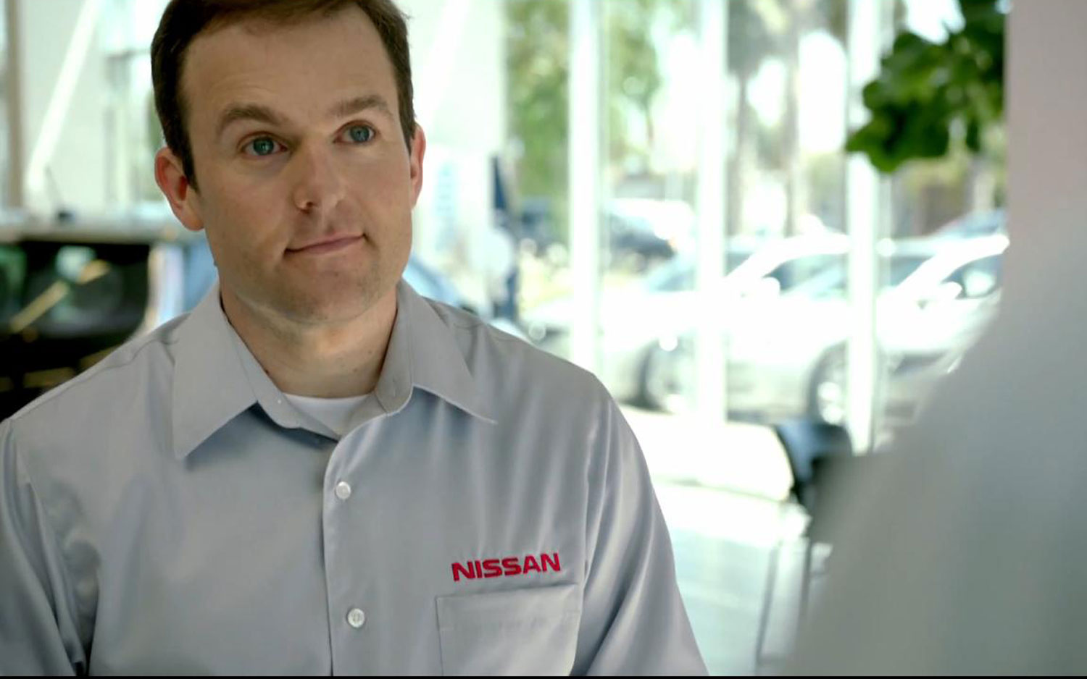
“What keeps you awake at night?”
Average Sales Person

Slide 24
“Wow, she knows my business.”
Great Sales Professional

Slide 25
Framework
“We’ve seen many scenarios of companies like yours in which ...”
“We’ve been able to solve this problem by ... I’d like to ask a few questions to find out if our solution would be a potential fit for you.”
… and you’re off…

Slide 26
Framework
“We’ve seen many scenarios of companies like yours in which you need an update to your access control system but your SSA has been expired for years and updating it is more expensive than a new system.”
“We’ve been able to solve this problem by offering a hosted system that gets you up and running without ripping out your current infrastructure. I’d like to ask a few questions to find out if our solution would be a potential fit for you.”
… and you’re off…

Slide 27
Strategy #4: Depart with Confidence

Slide 28
Not This
“What do you think?”
“Have you seen our competition?”
“What do we need to do to get you in this beauty today?”

Slide 29
Depart with Confidence
Framework
“I’ve gotta run.”
“Before I go, are you ok with this follow-up plan? I’ll send the invite later.”
“BTW, next meeting we need to schedule more time so I can hear more about your vacation.”
Shake hands, leave, and say good-bye to the receptionist.

Slide 30
“Great, but when am I going to do this?”
Prep Sheet Example

Slide 31
Summary
Fully prepared
First pitch a strike
Spoke their language
Disarmed them with your competent authority
Achieved you goal
Left like the Fonz leaving Arnold’s

Slide 32
SNAPP Poll Questions and Instructions

Slide 33
Action Items & Exercises
Action Items
Use SNAPP.
Download the Preparation Worksheet from SNAPP and use it.
Use the “Are you ready for…” on someone today
Report back on your experience with both.

Slide 34
Questions / Discussion Chris Peterson cpeterson@vectorfirm.com 321-439-3025

