Slide 1
Winning New Business Specifically Tailored for: Session #15: Delivering the Best Sales Presentations in Your Marketplace January 17th, 2016

Slide 2
What’s on your mind right now?

Slide 3
Riddle and Contest
Pick any number between 1 and 10
Multiply that number by 2
Add 8 to your new number
Cut your current number in half
Subtract your original number
1 – 26?

Slide 4
Riddle and Contest
1 2 3 4 5 6 7 8 9
A B C D E F G H I
10 11 12 13 14 15 16 17
J K L M N O P Q
18 19 20 21 22 23 24 25 26
R S T U V W X Y Z

Slide 5
Who got it right?

Slide 6
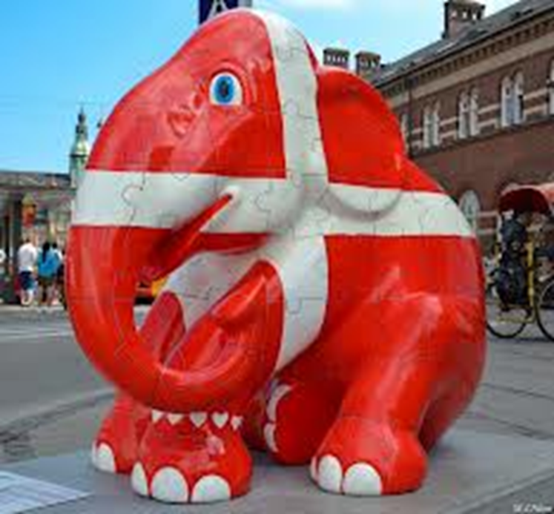

Slide 7
What’s on your mind now?

Slide 8
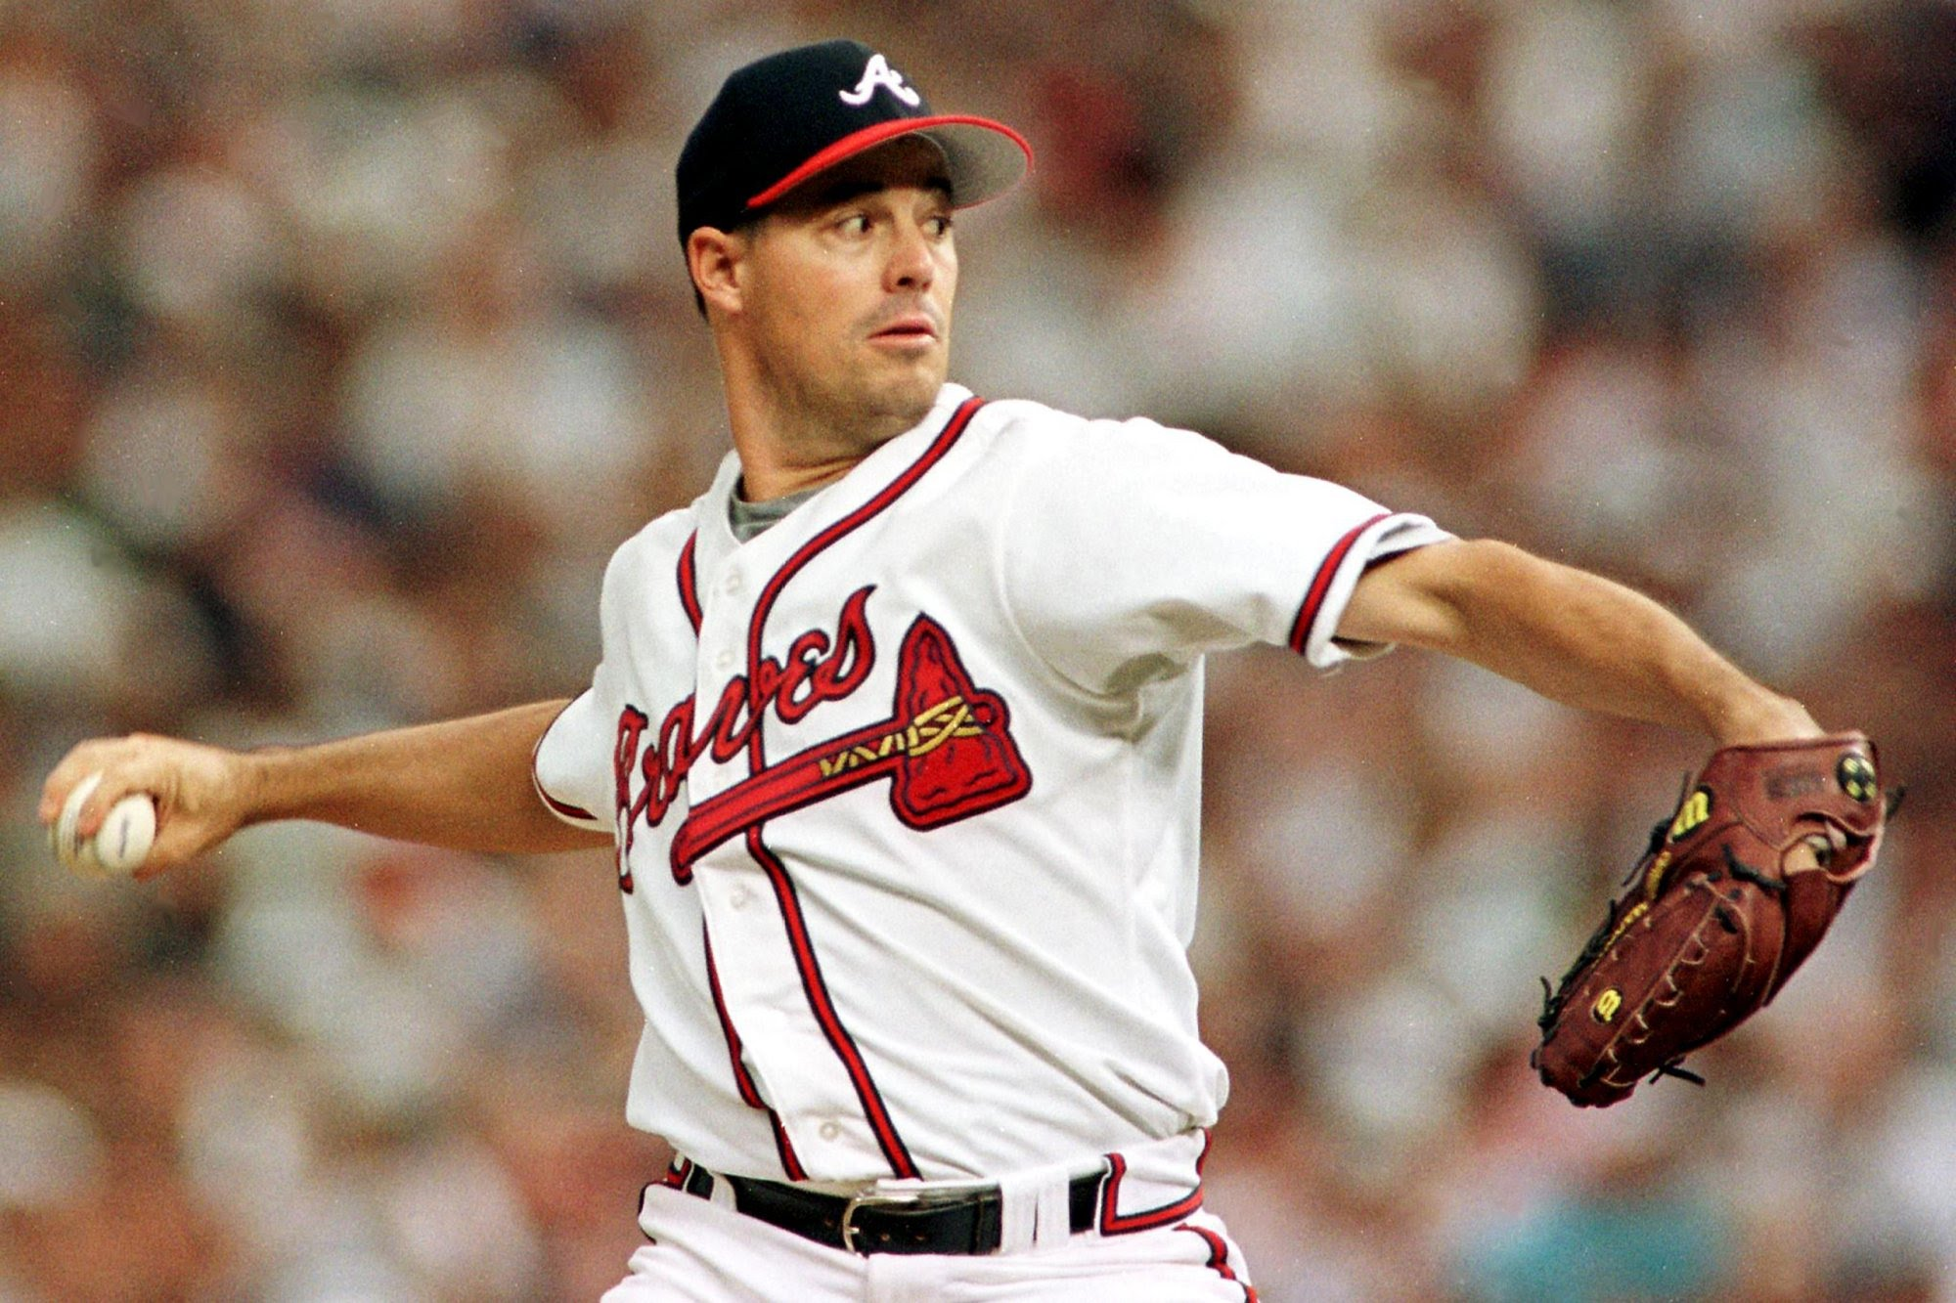

Slide 9
Objective of Sales Presentation:
Influence our customers that our solutions are worth more than the money we're charging, and better than our competition's proposal.

Slide 10
Objective of Sales Presentation:
Influence our customers that our solutions are worth more than the money we're charging, and… better than our competition's proposal.

Slide 11
Objective of Sales Presentation:
Influence our customers that our solutions are worth more than the money we're charging, and better than our competitions’.

Slide 12
Poll

Slide 13
In the hundreds of lost opportunities that I’ve diagnosed, what % have been blamed on getting beat in the presentation?

Slide 14
Secret:
The greatest opportunity you have to win business is to deliver killer sales presentations.

Slide 15
The Real Secret:
No one is very good.

Slide 16
The Real Secret:
No one is very good.

Slide 17
Huge Opportunity

Slide 18
Agenda
Preparation
Opening
Body
Closing and Follow-up
Other Ideas & Tips

Slide 19
Preparation
Objective: Create minor curiosity, and ensure their minimal preparation.

Slide 20
Preparation
Interview as many key people as possible.
Finish all preparation one week ahead of time.
One to three days before:
Send glossary of terms.
Send survey with a survey tool… and let them know there will be only one reminder.
Connect on LinkedIn

Slide 21
Opening
Objective: Shift their attention away from the thing they were thinking about when they arrived.

Slide 22
Poll

Slide 23
What were you thinking about when we started? What did you write down?

Slide 24
Opening
It’s all about the middleware.

Slide 25
Opening

Slide 26
Opening
Use a quiz, riddle, or some type of simple poll.
Tell a story that is relevant.
Don’t use PowerPoint / Prezi, etc. during the opening.
Walk them out of the conference room for a quick tour.
Show the survey results.

Slide 27
Body
Objective: Illustrate your value and create individual bias.

Slide 28
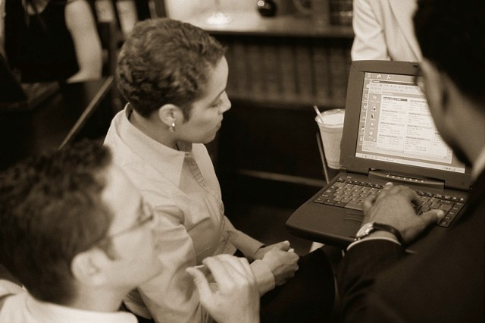
Body
Tell ‘em what you’re gonna tell ‘em.
Tell ‘em.
Tell ‘em what you told ‘em.

Slide 29
Tell ‘em what you’re gonna tell ‘em.
I’m going to share three benefits of our service agreement that I believe are relevant to your specific scenario…
Zero Hassle
Predictable Expense
Extended Life of Equipment

Slide 30
Tell ‘em
Benefit
Relevant Story
Tailored Benefit
Individual Bias

Slide 31
Tell ‘em
Benefit
Relevant Story
Tailored Benefit
Individual Bias

Slide 32
Tell ‘em
Benefit
Relevant Story
Tailored Benefit
Individual Bias

Slide 33
Tell ‘em
Benefit
Relevant Story
Tailored Benefit
Individual Bias

Slide 34
Individual Bias
“Jane, you know much more about this area of your business than I do. What are your thoughts?”

Slide 35
Individual Bias
One benefit at a time, you gain a bias from each key individual that is influential in the committee decision.

Slide 36
Individual Bias
“Jane, you know much more about this area of your business than I do. What are your thoughts?”

Slide 37
Example: Service Plan Zero Hassle
Zero Hassle
Downtown Healthcare
Your Process
CFO

Slide 38
Tell ‘em what you’ve told ‘em.
I’ve got three Amazon gift cards for anyone that can name one benefit…
… Thank you for helping. In summary, and if you remember anything, please remember these three benefits…
Zero Hassle
Predictable Expense
Extended Life of Equipment

Slide 39
Closing and Follow-up
Objective: “Wow … now that’s a professional.”

Slide 40
Closing and Follow-up
10-minute warning alarm.
Agree on action items on a public written forum.
Do NOT ask for feedback.
Get out of there.
“I’ve gotta run.”
“Before I go, are all of you ok with our action plan?”
Say personal good-bye to everyone possible.
Get in car and drive away.
Summary email(s) the next morning before 8:00.

Slide 41
Other Ideas & Tips

Slide 42
Other Ideas & Tips
Pause … a lot.
Be very comfortable with the opening – practice twice as much as the rest… and don’t start with a joke.
Use relevant stories.
Data is a leave-behind.
Take the hard technical questions offline – and let the group know it.

Slide 43
Action Items
Build your preparation kit.
Create a few pieces of middleware to shift your audience’s attention.
Join a professional-style Toastmasters club.

Slide 44
Sales Leaders Action Items
Practice and evaluate.
Work with your team during their preparation phase.
Encourage everyone to join a professional-type Toastmasters club.

Slide 45
Questions / Discussion Chris Peterson cpeterson@vectorfirm.com 321-439-3025

