Slide 1
Winning New Business Specifically Tailored for: Session #12: Managing Sales Obstacles

Slide 2
Agenda
Managing Sales Obstacles
Dead Silence
DIY Guy
Networking Slow
Wasting Time on Unqualified Activity
Wrong Person Possessing Your Time
Discouragement
Action Items & Exercises

Slide 3
Action Items & Exercises
Action Items
Take one idea and run with it
Know your Normandy – create and work a process that is focused on useful activity and targeted prospects
List five positive people and have them in your back pocket

Slide 4
Managing Early Obstacles

Slide 5
Dead Silence
Translation
Solution
I might be interested, but you haven’t compelled me to take action… yet
Either make it more convenient, or provide a reason for them to take action.

Slide 6
Dead Silence
Try different contact methods and times
Combine methods in same day
Engage your manufacturer teams
Ask for a meeting in three to four weeks
Breakup with them

Slide 7
Break-Up Email
Hi Michelle.
I know you’re busy and I don’t want to keep filling your inbox. If I don’t hear from you, this will be my last email.
I’m still very interested in meeting with you, so please let me know if it would be better to connect with you in 90 days or so.
Looking forward to hearing from you.
Chris

Slide 8
DIY Guy
Translation
Solution
I don’t understand why I’d pay you when I’m already paying my IT / facilities / security people.
Educate and let them draw their own conclusion. The DIY Guy is proud, and will only listen to their inner self.

Slide 9
Poll Question

Slide 10
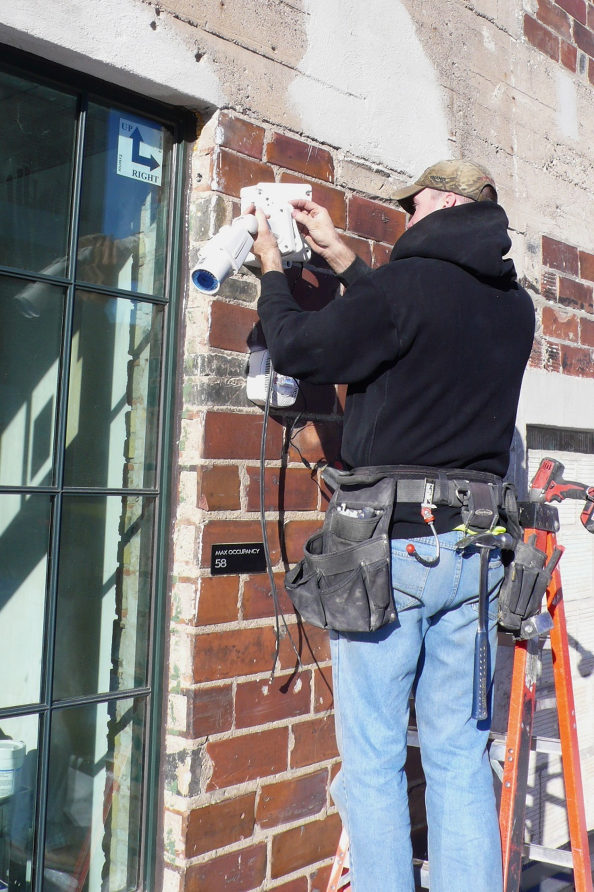
DIY Guy

Slide 11
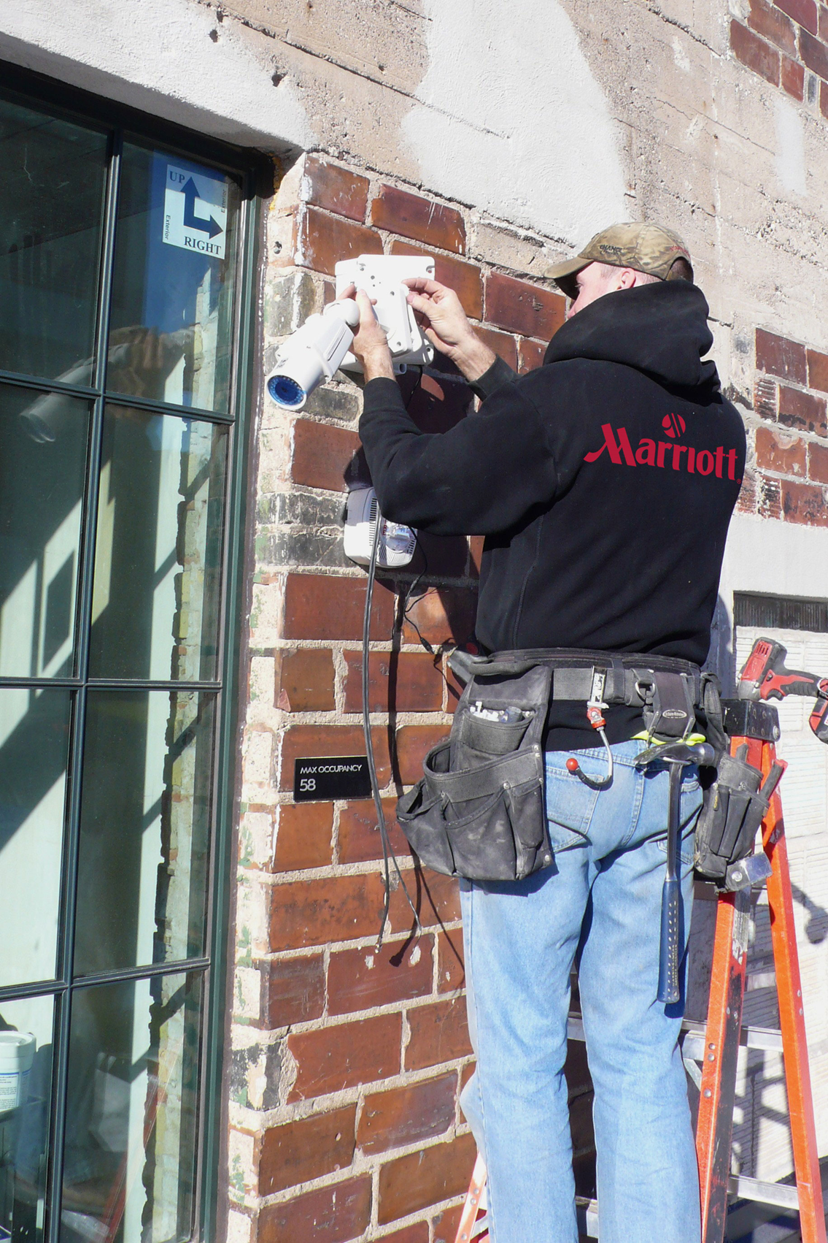
DIY Guy
Be open and analyze:
“Sometimes DIY makes sense. You’ve got a unique scenario – what are your thoughts?”
If possible, teach when there is NOT a project
Illustrate value of them focusing on their work
If you lose, follow-up in 30 – 45 days
Do not say “you get what you pay for”

Slide 12
Networking Slow
Translation
Solution
We don’t know or trust you enough to share our leads with you.
Before giving up, build trust in your current groups.

Slide 13
Networking Slow
Give five times before expecting to receive
Take on leadership role
Volunteer to speak, and have a section called: “how I can help you”
Take one person to lunch from your organizations per week
Ask others for feedback on the organizations

Slide 14
Wasting Time on Unqualified Activity
Translation
Solution
I’ll do anything. I’m just a sales person and can’t say no. What do you need?
and say no.

Slide 15
Wasting Time on Unqualified Activity
Translation
Solution
There is improvement to be made in our internal processes.
Focus, and say no.

Slide 16
Wasting Time on Unqualified Activity
Translation
Solution
There is improvement to be made in our internal processes.
Focus, say no, , and say no.

Slide 17
Wasting Time on Unqualified Activity
Translation
Solution
There is improvement to be made in our internal processes.
Focus, say no, and be part of the solution.y no.

Slide 18
The average amount of wasted time by sales people is 14 hours per week. *

Slide 19
The average amount of wasted time by sales people is 14 hours per week. *
* Calculated from four recent Vector Firm projects.

Slide 20
Generate unqualified quotes
Making cold calls that are not qualified because “you never know”.
Tracking down accounts receivable
Keep customer in the loop after orders have been processed.
Take incoming leads that end up being unqualified.
Work on very small quotes, following the same process as large ones.
Work on service issues with clients.
Check up on projects that are being handled by operations.

Slide 21
Poll Question

Slide 22
Wasting Time on Unqualified Activity
Know your Normandy
At times, “you never know” can be the three worst words in selling
Tell prospects: “I don’t know yet if we’d be a good fit for you. Can I ask a few more questions?”
Build a bridge with your install and service teams.

Slide 23
Wrong Person Possessing Your Time
Translation
Solution
I don’t want others meeting with you because it’ll take away the power I have … however false it is.
Creatively get in front of the right people … but don’t burn the bridge.

Slide 24
The #1 factor in making vendor selections in the post-internet age is…
… agreement amongst everyone involved. *Sales Executive Council

Slide 25
Wrong Person Possessing Your Time
Find out who you need to meet
Offer a lunch & learn w/ your specialist from out of town... and let your POC produce it
Ask your manufacturer partners to help you
Ask your network to help you
Always keep POC in the loop

Slide 26
Discouragement
Translation
Solution
I’m not getting the results I expect for the work I’ve been doing.
Develop proactive techniques and discipline to stay positive.

Slide 27
Discouragement
Have a process and work it … and trust it
Measure, measure, measure
Write down everything positive that happens each day - everything
List five positive people, and have them on speed dial
Talk with your boss or your coach regularly
Get away and strategize

Slide 28
Social Media Activity not Working
Translation
Solution
I haven’t built rapport or credibility with my virtual network.
Stay persistent, consistent, and get more creative.

Slide 29
Social Media Activity Not Working
Stay persistent and consistent
Review our plan from Session 2
Move your daily review to different time of day
Try an additional outlet
Identify someone who is doing it well and take them to lunch

Slide 30
Avoiding Early Obstacles

Slide 31
Anticipate everyday
Always bring specific value
Use your network
Stay positive, no matter what
How Can I Avoid Early Obstacles?
Notes:
Tim ask for opening social topics from people randomly
Elevat

Slide 32
Action Items & Exercises
Action Items
Take one idea and run with it
Join in the discussions on the Security Net Sales Training blog

Slide 33
Questions / Discussion Chris Peterson cpeterson@vectorfirm.com 321-439-3025

