Slide 1
Sales Training Session #22: Cheap Stuff
Competing Against It, and Selling It
September 19th, 2017

Slide 3
Agenda
Competing Against ‘Em
Don’ts
Dos
Selling ‘Em
Action Plan

Slide 4
Poll Question

Slide 5
How frequently do you compete against low-cost, cheap products?

Slide 6
Competing Against ‘Em

Slide 7
What NOT To Do

Slide 10
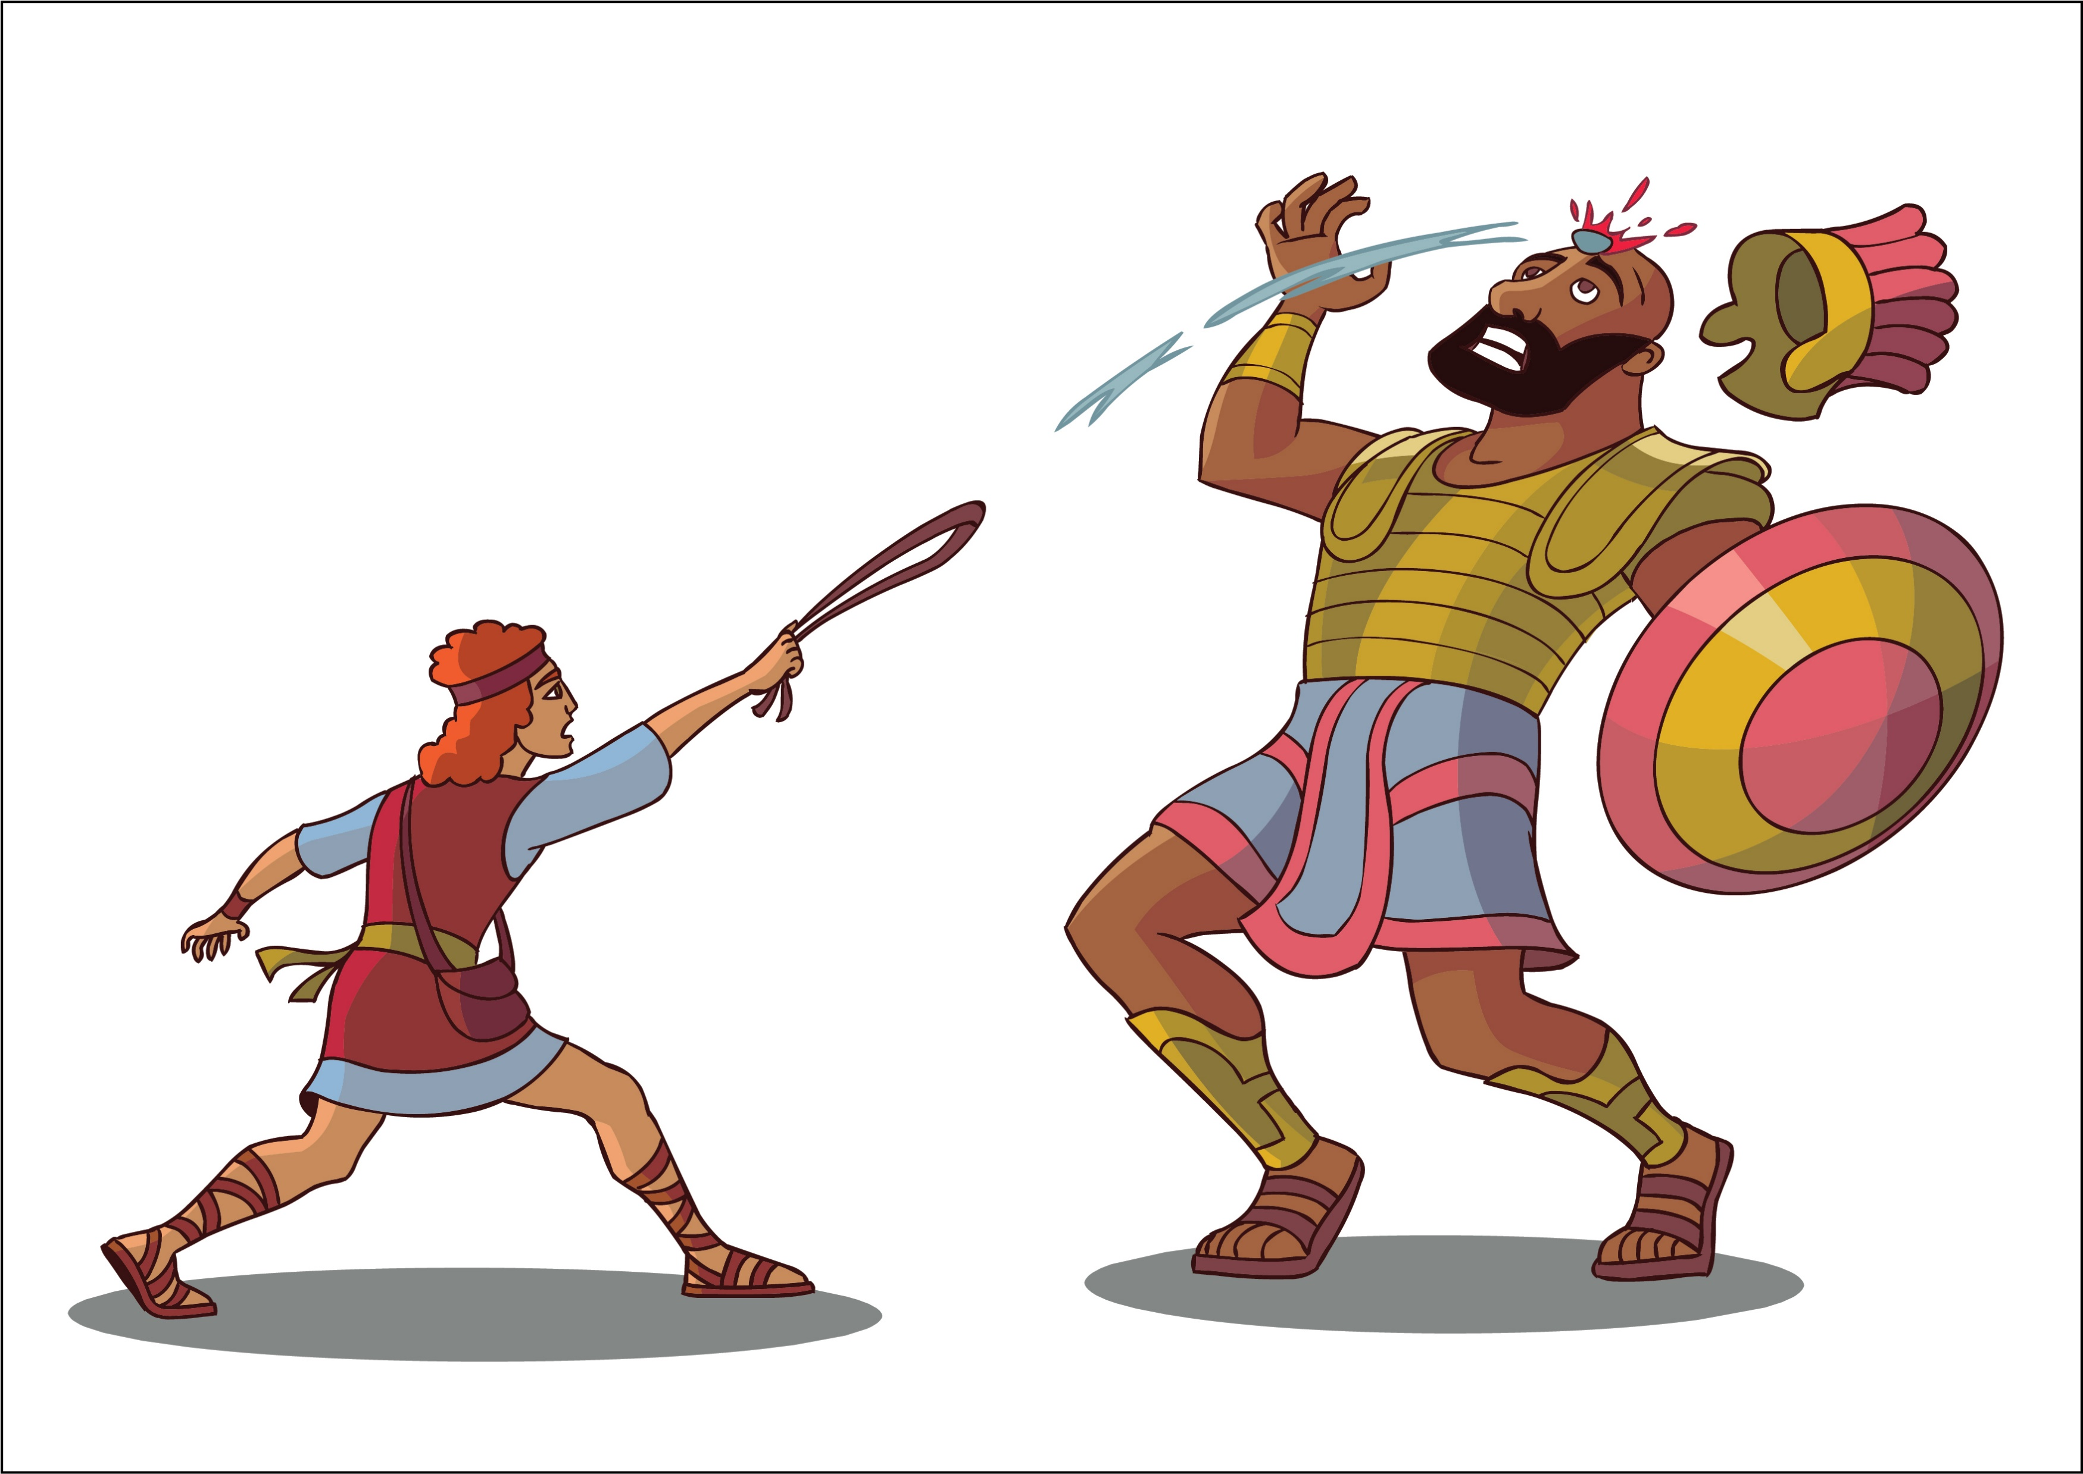
Don’t underestimate their performance

Slide 11
Don’t jump into a TCO / ROI debate

Slide 12
Don’t tell your customer how much better your product is.

Slide 13
Show it … and zip it

Slide 14
Don’t say “You get what you pay for”

Slide 15
Competing Against ‘Em

Slide 16
What to Do

Slide 17
Let them know that you’re going to be more expensive.

Slide 18
Know Your Differentiators

Slide 19
Know Your Differentiators
Quality Control
Warranty
You
After installation and long-term service / maintenance
Vertical market knowledge
Application-specific and solution
Technical training
Exercise
Let’s list some differentiators between your products / services and the less expensive ones we’re addressing.

Slide 20
Make it Personal

Slide 23
Personal Outcomes
Job Security
Job Opportunity
Working Environment
Less Stress
Termination
Lay-Off
Demotion
Pay Decrease
Promotion
Raise
Endorsement / Praise
Improvement in Performance
Less Hours
Cooler Toys
Avoid Jerks or Confrontation

Slide 24
Example, using the most important differentiator…

Slide 25
You
Explain exactly how you work with your clients.
Don’t use adjectives describing you – tell them what you do.
Use personal references from clients.
Ask personal outcome questions that matter to them – not the organization.

Slide 26
Key Takeaway
Ask these questions and present these differentiators on their own merit … don’t do it in response to the cheap stuff.

Slide 27
Have others Share Horror Stories
What did I do?

Slide 28
What if you lose…

Slide 29
If you lose…
Act Gracious.
“If you have any issues with this system, call me - we’ll jump on it for you.”
Stop by in 30 – 45 days.
Continue to pursue them.
This is one of the benefits of not being a jerk during the sale cycle.

Slide 30
How to Sell ‘Em

Slide 31
Poll Question

Slide 32
Are you considering or currently working with a manufacturer that is considered “low-cost”?

Slide 33
Objective: “I’ll be ok if I buy these products.”

Slide 34
Tips for Selling Inexpensive Products
Offer to demonstrate product
Provide testimonials and case studies
Explain the support structure
Prepare them for the fear tactics

Slide 35
Action Plan

Slide 36
Action Plan
Name three specific differentiators between you and your top low cost competitors.
Make sure they’re true, relevant, and objective.

Slide 37
Questions and Discussion
Chris Peterson
cpeterson@vectorfirm.com

