Slide 1
Winning New Business Specifically Tailored for: Session #5: Becoming the Perceived Expert February 16, 2016

Slide 2
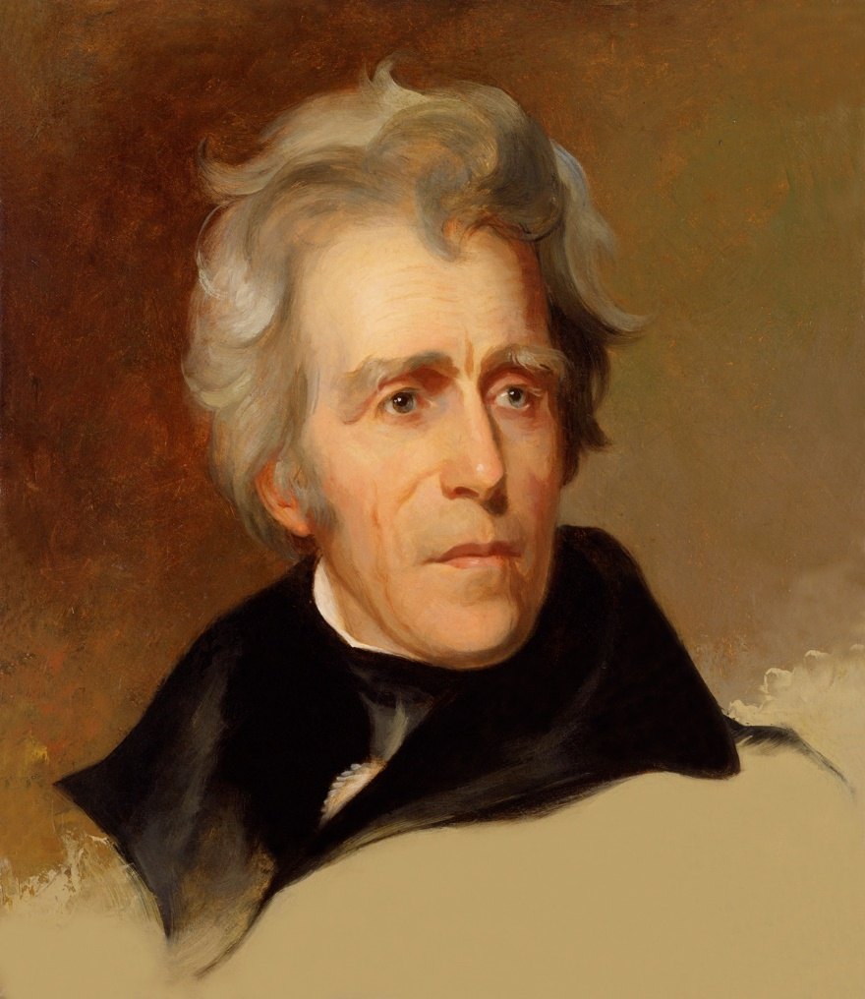
Who was Andrew Jackson’s Vice President during his second term?

Slide 3
By providing free information to the public, the internet has dramatically shrunk the gap between the experts and the consumers.
Stephen Levitt, Stephen Dubner Freakonomics

Slide 4
Tale of Two Eras
Sales Cycle: 2000 vs. 2016
6
Five companies called to evaluate systems
5
Contacts three providers, asking for pricing for his solution
Reduced it to three and asked for proposals
4
3
Reduced it to two
The winner stayed on as their trusted provider moving forward
# of Competitors
2000
One provider selected, based on price
2016
2
The winner decided, based on many factors
The customer
does research online, asking peers, & reviewing blogs
Move on with zero trusted providers - they don’t need you.
1
0
0
15
30
45
60
75
90
105
120
Time Frame (Days)

Slide 5
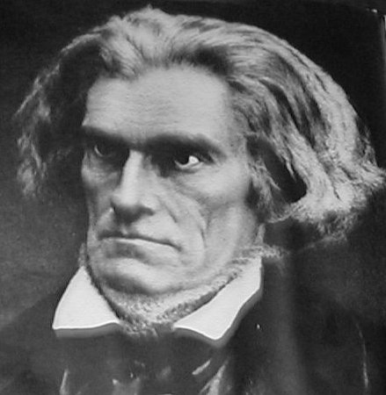
Answer: John C. Calhoun

Slide 6
What’s This Mean to Me?
Then
Now
POC’s source of info was their sales people – the experts.
Hungry for information and trusted their sales person’s competence.
POC was THE expert internally.
Only needed lunch from an informed sales person.
POC has access to everything they need.
POC has information overload and doesn’t read anything, but doesn’t trust sales person’s competence.
POC has turf battles.
Needs a knowledgeable sales professional to help them be smarter and better.

Slide 7
What’s This Mean to Me?
Then
Now
POC’s source of info was their sales people.
Hungry for information and trusted their sales person’s competence.
POC was THE expert internally.
Only needed lunch from an informed sales person.
POC has access to everything they need.
POC has information overload, but doesn’t trust sales person’s competence.
POC has turf battles.
Needs a knowledgeable sales professional to help them be smarter and better.

Slide 8
What’s This Mean to Me?
Your customers and prospects need (and are dying for) a knowledgeable sales professional to help them be smarter and better.

Slide 9
What’s This Mean to Me?
Your customers and prospects need (and are dying for) a knowledgeable sales professional to help them be smarter and better.

Slide 10
What’s This Mean to Me?
Your customers and prospects need (and are dying for) a knowledgeable sales professional to help them be smarter and better.

Slide 11
What’s This Mean to Me?
Your customers and prospects need (and are dying for) a knowledgeable sales professional to help them be smarter and better.

Slide 12
What’s This Mean to Me?
Your customers and prospects need (and are dying for) a knowledgeable sales professional to help them be smarter and better.

Slide 13
What Do You Do?
You have to become Google
Why is Google so popular?
Impartial (sort of)
Free
Easy

Slide 14
One Goal
While your customers are searching Google for their answers, they also call you.

Slide 15
Create the Process

Slide 16
Create the Process
Poll

Slide 17
Becoming the Perceived Expert: Process
Pick a topic for the year.
Research for content.
Define the methods of delivery.
Build the material.
Deliver.

Slide 18
Becoming the Perceived Expert: Process
Campaign Planning Sheet

Slide 19
One Heck of a Year…
Presentation to customers: Pros and Cons of Hosted Access Control

Slide 20
One Heck of a Year…
Begin regular LinkedIn Posts and Tweets on the Security in the Cloud

Slide 21
One Heck of a Year…
Presentation to specific customers on case studies of successful hosted access control scenarios in healthcare and K-12.

Slide 22
One Heck of a Year…
Presentation at local ASIS chapter: Hosted Video

Slide 23
One Heck of a Year…
Public Event with the entire team

Slide 24
One Heck of a Year…
BOMA Presentation: Hosted Access Control for Property Managers

Slide 25
One Heck of a Year…
Presentation to Customers: Industry Report on Hosted Video

Slide 26
What’s This Mean to Me?
Your customers and prospects need (and are dying for) a knowledgeable sales professional to help them be smarter and better.

Slide 27
What’s This Mean to Me?
Your customers and prospects need (and are dying for) a knowledgeable sales professional to help them be smarter and better.
… and it’s only six presentations and some social media work.

Slide 28
Stop Selling and Start Teaching

Slide 29
Best Practices to Teaching Customers
Use Disarming Authority to start your presentation.
Never outshine the master.
Learn your customers’ sources of info.
Understand their preferred method of learning.

Slide 30
Disarming Authority (Session #3)
“We’ve seen many scenarios of companies like yours in which ...”
“We’ve found that there is a lot of confusion in the market place, so we’ve put together this presentation to help clear the matter.
… and you’re off…

Slide 31
Disarming Authority (Session #3)
“We’ve seen many scenarios with property managers in which they’d love to offer access control to their tenants as a value-add, but managing it can be a hassle. Having someone else host their software is an option, but most property managers need to explain this to their tenants – where is their data?
“We’ve found that there is a lot of confusion in the market place about hosted access control, so we’ve put together this presentation to help answer some questions.”

Slide 32
Best Practices to Teaching Customers
Use Disarming Authority to start your presentation.
Never outshine the master.
Learn your customers’ sources of info.
Understand their preferred method of learning.

Slide 33
Best Practices to Teaching Customers
Use Disarming Authority to start your presentation.
Never outshine the master.
Learn your customers’ sources of info.
Understand their preferred method of learning.

Slide 34
Best Practices to Teaching Customers
Use Disarming Authority to start your presentation.
Never outshine the master.
Learn your customers’ sources of info.
Understand their preferred method of learning.

Slide 35
Thoughts & Ideas

Slide 36
Ideas
Use Pocket and become a content distributor
Speak, Speak, Speak
Monthly Drudge Report
Get to know the best plumber in town
Never, ever, ever say: “I’m just a sales rep”
Understand their preferred method of learning.

Slide 37
Common Questions
What should I do when we disagree?
Does it ever make sense to walk away?
What if they’re never right?
What are some good sources for material?

Slide 38
Sources
Your Manufacturers
Blogs / Newsletters – (I like SIA, BSMInfo.com, IPVM)
Corporate Marketing
Google Alerts – google.com/alerts

Slide 39
Monthly Action Plan
Action Items
Pick a topic on which you’ll educate your market place in 2016.

Slide 40
A few more items…
LinkedIn Group (private and secure)

Slide 41
LinkedIn Group
Completely private
Email digests notifying you of activity
Use @... to mention someone in a post

Slide 42
A few more items…
LinkedIn Group (private and secure)
POLL

Slide 43
A few more items…
LinkedIn Group (private and secure)
These sessions will be 45 minutes
Little injections of value in between sessions
Videos
Podcast
Forum / LinkedIn Discussions

Slide 44
Questions / Discussion Chris Peterson cpeterson@vectorfirm.com 321-439-3025

